Slide 1
Co-developing community-wide acceptance model with affected stakeholders for genetic approach of vector control
Global Forum on Bioethics for Research, November 2019
Dr Lea PARE TOE
Thizy Delphine

Slide 2
Background
Genetically modified mosquito appears to be a strong alternative tool to face the limits of the existing tools for control vector borne diseases
Various laboratory research are ongoing and the next step will be evaluation through field release
But how do we get social license for these research ?
Informed consent is not appropriate because it is about individual decision while the release will be done in collective space
Community acceptance is more appropriate

Slide 3
Community acceptance
Community acceptance raises the issues of :
  Representative voice
  Legitimacy of this voice
The questions are:
  How do we establish appropriate acceptance models that can make sense for communities ?
  Is it possible to co-developed with communities to ensure that the model respects the local context?

Slide 4
Community acceptance model for the release of genetically modified sterile male mosquito in Burkina Faso:
Target Malaria project

Slide 5
Target Malaria objectives
To develop and share a novel genetic technology for vector control of Anopheles mosquitoes to contribute to reducing the burden of malaria in Africa
To use an approach which is complementary to existing methods, sustainable, long term, and cost-effective
To reduce the population of the mosquitoes that transmit malaria, and therefore reduce transmission of the malaria parasite, through genetic modification of malaria mosquitoes

Slide 6
Target Malaria Vision, Mission and Values
Vision
Our vision is a world free of malaria
Mission
We will develop and share new, cost-effective and sustainable genetic technologies to modify mosquitoes and reduce malaria transmission
Values
Excellence
Co-development
Evidence-driven
Openness &
Accountability

Slide 7
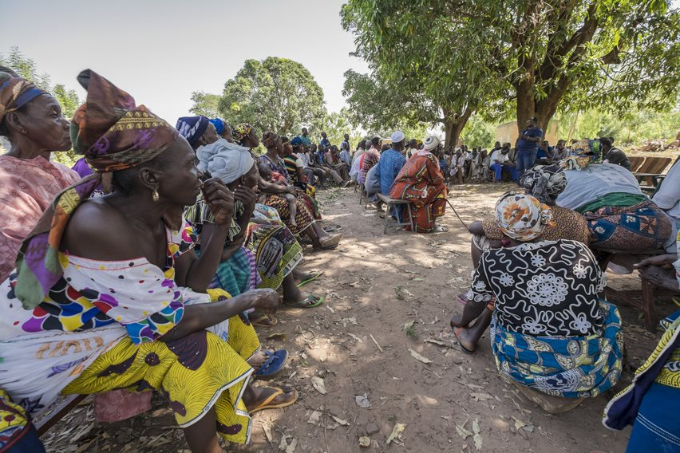
Development of the community acceptance model with communities
A to-and-fro exchange between community and power theoretical discourses and actual discussions with community members on the ground allowed for the design of the model, which was rooted in the community itself.

Slide 8
Co-developing the model with communities
The design of the model
The selection of community representatives/voice
The validation of the committee of representatives
Co-develop with community
The design of the acceptance form
Traceability of the acceptance

Slide 9
Development of the model: combined approach
Ethnographic study to understand :
  The relationship between social groups in the village site
  The collective decision making process
  The legitimacy issues (what is legitimate ? Who can decide on behalf of the community?
Set up the representative committee
Public meetings for the validation of the representative committee

Slide 10
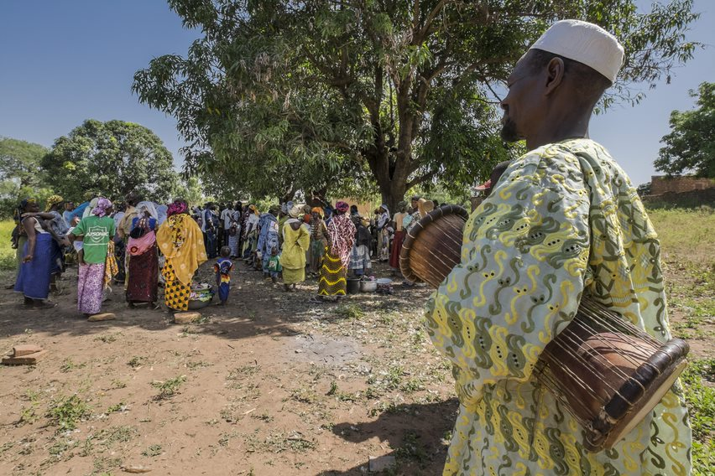
Achievement
A written agreement to express the community acceptance was one of process’ great achievements in the context of an oral culture. The suggested model was focused on persons who had the legitimacy to represent the community and speak on its behalf.

Slide 11
Challenges of the model
Time spent on building of the model ( time-consuming, approximately 4 months) by village
So:
This time-consuming could be a limit for the replication of the model in the whole country
For that
Work with community leaders (across the country) to address communities representatives legitimacy issues could be a good way for designing the model of acceptance for the field release of genetically modified mosquito

Slide 13
Thank you

