Slide 1
Public participation and regulation of Human Germline Editing in China
QI CHEN
CENTRE OF BIOETHICS, XIAMEN UNIVERSITY
2019.11.12

Slide 2
Outline
Background
Ethical issues and comments
Lack of prior awareness
Social participation
Approval and oversight of research

Slide 3
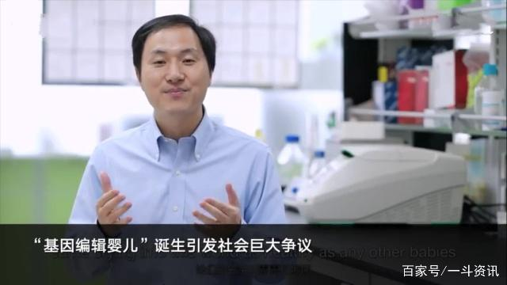
Background
Jiankui He
26,Nov,2018 The birth of “Gene Editing Babies” named Lulu and Nana has caused huge social controversy
Liang Puping, Huang Junjiu. Open the secret door of gene study in human embryos. [J]Chinese Bulletin of Life Sciences. ,2016,28(04):420-426.
Notes:
He reported at the summit that two volunteers were pregnant, with one giving birth to twin daughters Lulu and Nana. One of the other six dropped out of school and the other five were not pregnant.

Slide 4
Raise public awareness and discussion
Public participation in the formulation of development priorities and guidelines
Extensive oversight

Slide 5
Ethical issues and comments
Lack of public awareness
On November 9, 2018, a comparative public awareness report on gene editing techniques
Object | Time | Valid questionnaire | The questionnaire form
General public | June-August, 2018 | 4196 | Electronic
HIV-infected people nationwide | September, 2018 | 575 | Electronic
Two findings: The public knew little about gene editing technology
Positive attitude towards gene editing technology

Slide 6
Ethical issues and comments
How to improve the public’s knowledge of gene editing?
Government support: set up a special national department to manage genome editing
Department members: lawyers, ethicists, genetic researchers, etc
Responsibilities: popularize knowledge for gene editing
consulting services
guidance services

Slide 7
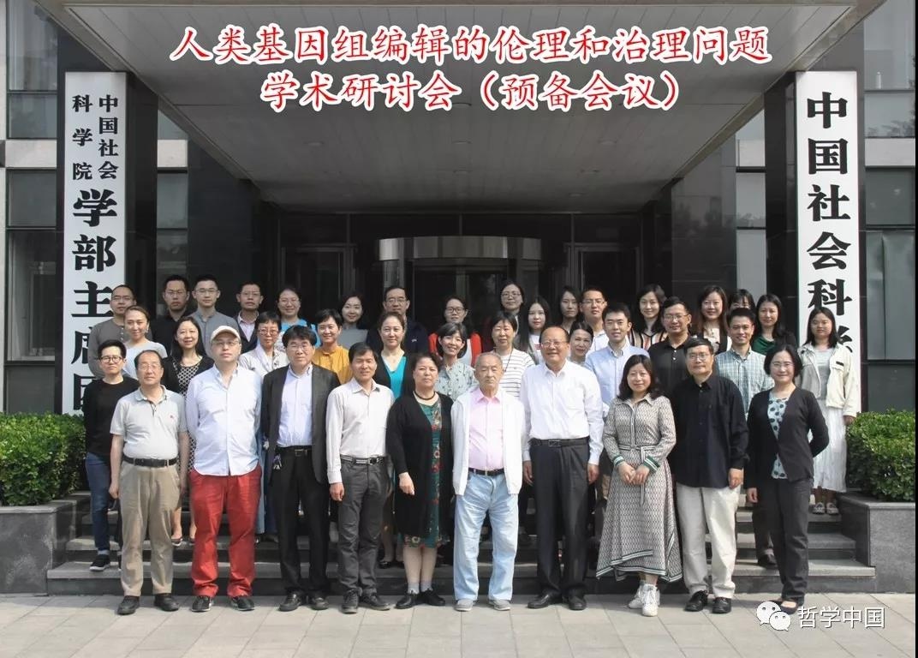
Ethical issues and comments
2. Social participation
On May 11, 2019，a preparatory conference on the topic of "ethics and governance of human genome editing“
Purpose: formulate a set of ethical and governance guidelines on gene editing
Result: Draft guidelines written by speakers at the conference

Slide 8
Ethical issues and comments
the national advisory department
Set up a comment column in their website
Analyze public discussions, generate reports and publish them online
The responsibility to expand public participation
researchers
government
Provide progress reports to government and advisory bodies
Organizing seminars or hearings
Disseminating information
Encourage public participation

Slide 9
Ethical issues and comments
3. Approval and oversight of research
National Committee of medical ethics experts
Supervise
Provincial medical ethics expert committees
Supervise
Institutional Ethics Committees
https://baike.baidu.com/item/伦理委员会/8884401?noadapt=1

Slide 10
Ethical issues and comments
Ethical Review Mode
pre-examination
passive examination
post-approval
supervision
Zhao Qinjun, Han Zhongchao. Prospects of Gene Editing Techniques, and its Ethics and Regulatory Issues[J]. Science and Society,2016,6(03):1-11.
Requirements of the Ethical Review System of Biomedical Research Involving Human. [J]. Chinese Medical Ethics,2016,(04):723-728.

Slide 11
Ethical issues and comments
Several normative documents that related to the HGE in China, all of which point out that: "Genetic manipulation of human gametes, zygotes and embryos for reproductive purposes is prohibited in China ", but there are no stated disciplinary measures for contravening this rule.
1.Human Assisted Reproductive Technology Management Method. Chinese Ministry of Health
. 2001.2
2.Methods for ethical review of biomedical research involving human beings (trial). Chinese Ministry of Health. 2001.1
3.Human Embryonic Stem Cell Research Ethics Guidelines (ministry of science and technology and the ministry of health). Ministry of Science and Technology of the People's Republic of China and Chinese Ministry of Health. 2003.12
4.The human assisted reproductive technology specification (formerly the Ministry of Health). Chinese Ministry of Health. 2001.8

Slide 12
Ethical issues and comments
An investigation into He Jiankui‘s research found:
He violated scientific integrity, forged consent forms for ethical review, and conducted gene editing of embryos, which is prohibited in China
Punishment: the termination of his employment at the University
Problems: ineffective legislation
improper incentives
lax supervision and inadequate penalties

Slide 13
Ethical issues and comments
Oversight recommendations
A reliable supervision mechanism should be established
Random check by the Institutional Review Board in each region

Slide 14
Ethical issues and comments
Form a regional group model (e.g., village-town-county-city-province)
We also need:
mass supervision (e.g., colleagues and subjects)
self-supervision (enhance self-ethical awareness)
whistle blowing (and protection of whistle blowers)
law

Slide 15
Discussion points
1. How could the public be better informed about developments?
2. How could the public participate in shaping guidance?
3. How could the public contribute to supervision/ governance?

Slide 16
THANKS ！

