Slide 1
Pathway to Genome Editing and Research in Nigeria
Simisola O. Akintola Ph.D
University of Ibadan Nigeria

Slide 2
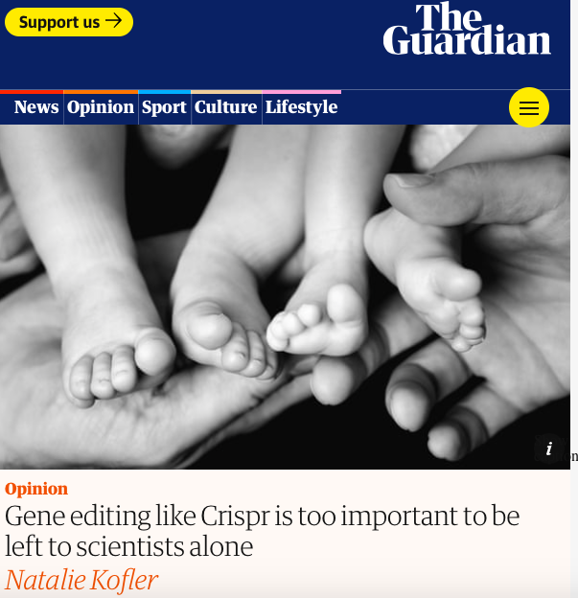

Slide 3
Outline
Enquiry
The future use of genome editing technology by Nigerians who desire to have children who are genetically related to them
Legal landscape
Thoughts
Recommendations

Slide 4
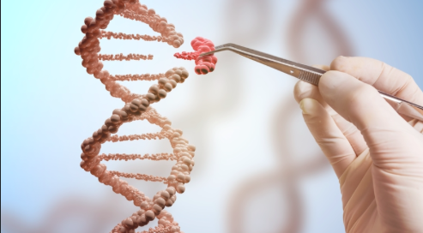
Genome Editing and Human Reproduction

Slide 5
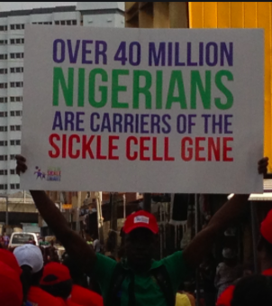
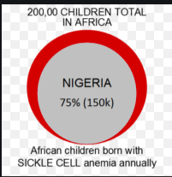
A double whammy Sickle Cell /Infertility ?

Slide 6
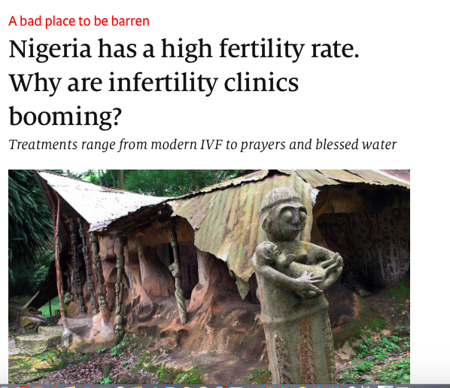
Infertility
A bad place to be barren
Nigeria has a high infertility rate. Why are infertility clinics booming?
Treatments range from modern IVF to prayers and blessed water

Slide 7
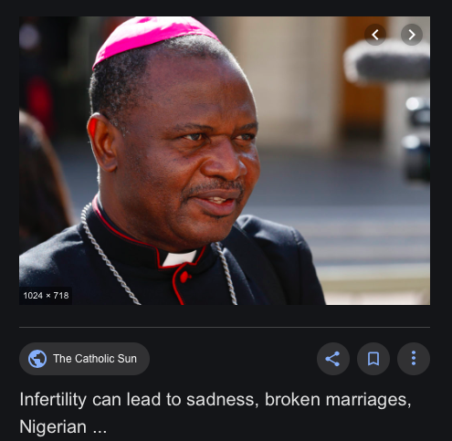
Infertility

Slide 8
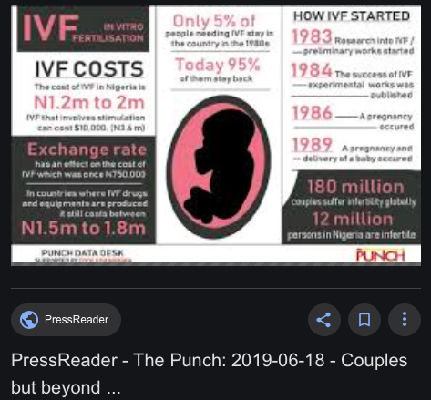

Slide 9
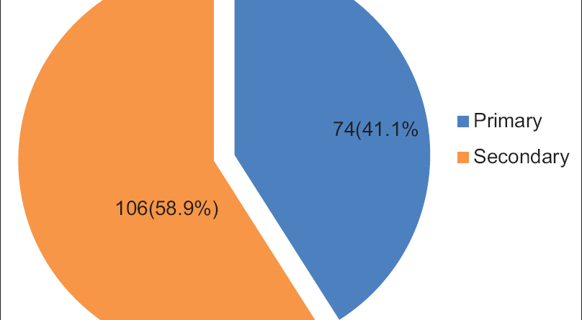
Odunvbun, W.O., Oziga, D.V., Oyeye, L.O. and Ojeogwu, C.L., 2018. Pattern of infertility among infertile couple in a secondary health facility in Delta State, South South Nigeria. Tropical Journal of Obstetrics and Gynaecology, 35(3), pp.244-248.

Slide 10
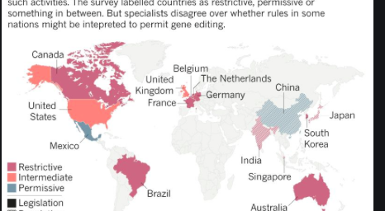
The Legal Landscape

Slide 11
The Nigerian Legal Vacuum
Parents
Children
Society/Community
Extended Family
Future Generation
Industry
Health workers
Lawyers
Politicians
National Health Act
National Health Policy
Code of Medical Ethics

Slide 12

WHICH WAY ?
of 20
Notes:
In what circumstances, in what ways and to what extent should people be permitted, enabled and assisted to pursue their goals?

Slide 13
Recommendations
Evaluating existing regulatory infrastucture
Redistribution of decision making powers
Registry of Crispr Trials
Sustained and inclusive public and communal deliberations
Avenues to air the concerns of Nigerians
Inclusion of women and youths

Slide 14

Key Takeaways

Slide 15


