Slide 1

Research Ethics Committees request for data sharing plan as part of ethics review process: Data from the National Research Ethics Committees Survey
Julio Canario, MSPH
Director, Etikos; Professor Universidad Autónoma de Santo Domingo.
Research Associate, CENISMI
Global forum on bioethics in research (GFBR)
South Africa, 13 November, 2018

Slide 2
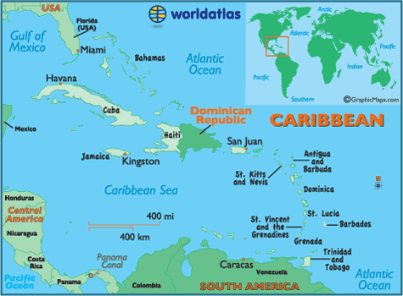
Background
The Dominican Republic is a middle-income country
Population total: 10,648,791 habitants
Health insurance coverage: 73.8%
Health expenditure: > 2% GDP (below of the Americas)
The percentage of out-of-pocket health expenditures (43.67%) is one of the greatest in the Americas
https://data.worldbank.org/indicator/SH.XPD.OOPC.PC.CD?end=2015&locations=DO&start=2000&view=chart

Slide 3
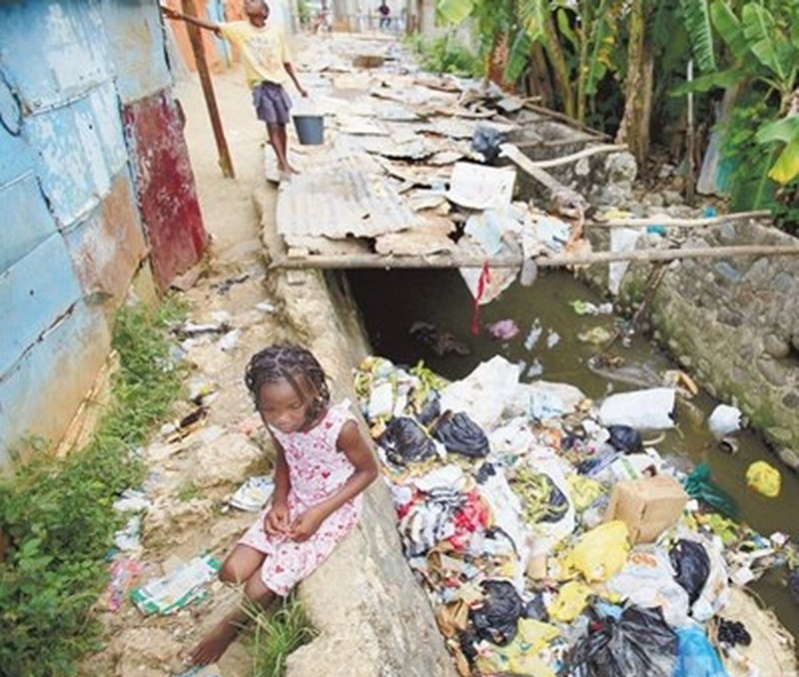
Background
Main public research funding agency: Ministry of Higher Education, Science and Technology.
Written policies on health research and research priorities by the Ministry of Health
A gap in health research persist
  funds are not allocated towards the diseases and conditions affecting the most vulnerable
  not directed towards improving outcomes of the health system itself.
Most of the health research projects are from the international pharmaceutical industry.
Gaps in health research in the Dominican Republic. https://www.ncbi.nlm.nih.gov/pubmed/27657182

Slide 4
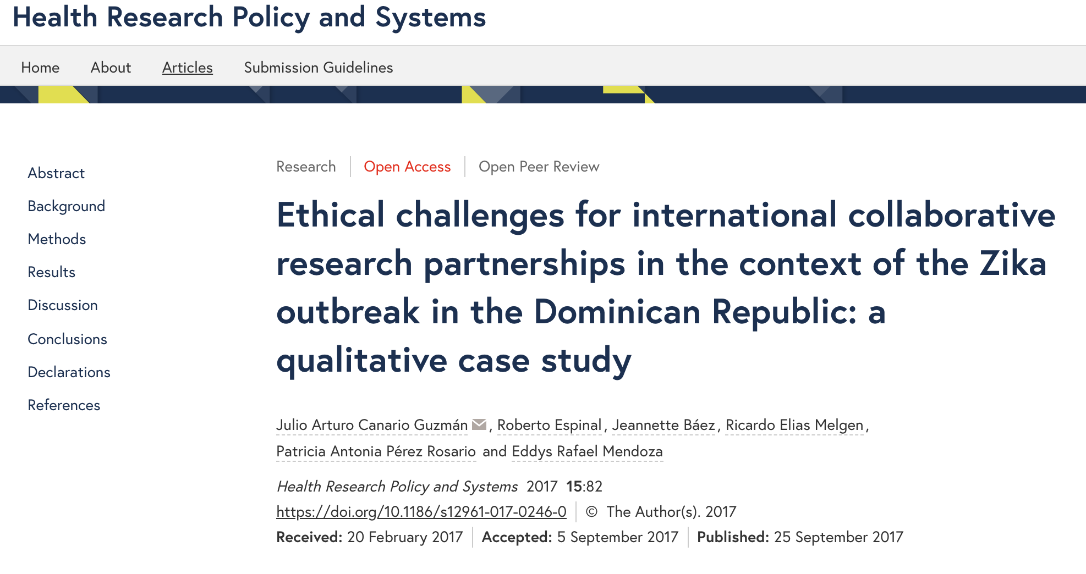
Background
In 2016 the Dominican Republic reported one of the largest Zika virus outbreaks in the Americas.
WHO oriented towards detection, prevention, care & support and research.
National researchers were not participating as meaningful collaborators in international research efforts.
Complaints that participation and sharing of responsibilities were not optimal.
Ethical challenges for international collaborative research partnerships in the context of the Zika outbreak in the
Dominican Republic: a qualitative case study. https://www.ncbi.nlm.nih.gov/pmc/articles/PMC5613490/

Slide 5

Description of the research project
The National Research Ethics Committees Survey aimed to identify the number of existing Research Ethics Committees (REC) in the Dominican Republic, their composition, organization, activities, ethics review and decision-making processes.
Around 400 health care organizations, academic and research oriented organizations, both public and private where contacted
Conducted from March 2017 through September 2018
A total of 20 REC’s completed the survey.

Slide 6

Study results
None of the RECs involved request a data sharing plan
RECs written policies did not include data sharing terms
Standard operational procedures or templates to evaluate data sharing plan were inexistent.

Slide 7
Ethical issues
CIOMS guidelines suggest that there are compelling reasons to share data but…
Would the researcher have a duty to respond to that request even though in a legal sense this is an unregulated component in many LMICs?
Does the decision to ask for data sharing plan applies to any type of research and regardless of the sponsor institution?
Would it be reasonable for REC’s request for data sharing plan?

Slide 8
Ethical issues
There is an increased recognition of the importance of collaborative research efforts globally, but…
What kind of international cooperation will be needed to promote equitable data sharing?
Who is going to monitor that this is done consistently and that the data gets actually analyzed by local researchers for the benefit of individuals and communities?
Could capacity building efforts be demanded as integral part of data sharing plan?
Should data from LMICs be shared internationally and for what reason?

Slide 9
Ethical issues
Lack of action at developing the HRS is an outstanding issue.
Collaborative work encompasses fair sharing beginning by identifying and empowering local research teams allowing them to participate in all phases of the research project, not just in the data collection phase.
To promote the inclusion and education of data scientist as part of the research team in LMICs will prompt and facilitate ownership of the data.
What if local agency on health research is minimum?

Slide 10
Conclusions
There is the need to advocate for policies on data sharing and biobanking in LMICs.
REC should discuss the feasibility of including data and biobanking terms within their written polices determining when and how a data sharing plan should be requested as part of a research protocol.
Sharing data and samples should be allowed only to those offering or having in place strong data sharing plans to avoid potential abuses or unequitable sharing.

Slide 11
Conclusions (2)
The National Council on Bioethics in Health (CONABIOS) should offer guidance to REC in terms of policies and standards on data sharing and biobanking.
MoH and the Ministry of Science and Technology should work together in the development of platform for Data and sample access.
  Policy development
  Organizational structure
  Central platforms (local and regional) to access and analysis the data
  Capacity building agreements

Slide 12

Recommendations
Open debates among policy makers, researchers, funding agencies and community representatives to clarify basic questions regarding the meaning, “pros” and “cons” of data sharing and biobanking policies should be promoted in each country and region.
Collaborative efforts on research ethics are increasing in the Latin America region. These groups could serve as a means to disseminate knowledge, policies and practices regarding data sharing and biobanking.

Slide 13
Gracias!
Merci!
jcanario@etikos.do
http://etikos.do
Thank you!

