Slide 1


The Ethics of Data Sharing in the Antenatal Corticosteroids Trial
Dr Sunil S Vernekar MD, Dipl Epidemiology
Associate Professor, Dept of Physiology,
Senior Research Officer, Women’s & Children’s Health Research Unit,
KAHER’s J N Medical College, Belagavi, India

Slide 2
Antenatal Corticosteroids Trial (ACT)
Preterm birth is a major cause of neonatal mortality, currently responsible for 28% of the deaths overall.
Antenatal corticosteroids (ACS) - at high risk of preterm birth is a powerful perinatal intervention to reduce neonatal mortality
Scaling up ACS has been a priority for some international health organizations.

Slide 3
Global Network ACT Trial (2011-2014)
  Community based, cluster randomized, conducted in six LMIC
  To evaluate feasibility, effectiveness and safety of intervention to increase ACS use in health facility
  Results of ACT
      No change in mortality in <5th percentile newborn before 28 days in the intervention group.
      Among all births, increased risk of perinatal mortality
      Increased OR for suspected maternal infection

Slide 4
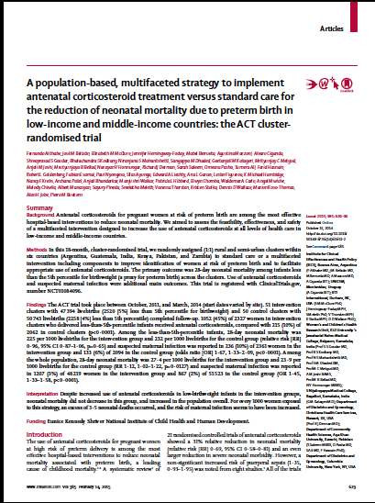
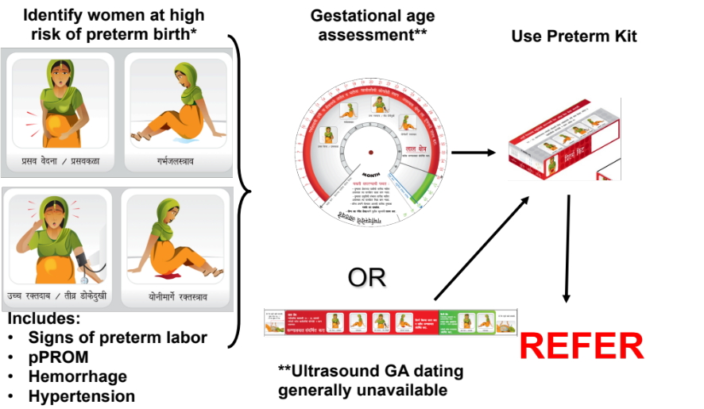
Global Network ACT Trial (2011-2014)
6 countries
102 clusters
99,742 mothers enrolled
100,705 babies
18-month intervention

Slide 5
ACT Trial: Results
Among women with babies
<5th percentile BW
45%
Among all women: 12%
10%
Ctrl
Int

Slide 6
Maternal and Perinatal Outcomes
Among births <5th percentile
Neonatal deaths 28d
Stillbirths
Suspected Maternal Infection*
Among all births
Neonatal deaths 28d
Stillbirths
Suspected Maternal Infection*
0.5
2
*Odds ratio

Slide 7
WHO recommendations on ACS usage
WHO recommend use of ACS, when following criteria are met (2015)
    Women at risk for preterm birth (24 weeks to 33 6/7 weeks)
    Sufficient standard of maternal and newborn care should be available
    No clinical evidence of infection in women
    Imminent preterm birth - next 48 hrs
    Accurate assessment of gestational age by Ultrasonography (USG)
Safety and efficacy of ACS in LMIC is not established in spite of widespread use
WHO guideline development panel felt that, efficacy trial of ACS in LMIC is therefore an urgent research priority
This was further supported by recommendation of WHO technical expert committee to conduct ACS efficacy trial

Slide 8
Ethical Issues
Since ACT presented negative results- keen interest among researchers & funding agencies for secondary analysis
According to policy of the funding agency- ACT data to be given public access for secondary analysis.
Outcomes of ACT collected in MNH Registry which is an ongoing study.

Slide 9
Ethical Issues
What data to be shared?
When should the data be shared?

Slide 10
ACT Trial - Ethical Issues
Primary Investigators decided to share only archived data
This month end – release of MNH data for 2010-2013 in NDASH

Slide 11


Data Sharing

Slide 12

Advantages of Data Sharing
Data sharing – efficient method for conducting large scale research
Minimizes known risk/ potential harm from unnecessary exposure to previously tested interventions
More imp-helps LMIC researchers to come out
with newer ideas from existing database
- to tackle local health problems
NICHD Data & Specimen Hub (DASH)- organise,
store & mine data from NICHD funded research
- allows public access
IDDO, WWARN, Wellcome Foundation, etc

Slide 13
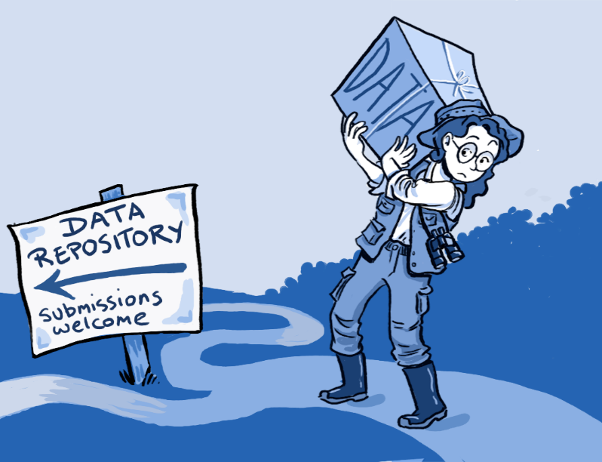
Challenges faced
Requires acquisition & maintenance of multiple interrelated capacities
Concerns about abilities of some researchers in LMIC settings to
compete with highly resourced
researchers in publishing initial &
subsequent analyses of data.
Recognition of primary researchers
on secondary analysis

Slide 14
Recommendations
Secondary analyses should be mutually beneficial to primary researchers from LMIC settings & also from high resource settings.
They should address the local issues along with an impact on global health
Primary researchers from LMIC to be given opportunity to be involved in development of research ideas, designing of secondary analyses
Opportunity for capacity building of the primary researchers- human resource, technology, infrastructure.
Collaborative research.

Slide 15
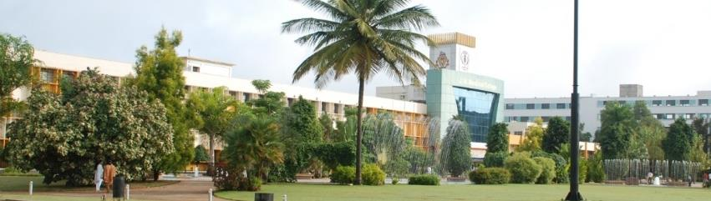
Thank You
drsunilsvernekar@gmail.com
KAHER’s J N Medical College, Belagavi

