Slide 1
Taiwanese Experience of Data-Sharing in Biobanking
Michael Cheng-tek Tai.Ph.D.
Chair professor of medical humanities & bioethics
Chungshan Medical University, Taiwan.
Member, Committee on Integrated biobank,
Ministry of Health & Welfares, Taiwan
Member, Taiwan Biobank EGC

Slide 2
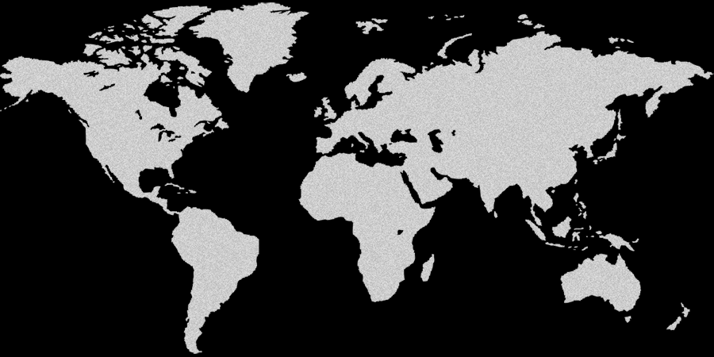
This is our world

Slide 3
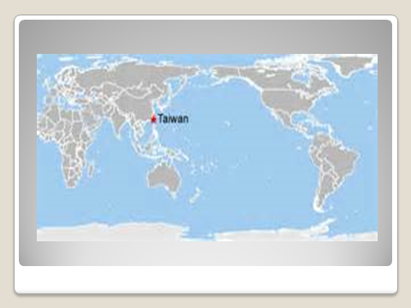

Slide 4
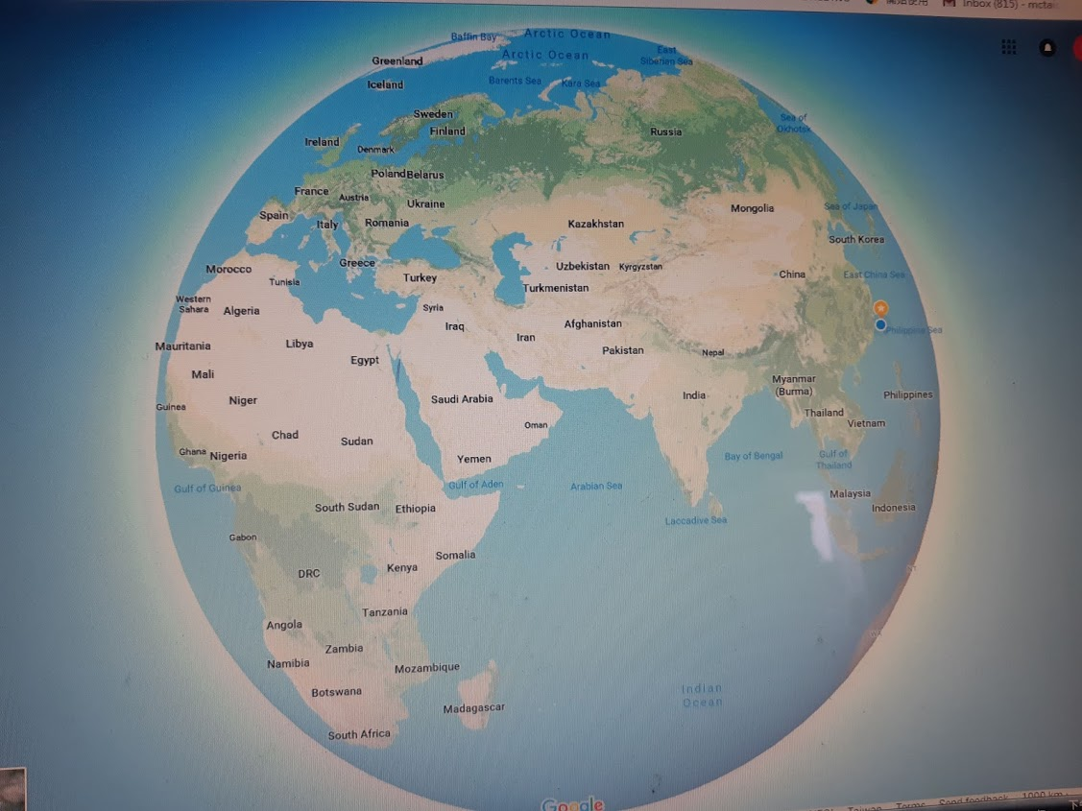

Slide 5
Taiwan
Area
• Total | 36,197 km² (13,976 sq mi)
Population
• 2018 estimate | 23,577,271
• 2010 census | 23,123,866
• Density | 650/km² (1,683.5/sq mi)

Slide 6
Introduction
The Department of Health of Taiwan , now the Ministry of Health and Social Welfares, announced a 4-year pilot scheme in 2005 to initiate a Biobank study (later changed to 5 years).
The purpose was to collect personal tissues/data from: 300,000 people in Taiwan aged 30–70 years old, including 100,000 patients diagnosed with various cancers.
The entire budget was provided by the Department of Health : $US 15 million & +.

Slide 7
The Institute of Biomedical Sciences at Academia Sinica in Taipei was commissioned to set up this population-based biobank, later known as Taiwan Biobank.
Four subdivisions within this biobank have been set up: the medical genetic group, the ELSI group, the information technology group and the industrial application group.
The Taiwan Biobank has been officially in operation since 2012.
Some pictures to share:

Slide 10
The Legislated Functions of the Taiwan Biobank
The establishment and operations of the Taiwan Biobank are regulated by detailed legislation. It is a repository of tissues/ information, but is not allowed to directly carry out research.
Information on the participants, all voluntary, whose samples are included in the biobank will link several sources of data: national identification number, National Health Insurance system, cancer registry, and cause of death registry.

Slide 11
The current status
The Taiwan Biobank has so far collected close to 200,000 sample tissues from volunteers in the Taiwanese population.
Its EGC meets four times a year. Besides reviewing requests to use tissue materials, the meeting mainly deals with housekeeping business or hearing reports from the operation team.
Any request to use Biobank materials has to go through these processes:
1. IRB approves the protocol.
2. a task force within ELSI reviews the request
3. EGC checks and votes on the request.
4. release of the material.

Slide 12
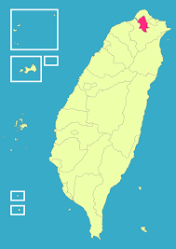
This first Taiwan Biobank is located in Taipei, the capital of Taiwan

Slide 13
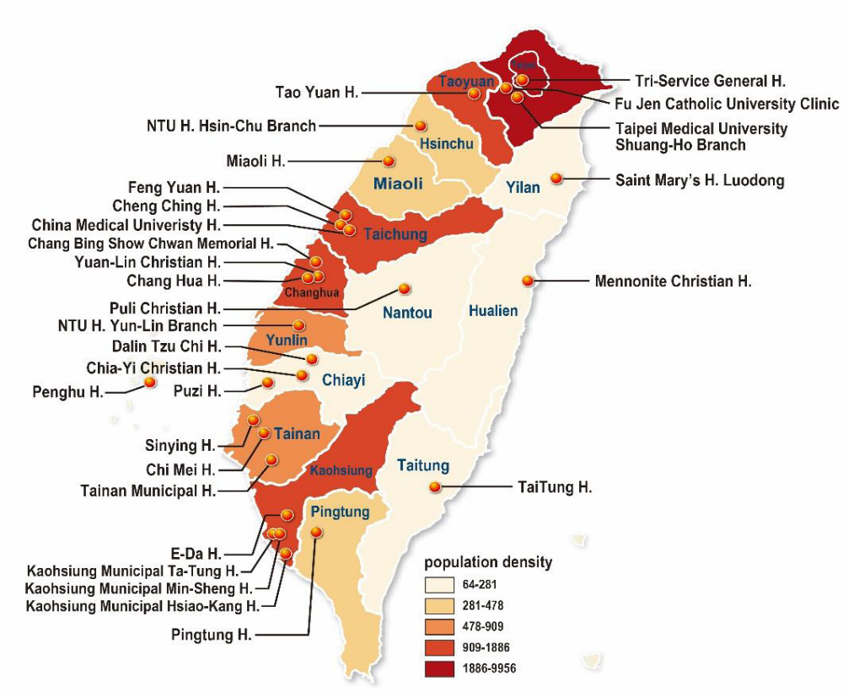
Today the numbers of biobank have grown from 1 to 31 in 13 years, among them three are population based and others diseases oriented.

Slide 14
How are these biobanks doing ?
Several scholarly papers have been published through the research using biobank’s data yet mostly in the areas of public health or calculation of people’s health status. Research on discovering the genetic roots of diseases and finding their cures have been lacking.
The Ministry of Health and Welfares started evaluation visits to all biobanks two years ago to find out how to effectively promote the function of these biobanks. A new attempt was eventually initiated this year that is called Biobank Integrating Platform with a structural innovation to integrate all biobanks through information and data-sharing with at least two goals in mind:
i. promote data-sharing.
ii. Facilitate the search for bio-tissues as some researchers complained that finding the right and suitable samples takes too long and is too complicated because there are 31 biobanks, each working on its own
iii. shorten the time of scientific and ethical review.

Slide 15
The New Attempt
The first step is to create an intranet to gather detailed information on all biobanks’ data and make it available to all other biobanks. In this way all biobanks can be integrated as one because all the information of biobanks is sent to the integrated platform for circulation to researchers
One common window system or portal is made available to all researchers to look for data.
A scientific review committee (e.g. CIRB) is set up to do an initial review of all protocols and the local IRB /EGC need only do an expedited review to facilitate the reviewing process.
This platform also provides consultation service to the outside world e.g. pharmaceutical and biomedical companies, for information.

Slide 16
Ethical issues
1. Before this integrated platform is established, a certain biobank director applied for and utilized a large amount of data for research. This has been criticized as a conflict of interest. Should the director or manager of biobank be prohibited from using the data in his/her own bank? Is there any conflict of interest violated if he/she uses large amount of tissue from own biobank material, depriving others from accessing the repository?
2. Who deserves formal credit when some great finding is discovered from the biobank data - the original institute that provided the sample tissues or the researcher and his/her institute?

Slide 17
Ethical Issues cont’d
3. Will the scientific reviewing committee doing the initial review deprive or undermine the right and duty of oversight of the local IRB/EGC?
4. Privacy of donors – the integrated platform assures donors that their personal identifiers will not be available to any researcher in order to ensure the protection of human subjects. But doubt has been raised about whether individuals’ privacy can be absolutely safeguarded.
5. Charging fees – each biobank has a different scale of charges and some are quite expensive. Researchers, however, often cannot afford to pay the high cost of bio-data. Should some mechanism be set up to make the bio-tissue data affordable ?

Slide 18
Conclusion
The establishment of an integrated platform shortens researchers’ search for data, ensures good quality of bio-tissues needed for study, saves resources, enhances the quality of research and promotes the mutual collaboration of work among researchers.
The integration is not to force all biobanks into one; rather, each biobank maintains its own strength, vision and uniqueness while opening up to all researchers so that the goal of promoting health and curing diseases can be realized.

Slide 19
Discussion points:
To avoid perception of conflict of interest, the executive director of the biobank should not use the stored data for research , but serve solely as a manager to manage and promote biobank.
Creating a centralized IRB may facilitate the review process. The system being recommended in Taiwan is to let the central IRB do the first review. Once approved, the local IRB need only do an expedited review. But when issues arise later on, whose responsibility would it be, CIRB or local IRB/EGC?
Biobanks can be a money-making business since users have to pay for the biodata and this is often expensive. Should the charge be reduced to a minimum in order to facilitate and promote research and find results in the public’s interest?
Ethics is concerned with how we do things. As such, we are given a task to make sure everything is done ethically. The EGC of all biobanks in Taiwan intend to be responsible for what they do, but how much and how broadly can they govern?

Slide 20
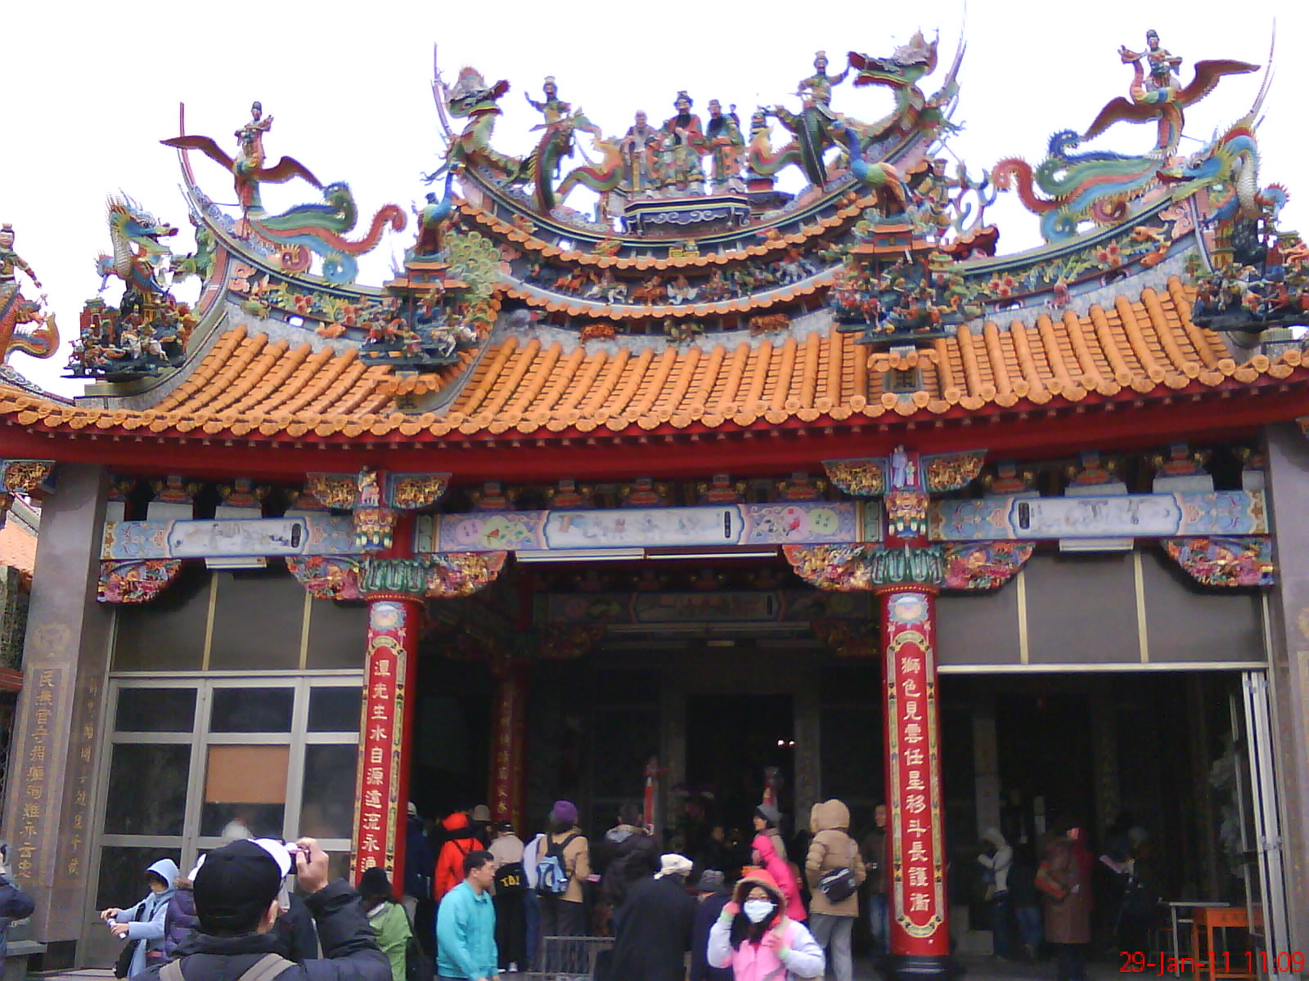
Thank you.(English)
Kam-sia. (Taiwanese)
Hsieh-hsieh. (Chinese)

Slide 21
References
1. Hunt A: Past, Present, Future, the ethics and governance of big biobank conference. UK biobank EGC:2014
2. Vuorio E: Possibilities for European Collaborative Prpjects with biobank and registry research. Biobank Conference, Oslo.May, 27, 2014
3. BBMRI-ERIC http://bbmri-eric.eu/about
4. Parts of the information in this presentation are taken from briefings given by Dr. Shen Chih Yang, the executive director of the Taiwan Biobank to Taiwan Biobank EGC.
5. Thanks is extended to Prof. Douglas Wassenaar for his assistance and mentorship

