Slide 1
Participant Protection and Data Governance: Research using routine electronic records from a Health Information Exchange
Nicki Tiffin
nicki.tiffin@uct.ac.za
Andrew Boulle
Centre for Infectious Diseases Research in Africa &
Division of Computational Biology &
Centre for Infectious Disease Epidemiology Research, University of Cape Town
Health Impact Assessment Directorate,
Department of Health
Western Cape Government

Slide 2
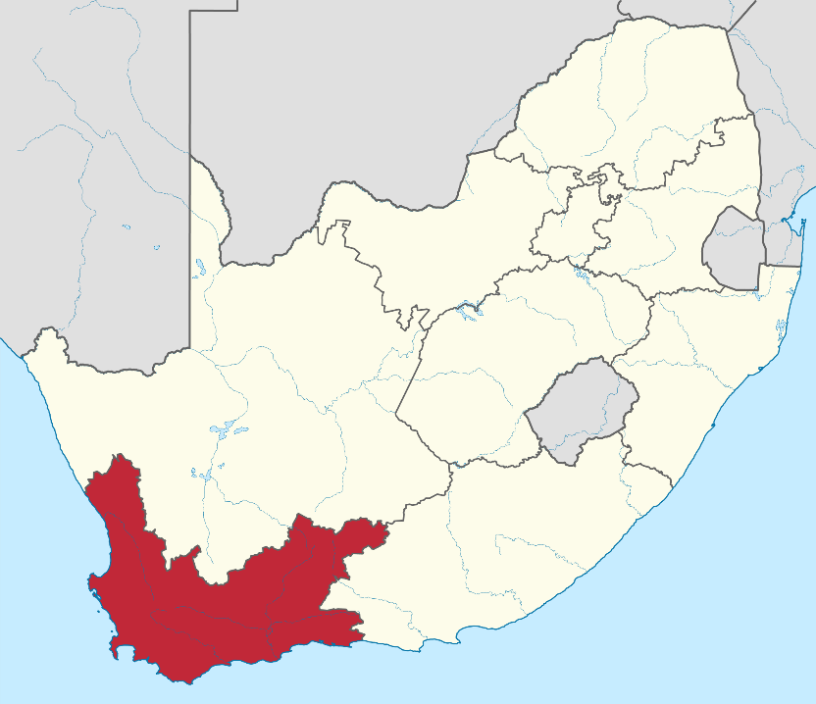
The Provincial Health Data Centre (PHDC)
An African Health Information Exchange
Developed and hosted at the Western Cape Department of Health
~ 6 million individuals
Routine electronic administrative records
Individual patients
Multiple data sources
Linking of data to a Patient Master Index
Facilitated by Province unique health ID
en.wikipedia.org

Slide 3
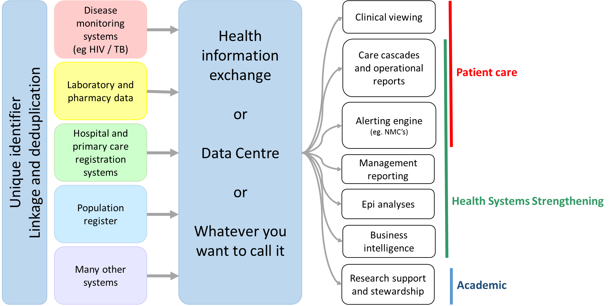
PHDC data flow

Slide 4
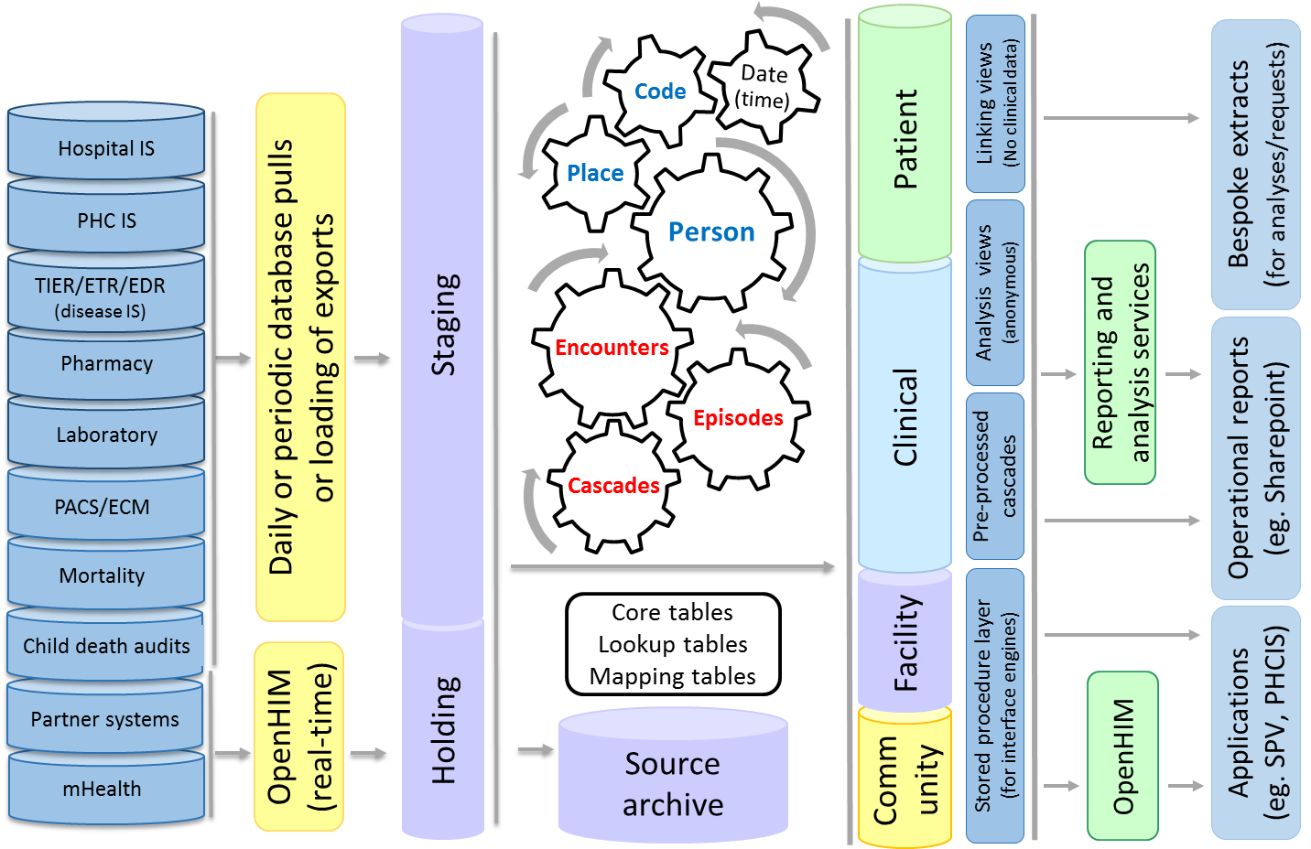
High level architecture

Slide 5
Using PHDC data for research
Pros
Longitudinal data for all health care clients in Western Cape
Laboratory, pharmacy, healthcare encounters
Updated daily – valid up to midnight last night
Derived information: episodes, cascades
identify burden of disease
identify outcomes
identify gaps in care

Slide 6
Using PHDC data for research
Con:
Implicit provider-client agreement that data are for providing health care
No consent for research or secondary data use
Incomplete data coverage, data limitations

Slide 7
Using PHDC data for research
Con:
Implicit provider-client agreement that data are for providing health care
No consent for research or secondary data use
Incomplete data coverage, data limitations
What do health care clients think?

Slide 8
Key Patient Perspectives on data use for research
Dr Thato Mosidi, WCGH (2018)
Focus group discussions at three facilities. 52 individuals, 50% female
Patient data are all information that a health facility collects from entry to exit of the facility.
Patient data are used for:
  Clinical care, continuity of care.
  DoH burden of disease epidemiology
  Service provision monitoring, improvement and planning.
Data ownership remains with the patient and not the Department of Health
Anonymised data that cannot be re-identified can be shared as long as individuals are not compromised.
Research is beneficial for the community, but a special request should be made to the patient for patient-level, identifiable data.
Consent information should be understandable for the target audience, and consent must always be recorded in writing.
Blanket consent is not acceptable, new studies must be re-consented
An Opt-out process should be available for anonymous data use.

Slide 9
Key Patient Perspectives on data use for research
Dr Thato Mosidi, WCGH (2018)
RESPECTING DATA PRIVACY
Focus group discussions at three facilities. 52 individuals, 50% female
Patient data are all information that a health facility collects from entry to exit of the facility.
Patient data are used for:
  Clinical care, continuity of care.
  DoH burden of disease epidemiology
  Service provision monitoring, improvement and planning.
Data ownership remains with the patient and not the Department of Health
Anonymised data that cannot be re-identified can be shared as long as individuals are not compromised.
Research is beneficial for the community, but a special request should be made to the patient for patient-level, identifiable data.
Consent information should be understandable for the target audience, and consent must always be recorded in writing.
Blanket consent is not acceptable, new studies must be re-consented
An Opt-out process should be available for anonymous data use.
The patient owns their own data
UPHOLDING A TRUST RELATIONSHP
Health data are collected only for provision of health care
RESPECTING CHOICE, INDIVIDUALITY, AUTONOMY
Specific consent is required
to use data for research.
Broad consent is not sufficient.

Slide 10

The Challenge
Promoting equity
Data privacy ↔ Improved health outcomes
Primary benefit of data use:
Participant health and well-being
[not research careers]
Balancing beneficence and risk:
Prioritise research that most directly benefits those put at risk through participation (especially if unconsented).

Slide 11
The Challenge
Data privacy ↔ Improved health outcomes
Data governance for data access requests
SOPs and defined processes for access to research datasets.
Distinguish between operational requests and research requests.
Operational requests:
Legislation (POPI): Department of Health is the responsible party.
Ethics: Data use for primary purpose, provision of health care.
Data protection: Data analysis within Government infrastructure.

Slide 12
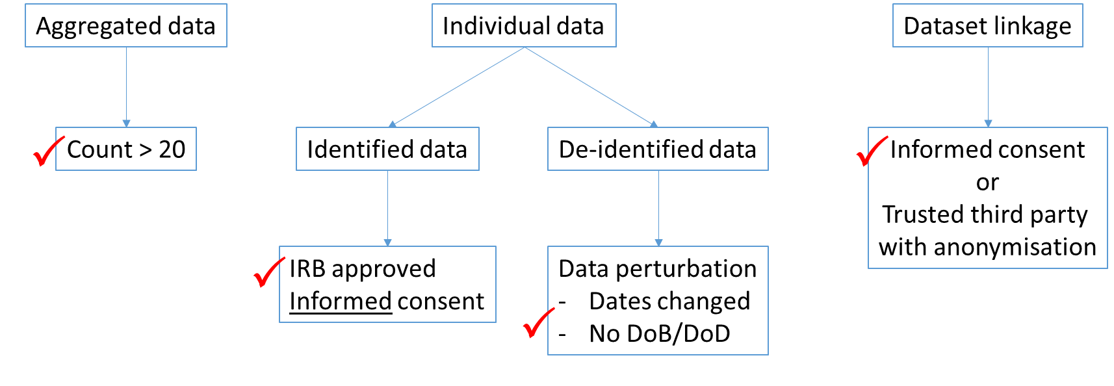
The Challenge
Data privacy ↔ Improved health outcomes
Research requests: Research use from outside the DoH

Slide 13
Future directions
Information for health care clients
- Posters, brochures, waiting room media
- Access for individuals to their own health data
Opt out mechanisms
Option to be excluded from anonymised research datasets
Opt-in mechanisms
Option to be included in research datasets
Tiered consent for primary research, secondary use, re-contact
Flagging eligible patients for clinicians to request consent

Slide 14





Thank you
FUNDING:
Wellcome CIDRI-AFRICA grant (203135/Z/16/Z)
The National Institute of Child Health and Development (NIH, USA): B-Positive R01HD080465
The Bill and Melinda Gates foundation: The African Health Information Exchange: OPP1164272
National Human Genome Research Institute (NHGRI), National Institutes Of Health (OD) H3ABioNet award, number U24HG00694
PHDC:
Andrew Boulle
Alexa Heekes
Mariette Smith
Themba Mutemaringa
Nesbert Zinyakatira
Florence Phelanyane
Njabulo Dube
Cara Peinaar
HIA Directorate

