Slide 1

CHIMS: What does it mean to be a responsible research funder?
Katherine Littler, 29 November 2017
GFBR

Slide 2
Wellcome: Why are we interested in CHIMS?

Slide 3
Vaccines at Wellcome
Why we care about vaccines?
Vaccines save 2-3m lives a year but:
we lack effective vaccines for many emerging and neglected infections like Zika, MERS, group A strep and Shigella;
some existing vaccines are not as effective as they could be;
essential vaccines don’t always reach those who need them e.g. the vaccines for malaria and rotavirus.
As a global leader in scientific research and policy, Wellcome is well placed to bring about the change that’s needed to save more lives through vaccination.

Slide 4
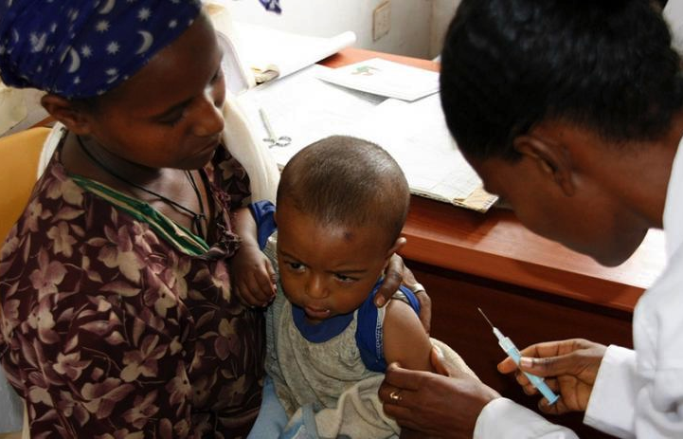
Vaccines at Wellcome
Four ways we are taking action
A world prepared for epidemics
Innovation in vaccine development
  through the expanded use of controlled human infection models to accelerate vaccine design and development for target populations.
Generating evidence for decision making
Increased vaccine expertise

Slide 5
Wellcome: Accelerated vaccine development through increased knowledge of target populations

Slide 6
CHIMs provide us with early answers to focus our efforts and develop more relevant vaccines for those most in need
Time it take to develop & deliver new vaccines to market is too slow
Current situation is unsustainable for public health where there is often little commercial value
Need new models to determine vaccine efficacy earlier, derisk Ph3 trials & shift cure to the left
100%
$300M
NEW
MODEL
80%
60%
Probability of Success
Cost
40%
REDUCED
RISK
20%
CURRENT
MODEL
$10M
0%
$1M
Target Antigen
ID
Pre-clinical
Proof
of Concept
Phase IIB/III
Registration
Vaccine development pipeline

Slide 7





Expanding the use of CHIM in endemic areas
Our approach:
Wellcome has a long history of support for research capacity building in Africa and Asia
Due to complex nature of these studies and the capacity that needs to be built in endemic areas, we will be starting small & working with organisations we know well
We intend to support a holistic and coordinated approach to build capacity for CHIM, including ethics, regulatory, engagement etc…
Why do we support CHIM in endemic areas?
Host-pathogen or host-vaccine interaction can be different in LMICs as compared to UK/US
Genetics, infectious disease history, co-infections, immune status, and environmental factors might can only be appropriately tested in the targeted settings.
Potential benefits of the trial results in the country where the diseases occur
Outcome: Accelerate and optimise vaccine development for target populations

Slide 8
What does it mean to be ‘holistic’, coordinated and responsible?

Slide 9
Developing an ethical framework for CHIMS – a starting point
Evidence review of previous CHIMs
Funder’s principles
Community engagement
What kind of responsibility do
sponsors of scientific research have in making a decision to fund CHIM?
What can be learnt from previous/existing CHIM models in endemic settings?
What are the local community’s understandings and perceptions of
CHIM studies?
Ethically and socially justified and safe research
Studies need to be driven by local needs and local clinicians.
Confidence and support of the public and key stakeholders
  Trust building and benefit sharing
  Capacity strengthening
Ethical and regulatory challenges and issues faced by previous CHIM studies in disease-endemic countries (Gabon, Tanzania, Kenya and Thailand etc.) → new considerations? What additional support/training is necessary?

Slide 10
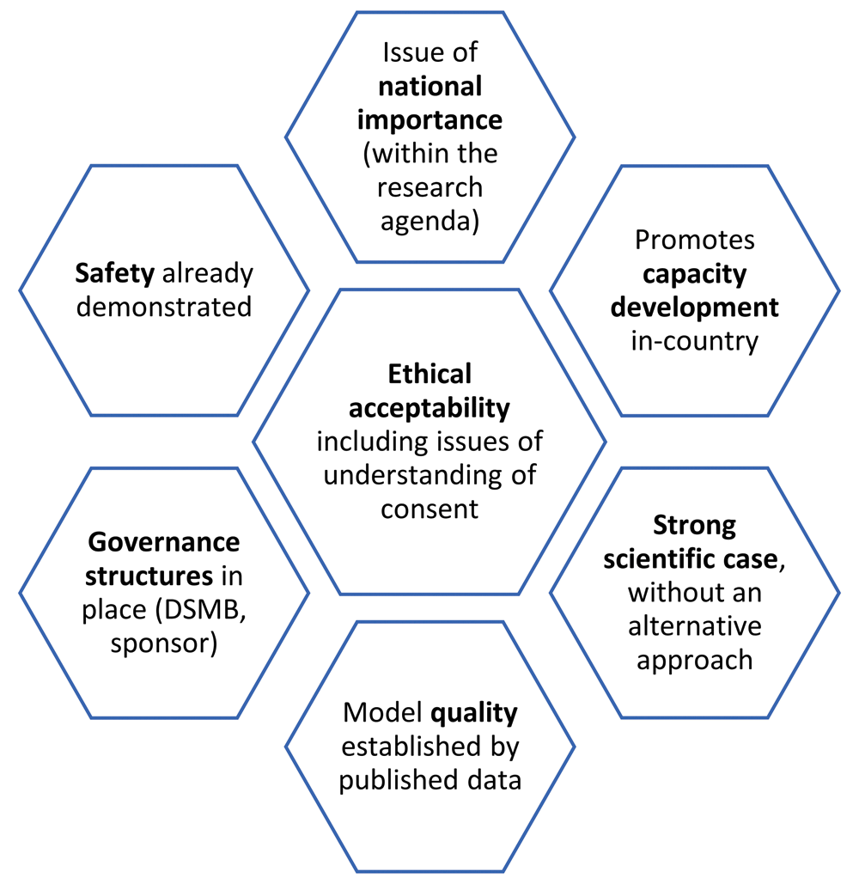
Funders Principles
Why Funders Principles?
Funders have a responsibility to support innovation that promotes and sustains the public good
CHIM studies raise unique ethical concerns – purposefully infecting a healthy individual carries a high burden of responsibility for those funding this type of research
Precedent for this model – i.e. emerging technologies, data sharing, access to medicines (also a challenge – need to ensure coherence and not just a ‘proliferation of principles’).
Complimentary to other international and local guidance
  i.e. WHO guidance, Malawi framework.
Implementable – embed in the research practice
How?
Bring together Funders to discuss and agree, convening Feb 2018 & consider how to implement
[Gordon et al, 2017]

Slide 11

Thanks to Zoe Seager & Cecilia Chui, Vaccines Team at Wellcome
Katherine Littler
Global Policy Lead, Wellcome
k.littler@wellcome.ac.uk

