Slide 1
Recap- Day 1- GFBR 2017
Dr. Anant Bhan
Member, Steering Committee, GFBR
Incoming President, International Association of Bioethics

Slide 2
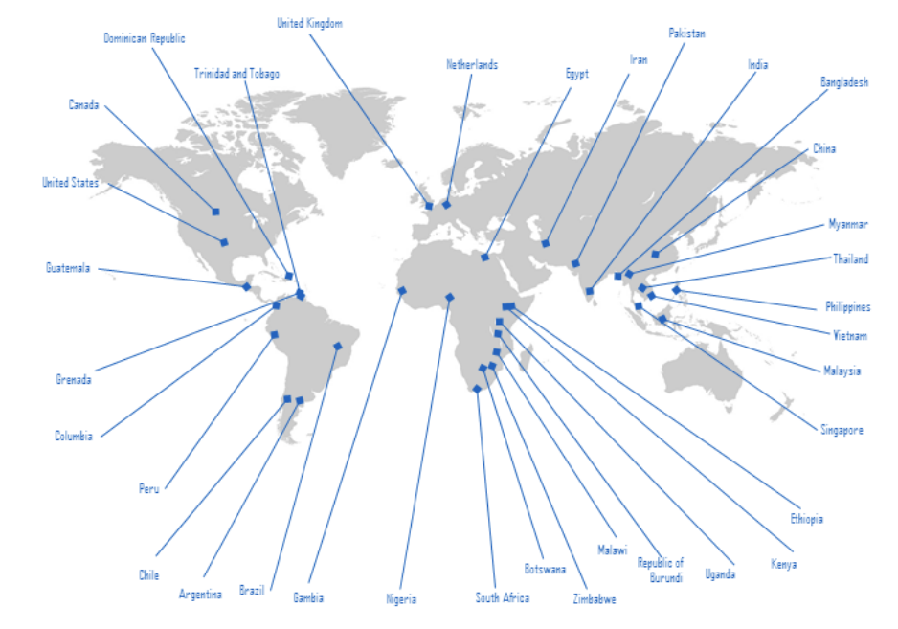
GFBR 2017
“Ethics of alternative clinical trial designs and methods in low- and middle- income country research”.
Increasing role for alternative innovative CT designs in the post-Ebola world- replacing/adding on to conventional CT designs in LMICs

Slide 3
Why are we discussing these designs
More ‘efficient’ science
Accelerating vaccine, drug development, research on new interventions, making CTs more socially acceptable and adaptable
Gaps in guidelines and regulations
Not enough discussion on ethical facets of such designs

Slide 4
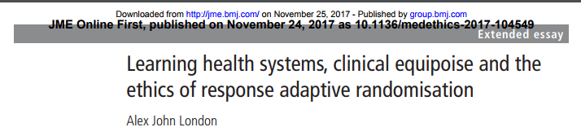
Literature needs more through examination
Exploration of the challenges done conceptually, empirically, and based on experiences
Focus on HIC settings primarily, but certainly good to draw from
Can better inform discussions
Learning health systems

Slide 5
Key issues
Cost is a major factor– from a sponsor, health systems, resource investment perspective
Time is a major constraint- procedural delays can lead to innovative designs not being implemented in time (e.g. in an ongoing epidemic)
Population level variability requires adequate focus– and hence the need to explore these designs across different population sub-sets
How do we aid policy makers make better and more evidence based decisions
  how do we ensure they make decisions once they are presented with the evidence?
  How do we preclude them from finding ways of ‘faulting’ the evidence.

Slide 6
Key issues
Capacity is a major constraint
How can we work with our researchers, regulators, ethics committees to be able to better understand the facets of this nimble science?- risk, bias, power calculations, limitations and strengths.
Help them in being able to digest the scientific aspects, but to also be able to better discern the key and emerging ethical issues in such approaches
Plan in advance to build such country/region level capacity before such approaches are deployed, and reinforced by continuous engagement (taking the GFBR to the regional and local levels?) – fora for researchers, ethicists, and statisticians to get together regularly.
Remember that committees often remain under-staffed and over-worked.

Slide 7
Key issues
Dealing with specific issues which arise in such designs
  collecting data from an arm(control) but not responding (ethical issues/community engagement).
  use of financial incentives (reimbursement Vs incentive as a key part of the research intervention, the role of which is being investigated for a health behavior change)
  Role of nuance- do we resort to the ‘coercion’ argument too soon
  Adaptation of research design during implementation– flexibility of approach
  - oversight of adaptive interventions- ‘committees’ Vs ‘AI’?
  Interface with the health system– role of health system functionaries (including as research agents and serving as research participants)
  Gatekeepers- local community level, political leadership

Slide 8
Ethics explorations- innovative designs
Delays in providing intervention- interface with equipoise?
  is it ethically acceptable to delay provision of an intervention which has (strong) potential benefits
  on what grounds is such delay acceptable?- logistical, administrative, political, research design/science
Consent
  Consent modification, adaptation– how much flexibility do current regulations allow?
  Is waiver of consent appropriate for cluster-level interventions/innovative CT designs?
  Is it acceptable not to gain individual patient consent for use of their data?
Level of care for the control group
  Is there a minimum base care which needs to be offered (better than status quo? Duty to rescue?)

Slide 9
Innovative designs
Do they need ethics review, ethics oversight, ethics approvals- clear justification for the choice
  We often conflate Research ethics review Vs ethics review of any kind (evaluation, oversight to pick up salient points).
  Oversight mechanisms– might include independent review (departmental), technical review, independent experts
  Quality improvement oversight committee
How can we work with other stakeholders (journal editors?)

Slide 10
Innovative designs
Post-trial access- needs more exploration
Are adaptive platform trials ethically preferable to standard RCTs?
Role of ‘unbiased’ algorithms– or combined factorial approaches

Slide 11
Pecha-kucha
Good snapshot of country experiences, and explorations in research domains
Extended elevator pitches
Diversity of country level regulatory and ethics review approaches, but also needs
Need to be able to better understand and explore research and practice elements in areas such as CAM, as well as collaborations with experts in statistics, health systems, research design innovation

Slide 12
Moving forward
How do we utilize these designs towards ‘learning’ health systems– moving toward overall delivery of optimized quality interventions.
How do we get LMIC contexts to be evolved to be able to understand and deal with such approaches– and have the capacity to deploy such designs– rather than being stuck with a lack of knowledge or being stuck on questions around interventions such as consent.
What kind of materials, trainings etc do RECs require across the globe to move forward? How can we achieve that?
When you plan studies in LMICs, budgeting funds for training and capacity building would be useful

Slide 13

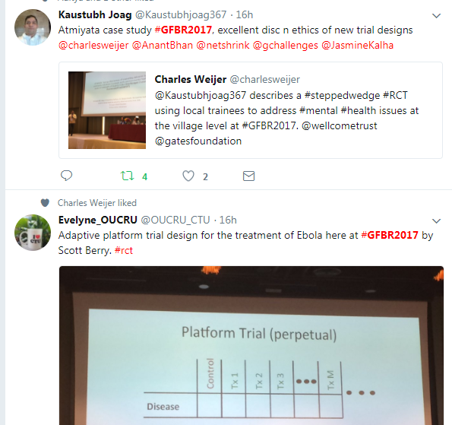

Reminder- social media #GFBR2017

Slide 14
Welcome to an exciting day 2
#GFBR2017

