Slide 1
Enhancing Community Protection in Research on Displacement and Migration:
Expanding the Roles of Community Advisory Boards
Courtland Robinson, PhD
Center for Humanitarian Health
Associate Professor, Department of International Health
Johns Hopkins Bloomberg School of Public Health
Ethics of Research with Refugees and Migrant Populations, Bangkok, Thailand, Nov 30 –Dec 1, 2017

Slide 2
Overview
Research on the China/North Korea and Thailand/Myanmar borders
Community Advisory Boards as local IRBs
Commentary on ethical issues
Discussion and conclusions

Slide 3
Research on the China/North Korea and Thailand/Myanmar borders
Notes:
WE WILL NOW LOOK MORE closely at COORDINATION IN HUMANITARIAN CRISES.

Slide 4
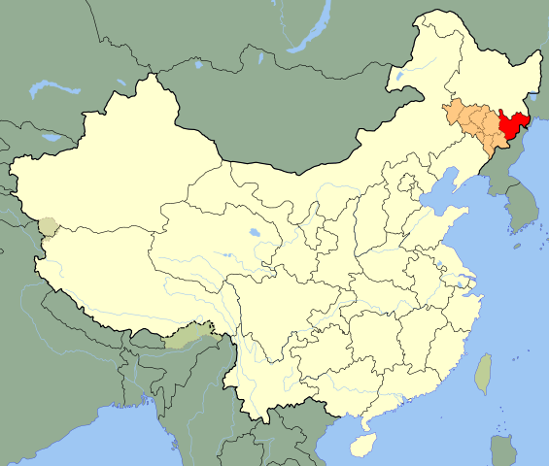
Yanbian Korean Autonomous Prefecture, Jilin Province, PRC
 | Figure 1: Yanbian Korean Autonomous Prefecture (red), Jilin Province (orange), People’s Republic of China (white)

Slide 5
North Korean migration to China
Since 1994 or 1995, significant numbers of North Koreans began moving across the Chinese border in search of refuge and asylum and/or survival necessities for themselves and their families.
As of 1998, between 50,000 and 150,000 North Koreans were staying temporarily in China, principally in Yanbian Korean Autonomous Prefecture, which is home to more than one million Korean-Chinese.
Beginning in 1998, the Center for Humanitarian Health began monitoring the health and human rights of the North Korean population within and outside the country’s borders.

Slide 6
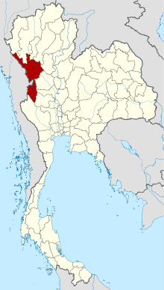
Tak Province, Thailand
Figure 2. Tak Province (red), Kingdom of Thailand (white)

Slide 7
Myanmar migration to Thailand
Thailand is a source, transit, and destination country for trafficking. Main sectors for work include commercial sex work, begging, domestic work, factory work, construction, agriculture, and fishing industries. The majority come to Thailand from Myanmar (Burma).
Tak Province is home to over 120,000 migrants, most of whom are undocumented Myanmar migrant workers living in Mae Sot District.
From 2010 to 2015, the Center for Humanitarian Health conducted a number of studies of refugee, migrant and displaced populations from Myanmar living in Thailand, particularly Tak Province.

Slide 8
Community Advisory Boards as local IRBs
Notes:
WE WILL NOW LOOK MORE closely at COORDINATION IN HUMANITARIAN CRISES.

Slide 9
CABs and border populations
In both border projects, we felt that the protection of community interests among displaced, marginalized border populations warranted the establishment of Community Advisory Boards with roles and responsibilities akin to that of a local IRB. Johns Hopkins Bloomberg School of Public Health served as the IRB of record for the projects.
CAB as local IRB means that they provided a forum and format for community consultation but also community consent (though individual consent of study participants also was sought). All study protocols and study documents were reviewed and approved both by the JHSPH IRB and by the local CAB before research could begin, and both Boards were informed of ongoing implementation procedures and of study results.

Slide 10
CABs and border populations
In China, the five CAB members included a local physician, a local academic (also a clinician), a local NGO director, and two local church leader (churches were active in providing aid to the North Korean population). The CAB included two females and three males; all were Korean-Chinese (one married to a North Korean).
In Thailand, the five CAB members included a local academic, the director of a local NGO, a member of the Burma Medical Association, and two local headmasters. Of the five, two were female; all were born in Myanmar, and had been migrants and displaced persons in Thailand, though one had obtained a Thai ID card.

Slide 11
CABs and border populations
Both CABs were provided bilingual training in human subjects research: role of the data collector, importance of respect, voluntary participation, informed consent, vulnerable populations, privacy, confidentiality, data storage, and dealing with unanticipated problems and adverse events.
Both CABs were provided translated copies of all study documents (research plans, recruitment scripts, consent forms, questionnaires and interview guides) as well as relevant program information about local study partners.
CAB members were also provided regular updates on study progress and were provided summaries of study findings and recommendations. Meetings were arranged to share findings and recommendations to community members and other stakeholders.

Slide 12
Commentary on ethical issues
Notes:
WE WILL NOW LOOK MORE closely at COORDINATION IN HUMANITARIAN CRISES.

Slide 13
Community consent
Weijer and Emanuel (2000) suggest that “if community consent is to be sought before individuals are approached for study participation, the community must have a legitimate political authority that is empowered to speak authoritatively for, and make binding decisions on behalf of the community; more than mere representation is required.”
In the context of displaced populations living in border areas, often without identification or documentation of migration or work status, however, “mere representation” may be all that is possible. Such representation must include the host community who have documentation and identity but who may need to balance the perspectives of border communities with that of their broader national identity.

Slide 14
Community risk
Risk not only to the community but to the researchers themselves and the local institutions they served.
While risk to researchers is not always considered in reviewing the ethics of research, the CABs helped to develop procedures for field travel and contact with local community members, and also provided guidance on the dissemination of findings, to ensure that, above and beyond the normal protections of confidentiality regarding identification of individuals, the community would not be exposed to possible harm.
For the North Korean research, CAB members asked that their names and their functions be kept confidential. Additionally, we agreed to delay release of some publications (only limited release to key stakeholders).

Slide 15
Disparate power dynamics
How meaningfully empowered the CAB members actually felt to challenge the study protocols of an internationally funded project, coordinated by an established, Western institution of higher learning?
Training and capacity building we provided did emphasize the autonomy that the CAB had—and was expected to maintain—in relation to the conduct of the study. We can also attest to a number of occasions when the CABs requested clarifications of, and revisions to, study documents, and also required specific levels and kinds of compensation for burdens of research (primarily time) imposed on study participants.

Slide 16
Discussion and conclusions
Notes:
WE WILL NOW LOOK MORE closely at COORDINATION IN HUMANITARIAN CRISES.

Slide 17
Ethical goals for CABs
Dickert and Sugarman (2005) propose four ethical goals for community consultation (which may or may not include community consent): “(1) enhanced protection, (2) enhanced benefits, (3) legitimacy, and (4) shared responsibility.”
Local CABs can and should be empowered beyond a consultative role to serve, for the duration of a project, as a local IRB and, in that capacity, to provide a meaningful form of community consent. This does not mean that they speak for all members of the community—individual consent is still necessary to safeguard individual risk—but CABs can bring an important measure of “cultural competency” to the informed consent process in international health research, especially research involving marginalized and vulnerable communities.

