Slide 1
Health research on refugee populations in Lebanon: whose agenda and the role of national institutions
Iman Nuwayhid
Faculty of Health Sciences, American University of Beirut, Lebanon
Satellite meeting on the ethics of research with refugee and migrant populations
Bangkok, November 30-December 1, 2017

Slide 2
Outline
Public health challenges in Arab world (our context)
Our Faculty and University
Research on Syrian refugees in Lebanon
How to improve research ethics in these contexts: 4 Points of departure

Slide 3
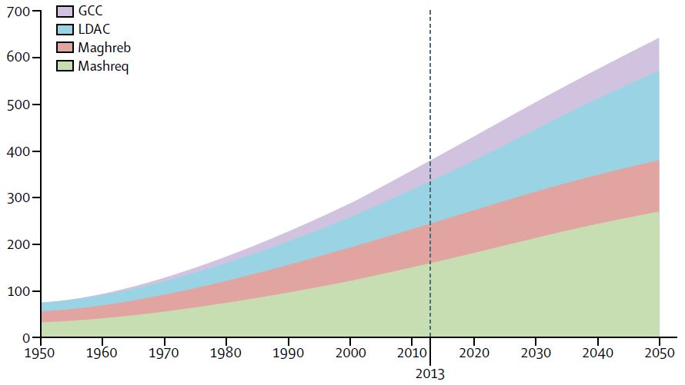
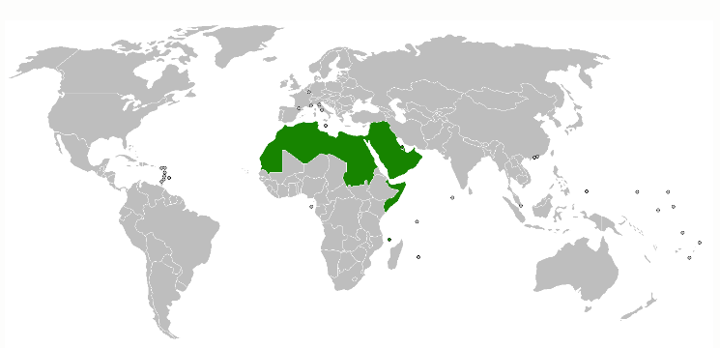
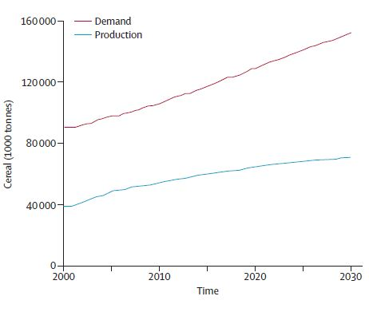
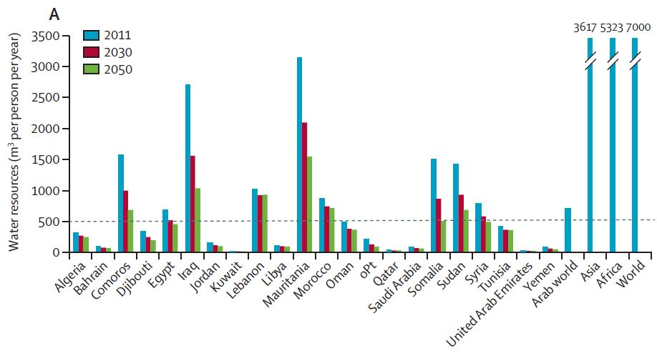
The Arab World
359 million to double in 35-40 years
Water insecure
Food insecure
El-Zein et al. 2014. Health and ecological sustainability in the Arab world: a matter of survival. The Lancet, 2014; 383:458–76

Slide 4
Public Health Challenges in the Arab Region
Burden of Disease
Rise in non-communicable diseases
Double burden of malnutrition and obesity
Rise in road traffic injuries and casualties
Resurgence in communicable diseases
Needs of Special Populations
People living longer
Highest youth population proportion in the world
Health effects of conflict (mortality, refugees, internally displaced)
Gross inequities between and within countries
Systems
Weak health systems
Lack of good public health data
Health systems in transition
Number and skills of public health professionals
Biomedical model of public health education

Slide 5
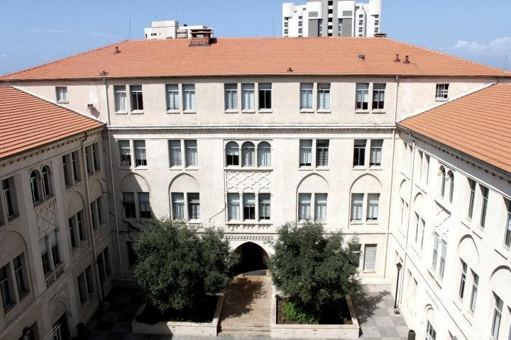
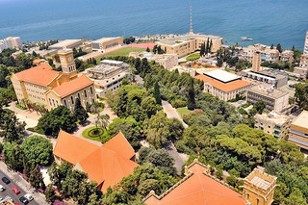
The American University of Beirut-1866
The Faculty of Health Sciences
Established in 1954 as the first and fully independent school of public health in the Arab region

Slide 6

FHS: a center of excellence
Graduate Programs
Master of Public Health (MPH)
MS: Epidemiology; Environmental Health; Public Health Nutrition; Clinical research; Healthcare leadership (executive)
PhD- Epidemiology
Research themes
Environmental and Occupational Health
Health Management and Policy
Ethics in Research
Mental Health
Conflict and Health
Non Communicable Diseases
Tobacco Control
Older adults; Youth
Women’s health
Reproductive and Sexual Health
Social determinants of health

Slide 7


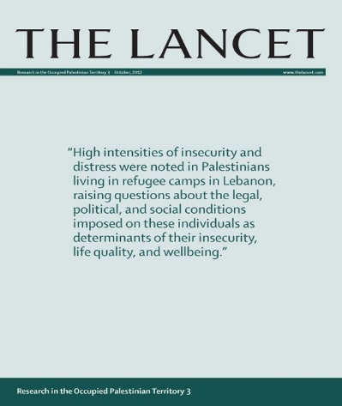
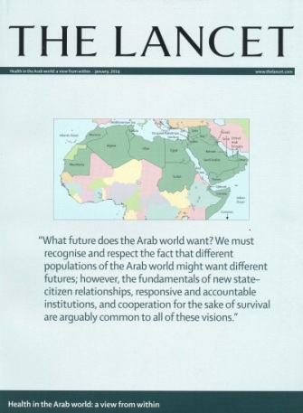
FHS Building Institutional Networks and Promoting Public Health Knowledge
PHAW online community: www.aub.edu.lb/fhs/phaw
EMRAIN, a network of academic public
health institutions in the Eastern
Mediterranean region
2012
2013
2012
2014
Health in the Occupied Palestinian Territory
Health in the Arab World: a view from within

Slide 8
FHS and conflict/war: a theme or a context

Slide 9
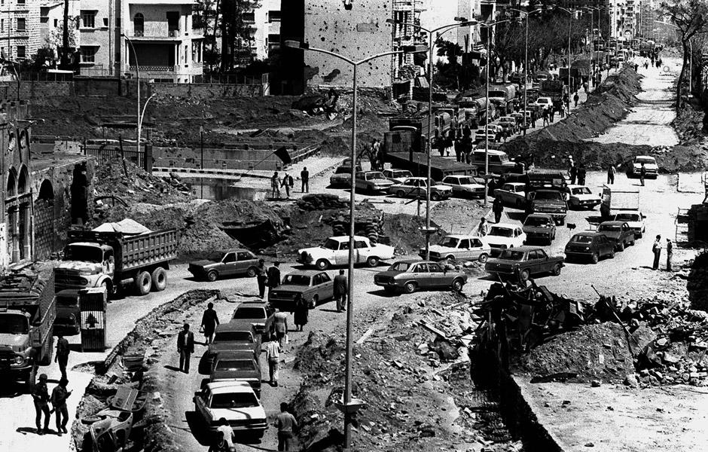

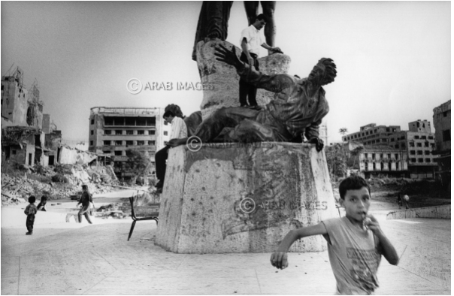
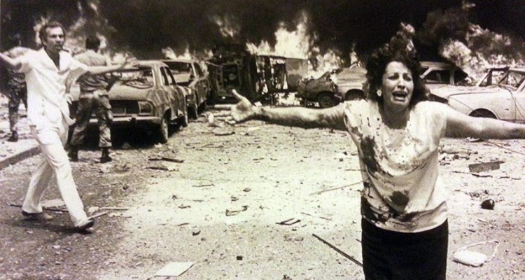
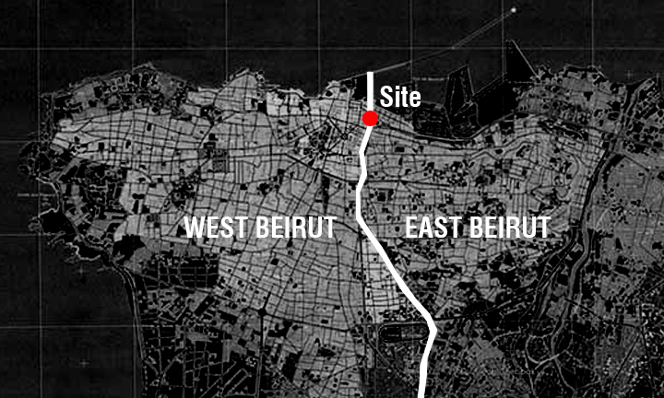
“Civil” war in Lebanon (1975-1990)

Slide 10


Beirut 1984
A Population and Health Profile
15 years “civil” war: Where is the war context?
Beirut: A Health Profile
1984-1994
Table of contents:
1- Introduction and methodology
2- Demographic and Socio-economic characteristics
3- Environmental health conditions
4- Morbidity and risk factors
5- The utilization of health services
6- Maternal health attitudes and the pre- and postnatal care of children
7- Dental health
Table of contents:
1- Introduction
2- Survey methodology
3- Demographic and socio-economic Characteristics
4- Utilization of health services
5- Morbidity, mortality and risk factors
6- Reproductive and child health
7- The health profile and future prospects of Beirut: Concluding remarks

Slide 11
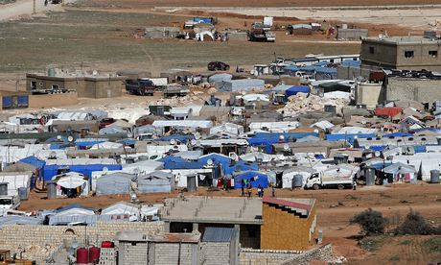
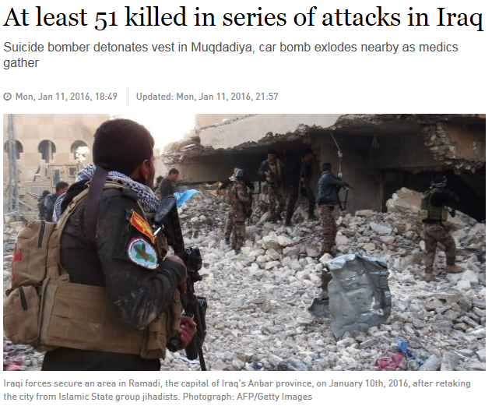
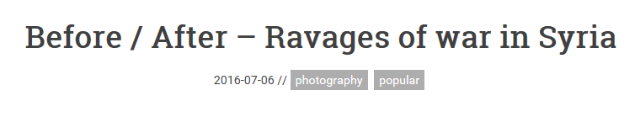
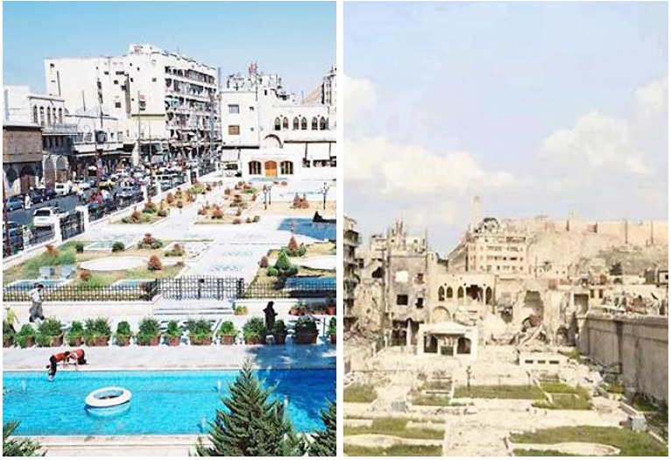
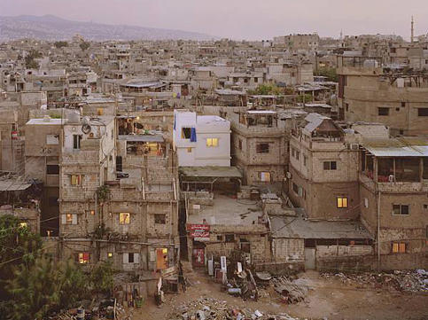
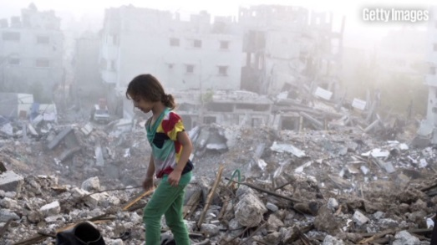
Times are changing…
Ten out of 22 Arab countries… are in some state of turmoil and host 50% of all the world’s refugee and displaced populations
Syrian Refugees in Irsal, photo: Joseph Eid
Destruction in Gaza: July 2014. Photo: CNN
Beirut Palestinian Refugees camps

Slide 12
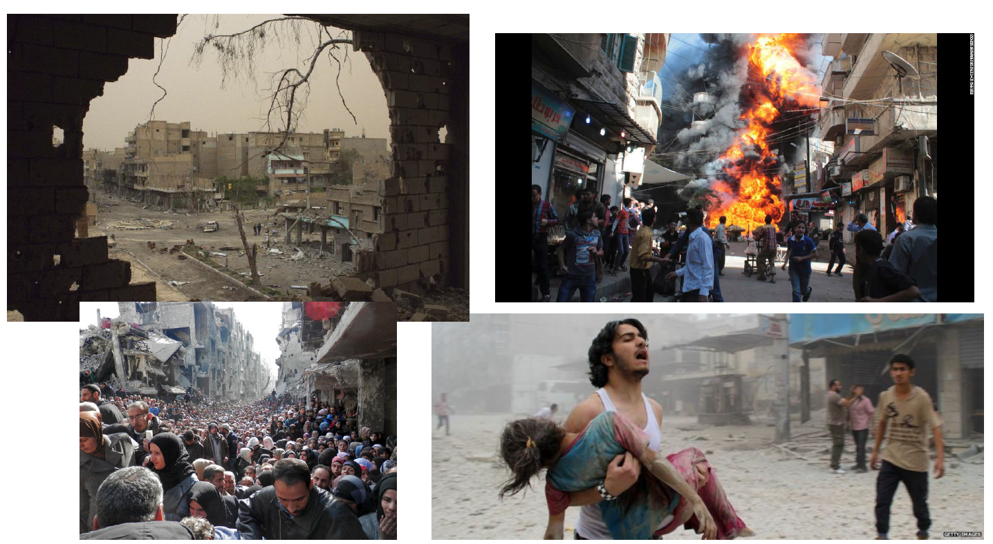
Syria 2011-present: 6 million internally displaced and 5 million refugees

Slide 13
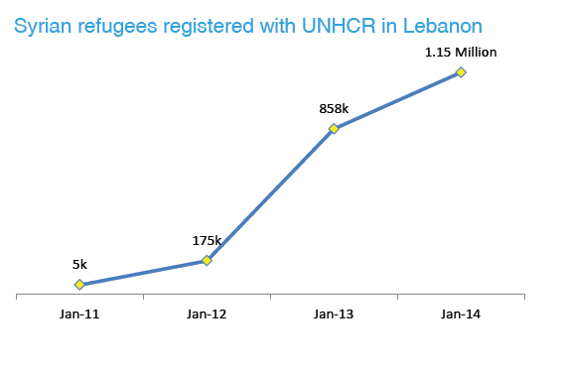
Syrian refugees in Lebanon
Source: Refugees from Syria: Lebanon. March 2015. UNHCR0The UN Refugee agency

Slide 14
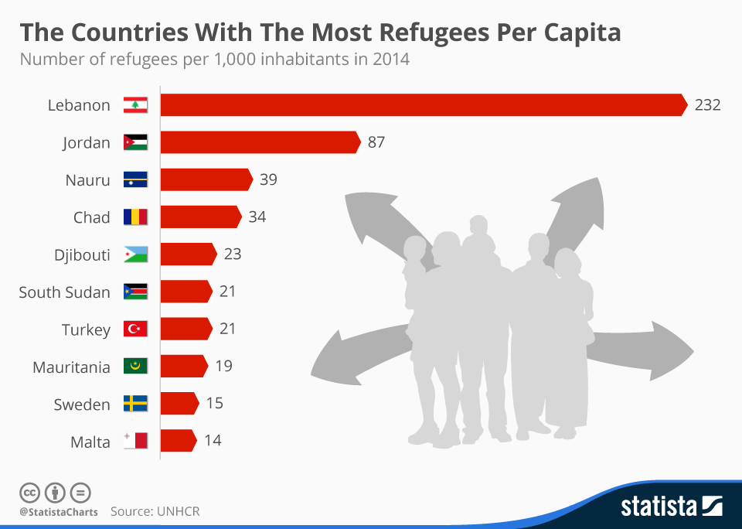
Source: http://images.huffingtonpost.com/2015-12-17-1450336339-3065708-ScreenshotofForbesStatistaUNHCRrefugeefigures-thumb.jpg

Slide 15
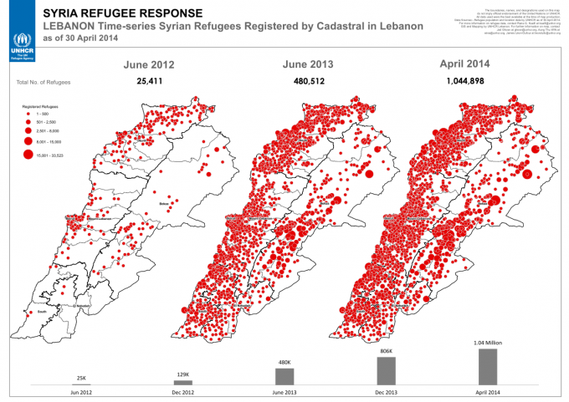
Source: https://eyeontheeast.org/2014/05/13/syrian-refugees-in-lebanon-is-anybody-listening/

Slide 16
Response to crisis at AUB
AUB
  Center for Civic Engagement
  AUB4Refugees (Provost Office)
  Conflict Medicine and Refugee Health Programs (Global Health Institute)
Faculty of Health Sciences:
  MPH certificate on ‘health and conflict’
  Humanitarian engineering and Digital PH for refugees (with Engineering)
  Health in Conflict and Humanitarian Crises: a common theme for the three Centers for Research, Practice, and Policy
  PhD Epidemiology– oriented to research in under-resourced and conflict settings

Slide 17
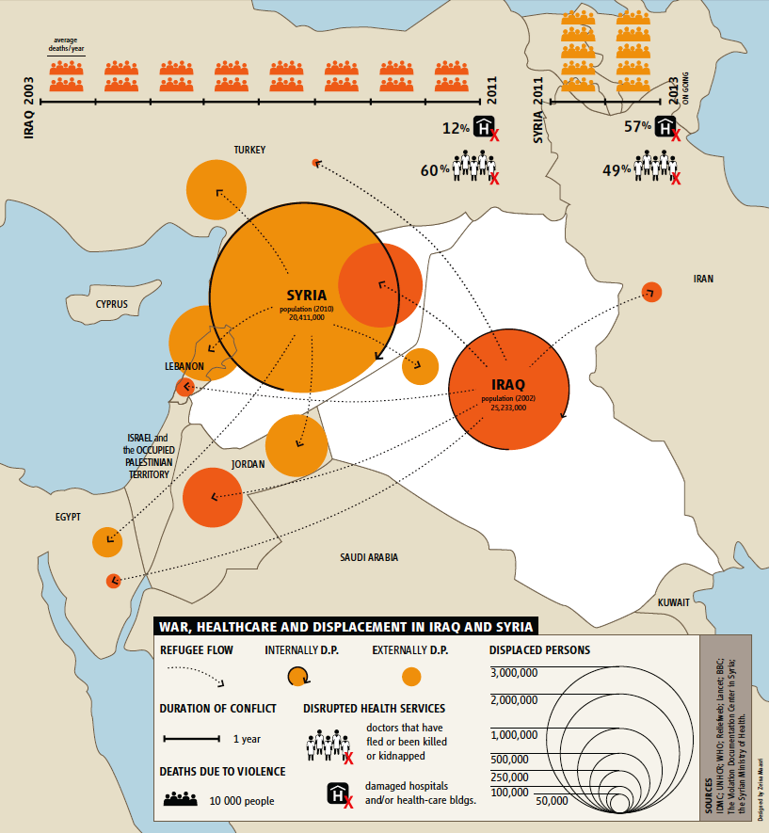
“Conflict and Health” research at FHS
Reproductive and sexual health
Health system resilience
Access to health services
Non- communicable diseases
Medical and social experiences of war injuries
“Therapeutic geography”: Omar Dewachi coined the term (The Lancet 2014)
Experience of health and displacement
Ecology of war
Child labor/ working children
Nutrition and Healthy Kitchens
Changing therapeutic geographies of the Iraqi and Syrian wars. Dewachi et al, The Lancet 2014; 383: 449–57.

Slide 18
Research at AUB: health/conflict
Project Theme | Number
Food and Nutrition | 6
Humanitarian Service Provision/Assessment | 7
Reproductive Health | 6
NCDs | 3
Child Labor | 1
Training of Trainers | 5
Mental Health | 4
Informal Institutions building | 2
Empowerment of Syrian refugees | 1
Total | 35

Slide 19
Data and research on Syrian refugees in Lebanon

Slide 20
International NGOs
Foreign country aid agencies (regional/ international)
Regional donors
International Academy
Refugees
UN Agencies
Municipalities
Government
Host communities
Local
NGOs
International donors
Regional Academy
National
Academy

Slide 21
Points of departure…
Building local IRB capacities to ethically but efficiently clear proposed health research on these vulnerable populations.
  How to balance urgency with proper ethical clearance?
  Are there ethical principles adaptable to crisis situations?
Assessing and proposing guidelines for partnerships
  Local and international academic institutions
  Academic institutions and government, and local and international NGOs and agencies
  Including the voice of refugees and host communities.

Slide 22
A telling incident…
A Canadian researcher working with an iNGO in Lebanon
Requested support for a research project he is leading on Diabetes among Syrian refugees to inform the iNGO’s health clinics
  IRB clearance from AUB
  Identifying and training field workers

Slide 23
From: JE
Sent: Wednesday, August 20, 2014 6:23 PM
To: Iman Nuwayhid <nuwayhid@aub.edu.lb>
Cc: ML; Deputy
Subject: Today's Meeting - Diabetes Project
Dear Dr. Nuwayhid,
I want to thank you for your time and hospitality during today's meeting, it was much appreciated.
I have spoken to my colleagues here and in Geneva about our discussion. Unfortunately, the timelines for cooperation with American University of Beirut on this project are too long for our purposes.
Though we respect AUB must take steps to maintain its reputation and academic rigour, our primary responsibility is to our patients. For this reason we must select a partner institution that can move more promptly so that we can begin to comprehensively address the needs we are seeing in our clinics.
I sincerely hope you understand our position. We are by all means open to future collaboration and wish you best of luck in your own research endeavours.
Best regards,
JE

Slide 24
Publications by UN and main International NGOs (2011-mid 2017)

Slide 25
38 peer-reviewed publications on Syrian refugees in Lebanon (2011-mid 2017)
Year of publication | Comment/ Lit Review/ Opinion | Research | Total
2011 | 0 | 0 | 0
2012 | 0 | 0 | 0
2013 | 1 | 0 | 1
2014 | 1 | 4 | 5
2015 | 2 | 6 | 8
2016 | 7 | 13 | 20
2017 mid | 0 | 4 | 4
Total | 11 | 27 | 38

Slide 26
38 peer-reviewed publications on Syrian refugees in Lebanon (2011-mid 2017)
Theme | Comment/ Lit Review/ Opinion | Research | Total
Health system/ Policies | 5 | 7 | 12
Infectious diseases | 2 | 8 | 10
Reproductive and sexual health | 2 | 5 | 7
Mental health | 0 | 5 | 5
Other | 2 | 2 | 4
Total | 11 | 27 | 38
IRB | N
Not applicable | 3
Lebanese academic | 10
Non-Lebanese academic | 6
Both Lebanese and non-Lebanese | 1
No IRB | 6
Total | 26

Slide 27
38 peer-reviewed publications on Syrian refugees in Lebanon (2011-mid 2017)
Leading institution | Comment/ Review | Research | Total
Lebanese academic | 1 | 13 | 14
Lebanese government | 1 | 1 | 2
Lebanese NGO | 2 | 2 | 4
Non-Lebanese academic | 6 | 8 | 14
UN or INGO | 1 | 3 | 4
Total | 11 | 27 | 38
Leading institution | Alone | National partner | Inter partner | Total
Lebanese academic | 6 | 6 | 2 | 14
Lebanese government | 0 | 1 | 1 | 2
Lebanese NGO | 3 | 0 | 1 | 4
Non-Lebanese academic | 4 | 8 | 2 | 14
UN or INGO | 2 | 1 | 1 | 4
Total | 15 | 16 | 17 | 38

Slide 28
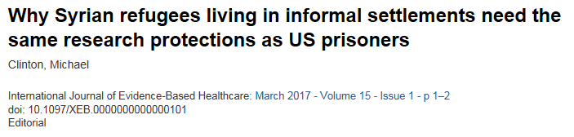

Slide 29


Slide 30
The Lancet-AUB Commission on Syria (LCS): Roadmap for Governance of Data Used for Research Purposes
Type of data used | Action points needed for IRB
Dataset | De-identified Dataset: Submit an application for IRB governance under exempt category. Identified Dataset: Submit an application for IRB governance under expedited review
Meetings that LCS is invited to | No applications are required to be submitted to IRB on these endeavors
Meetings in which LCS act as observers
Meetings Initiated by LCS | Submit an outline of all activities for determination of whether IRB review and approval are required. Develop a summary overview of the protocols to be followed
Meetings with individual key informants | Assessment on case-by-case basis.
Primary data collection | AUB IRB approval is required for any protocol in which AUB resources/ staff are involved⃰. AUB may consider dual IRB governance** with another institution being lead IRB, but full approval is still required by AUB IRB→ Submit full application with a proposal

Slide 31
A point of departure…
Integrating research on displaced and refugee populations into academic programs, especially in schools/programs of public health.

Slide 32
A point of departure…
Developing guidelines or criteria to assess relevance of health research question and clear quality and impact of research designs.
  Should these criteria include the ability of the research to inform policy and practice?
  Should these criteria include setting health priorities for research?

Slide 33
FOUR Points of departure
Local IRB capacities
Guidelines for partnerships
Guidelines/criteria on relevance of health research question and quality and impact of research designs
Research on displaced/refugee populations into academic programs (public health)

