Slide 1
Case study: Ethical process on the qualitative research
“Labour Exploitation, Trafficking and Migrant Health: Multi-country Findings on the Health Risks and Consequences of Migrant and Trafficked Workers”
Satellite meeting on the ethics of research with refugee and migrant populations
Bangkok, November 30 & December 1

Slide 2
Research objetives
Explore the experiences of exploitation and exposures to occupational risk (both physical and psychological), and how these impacted the health of trafficked persons and exploited migrant workers in Argentina, Peru and Kazakhstan working, respectively, in textiles, artisanal gold mining and construction

Slide 3
Background
Identification of “low-skilled labour sectors” that are commonly considered to be exploitative or known for practices associated with human trafficking: textile work, construction and artisanal gold mining. Each of the selected study countries – Argentina, Kazakhstan and Peru – has destination locations for either international or internal trafficking in these sectors

Slide 4
Sample
Country | Sample population | Sample size
Argentina / Bolivia | 1. People identified as trafficked in post-trafficking services 2. Migrant workers in the textile sector | 6 15 Total: 21
Peru | 1. Migrant workers in the mining Sector in Madre de Dios region | 21 Total: 21
Kazakhstan | 1. People identified as trafficked in post-trafficking services 2. Migrant workers in the construction sector, in and around Astana | 12 17 Total: 29
From a total of 71 interviews (men and women aged 18 to 55), 18 were formally identified as victims of trafficking and 53 were migrant workers

Slide 5
Ethics – project considerations
Local risk assessment of the field sites in cooperation with trusted local partners
Informed consent in an easily comprehensible language for participants
Anonymity and confidentiality were ensured through coding and secure data storage and publication
Referral options to problems reported by interviewees

Slide 6
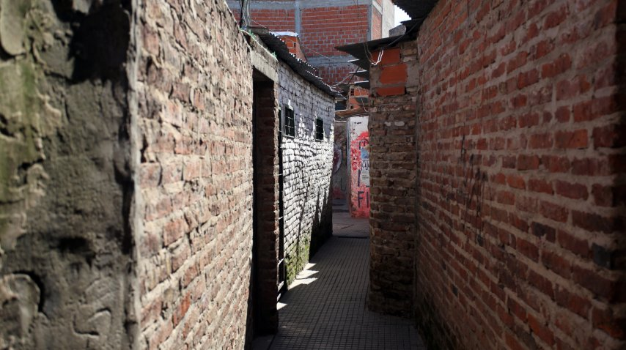
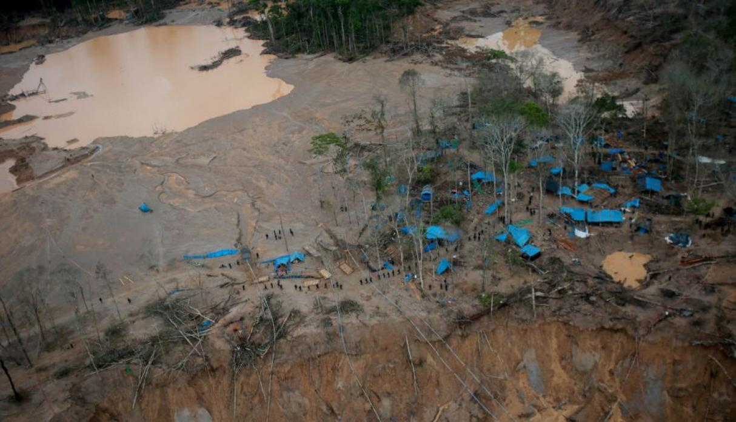
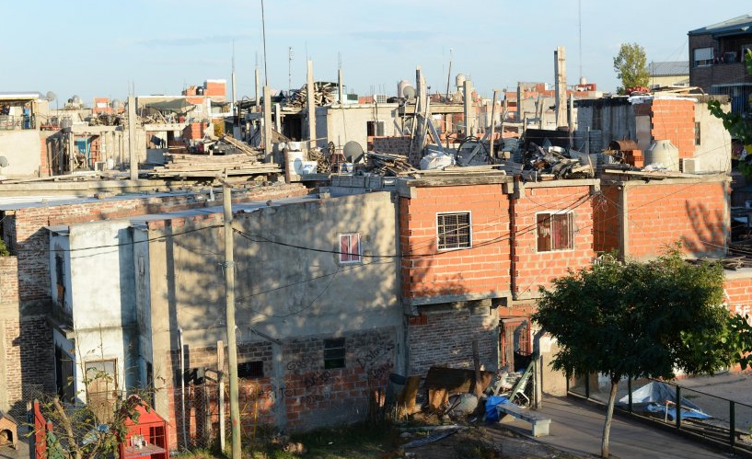
Ethics - Main challenges
Lack of immediate services offered to migrant workers
Risk to conduct fieldwork (for team and participants)
Psychological distress (for team and participants)
Photo credits: MinutoUno
Photo credit: Juan Carlos Guzmán/Andina

Slide 7
Ethics - recommendations
Guidelines on how to manage participant expectations
Referral resources to assist a participant when possible
Recommendations on security issues in hostile or risk-prone settings, for both the team member and the participant

Slide 8
Ethics - recommendations
Guidelines on how to manage difficult situations with participants
Guidelines on self-care and team support
Informed consent: ensure the right type of approach to secure that a participant actually understands it

Slide 9
Vanesa Vaca
South American Research Coordinator
EXTRMHE Project
vvaca@iom.int

