Slide 1
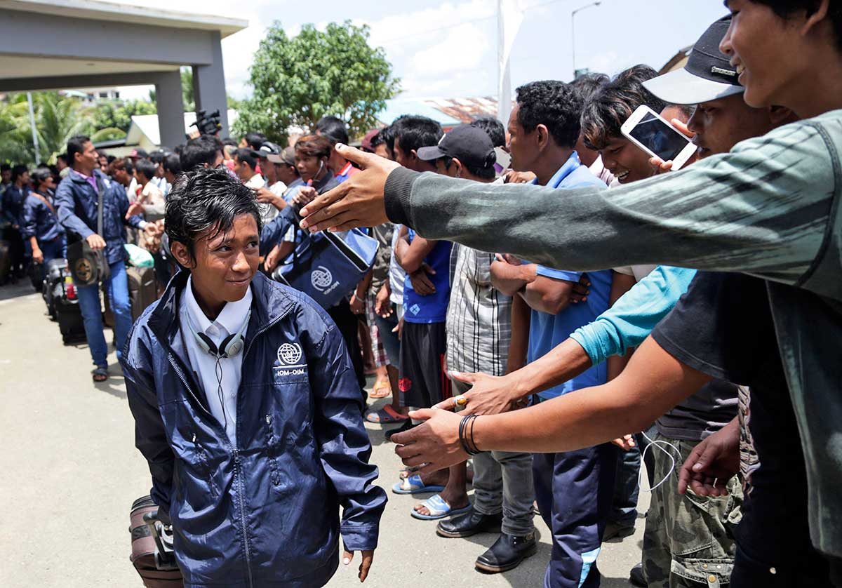
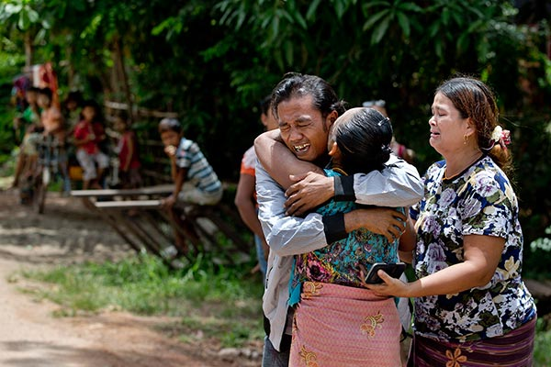

Ethics in trafficking research:
Study on Trafficking, Exploitation & Abuse in the Mekong (STEAM)
Nicola Pocock
Postdoctoral Fellow
Trafficked fishermen returning home from Indonesia. Copyright @ Associated Press

Slide 2




Study settings
Post-trafficking service providers
Migrant helplines
Case file review
At work (supply chains), in transit (border crossings) or in home communities..

Slide 3
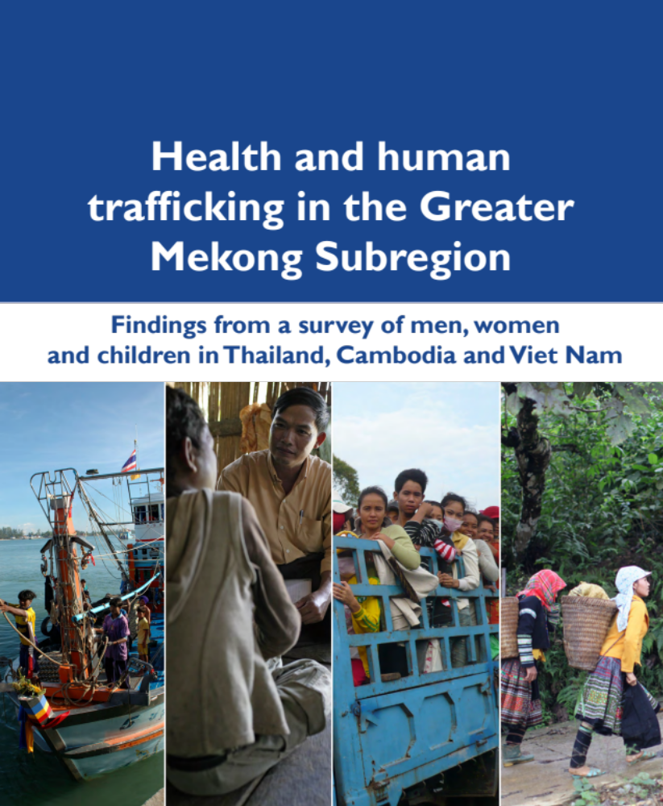




STEAM

Slide 4



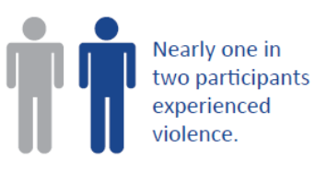




Study overview
First interview
(2 weeks)
Follow up interview
(1-3 months later)
Lost to Follow up
Service providers
N = 251
N = 5
Women = 320
N = 69
N = 281
N = 6
Men = 395
N = 114
N = 216
N = 4
Children = 387
N = 171
TOTAL N = 15
N = 1102
N = 748
N = 354 (32%)

Slide 5

Ethical issues & concerns

Slide 6
Interview difficulty (%)

Slide 7
Will you meet again to answers questions like this in 3-4 weeks? (%)

Slide 8
Reasons for not agreeing to
follow-up interview (%)

Slide 9
Recommendations
Referral pathway
Shelter populations
Co-designed research
Priority of SP
In-country IRB
At minimum
INGO research
ETHICAL LITERACY
Built-in dissemination
STROBE?

