Slide 1

CHIMS: What does it mean to be a responsible research funder?
Katherine Littler, 29 November 2017
GFBR

Slide 2
Wellcome: Why are we interested in CHIMS?
Notes:
Wellcome is interested in supporting in endemic settings - Accelerated vaccine development through increased knowledge of target populations:
Potential to rapidly advance the development of vaccines with public health relevance to LMICs
Test host-pathogen interaction or vaccine targets in the country where the disease is found
Biological variables in host-pathogen or host-vaccine interaction will differ
Genetics, infectious disease history, co-infections, immune status and environmental factors are likely to play a role in how the host responds to the pathogen or vaccine

Slide 3
Vaccines at Wellcome
Why we care about vaccines?
Vaccines save 2-3m lives a year but:
we lack effective vaccines for many emerging and neglected infections like Zika, MERS, group A strep and Shigella;
some existing vaccines are not as effective as they could be;
essential vaccines don’t always reach those who need them e.g. the vaccines for malaria and rotavirus.
As a global leader in scientific research and policy, Wellcome is well placed to bring about the change that’s needed to save more lives through vaccination.
Notes:
General vaccine programme strategy/background slide
Why vaccines?
Vaccines work. They prevent around 2-3m deaths a year and have transformed human health over the past century.
Another 1.5 million deaths could be prevented each year through better vaccination coverage.
However:
We lack effective vaccines for many emerging and neglected infections like Zika, MERS, group A strep and Shigella.
Some existing vaccines are not as effective as they could be, and don’t reach those who need them eg the vaccines for malaria and rotavirus.
As a global leader in scientific research and policy, Wellcome is well placed to bring about the change that’s needed to save more lives through vaccination.
General vaccine programme strategy/background slide

Slide 4
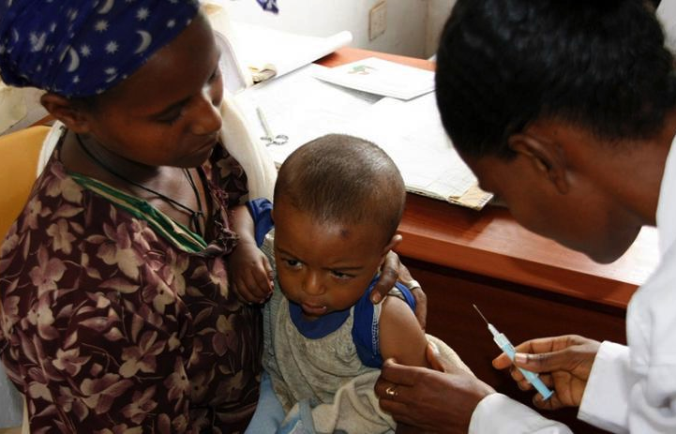
Vaccines at Wellcome
Four ways we are taking action
A world prepared for epidemics
Innovation in vaccine development
  through the expanded use of controlled human infection models to accelerate vaccine design and development for target populations.
Generating evidence for decision making
Increased vaccine expertise
Notes:
General vaccine programme strategy/background slide
What we want to see change / our vision
We want to see a world better equipped to combat infectious diseases. Vaccines are one way to achieve this.
We will work with partners to speed up vaccine development and make sure they are relevant to vulnerable populations.
We will make sure that advances reach those who need them by using evidence to increase the uptake of, and access to, new and existing vaccines.
What we’re doing
We’ve funded almost £200m of vaccine research over the past ten years, including the successful Ebola vaccine, developed and tested during the 2014-16 epidemic.
This core of response mode funding for fundamental research won’t change, but we will do more to ensure that the outcomes of this research are translated to improve health.
We’ve co-founded CEPI (the Coalition for Epidemic Preparedness Innovations), a global partnership to develop safe, effective and affordable vaccines for epidemic threats including MERS-CoV, Lassa and Nipah virus
NOTE: Current focus for 2017 has been to develop and implement activities for the first two objectives – on Epidemic preparedness and on human challenge models.
A world prepared for epidemics: through a global coalition (CEPI) tasked with development of vaccines that would otherwise not be developed.
Innovation in vaccine development: through the expanded use of controlled human infection models to accelerate vaccine design and development for target populations.
Generating evidence for decision making
Working with GAVI to optimise their vaccines investments through our research focus.
Public health investment cases / value propositions
Increased vaccine expertise in low resource settings through global network. (Africa)
Support vaccines capacity from within our existing networks (Africa and Asia) and connecting with partnerships we have in industry, biotech and not for profit. Host African scientists to build skills base.
Stimulate greater investment in vaccines for Africa

Slide 5
Wellcome: Accelerated vaccine development through increased knowledge of target populations
Notes:
Wellcome is interested in supporting in endemic settings - Accelerated vaccine development through increased knowledge of target populations:
Potential to rapidly advance the development of vaccines with public health relevance to LMICs
Test host-pathogen interaction or vaccine targets in the country where the disease is found
Biological variables in host-pathogen or host-vaccine interaction will differ
Genetics, infectious disease history, co-infections, immune status and environmental factors are likely to play a role in how the host responds to the pathogen or vaccine

Slide 6
CHIMs provide us with early answers to focus our efforts and develop more relevant vaccines for those most in need
Time it take to develop & deliver new vaccines to market is too slow
Current situation is unsustainable for public health where there is often little commercial value
Need new models to determine vaccine efficacy earlier, derisk Ph3 trials & shift cure to the left
100%
$300M
NEW
MODEL
80%
60%
Probability of Success
Cost
40%
REDUCED
RISK
20%
CURRENT
MODEL
$10M
0%
$1M
Target Antigen
ID
Pre-clinical
Proof
of Concept
Phase IIB/III
Registration
Vaccine development pipeline
Notes:
Expanded use of CHIM
The time it takes to develop and deliver a new vaccine to market is too slow (20yrs).
Phase 3 trials are most expensive phase needing 1000s of volunteers and it is not until this stage that we truly understand if a vaccine is effective, so industry has to take a huge risk to invest in Ph3 clinical trials.
Current situation is unsustainable for public health where there is often little commercial market
We need new models to determine vaccine efficacy earlier, to derisk Ph3 trials and shift the curve to the left
Controlled human infection models can be used to do this
But can also gain a greater understanding of fundamental biology from these models
Currently very few models established in disease endemic area where target populations are living in very different environments. This is our focus.
Key to expanding these models is having a robust ethical and regulatory framework and strong community engagement – which we already have at our major overseas programes.
Really strong position to support these models in disease endemic areas.
Our objectives are ….

Slide 7





Expanding the use of CHIM in endemic areas
Our approach:
Wellcome has a long history of support for research capacity building in Africa and Asia
Due to complex nature of these studies and the capacity that needs to be built in endemic areas, we will be starting small & working with organisations we know well
We intend to support a holistic and coordinated approach to build capacity for CHIM, including ethics, regulatory, engagement etc…
Why do we support CHIM in endemic areas?
Host-pathogen or host-vaccine interaction can be different in LMICs as compared to UK/US
Genetics, infectious disease history, co-infections, immune status, and environmental factors might can only be appropriately tested in the targeted settings.
Potential benefits of the trial results in the country where the diseases occur
Outcome: Accelerate and optimise vaccine development for target populations
Notes:
Wellcome CHIM strategy/why CHIM in endemic areas
CHIM are high risk-high reward studies which have the potential to rapidly advance vaccine design and development, particularly if they can be moved to more representative populations as described in the Vaccines Strategy (Nov 2016). This requires a holistic and coordinated approach to expansion: ethics and regulatory strengthening, sharing of data and learnings and global harmonization, which can be fast-tracked through Wellcome if we take a more proactive and directed approach as outlined above. We believe the most effective route to expansion in the first instance for Wellcome is through direct engagement with Wellcome’s MOPs – they have clinical expertise, ethical and regulatory oversight and are embedded in their communities, all key to the success. A managed and closed call demonstrates to them and the community that this is more than business-as-usual Wellcome funding, enabling us to develop our relationship with them in this area and build programs with the highest chance of success. This is also an opportunity for Wellcome to expand the MOPs capabilities and add value to other Wellcome activities including data sharing platforms, international engagement and product development via Innovations and the Hilleman Laboratories, achieved best through a more managed and hands-on process.
Funding for studies:
Due to the complex nature of these studies including the need for robust engagement, and the capacity that needs to be built in endemic areas, we will be starting small and working with organisations we know well, but may expand out over the coming years.

Slide 8
What does it mean to be ‘holistic’, coordinated and responsible?

Slide 9
Developing an ethical framework for CHIMS – a starting point
Evidence review of previous CHIMs
Funder’s principles
Community engagement
What kind of responsibility do
sponsors of scientific research have in making a decision to fund CHIM?
What can be learnt from previous/existing CHIM models in endemic settings?
What are the local community’s understandings and perceptions of
CHIM studies?
Ethically and socially justified and safe research
Studies need to be driven by local needs and local clinicians.
Confidence and support of the public and key stakeholders
  Trust building and benefit sharing
  Capacity strengthening
Ethical and regulatory challenges and issues faced by previous CHIM studies in disease-endemic countries (Gabon, Tanzania, Kenya and Thailand etc.) → new considerations? What additional support/training is necessary?
Notes:
Despite the scientific importance of these studies, there is limited bioethical discussion and guidance to assist stakeholders, including funders, institutional review boards, ethics review committees and researchers, in considering different issues raised by research that involves purposefully infecting healthy volunteers. One way Wellcome is addressing this is through the support of a comparative review of previous CHIM studies taking place in a variety of contexts, to identify different ethical and regulatory challenges that may have arisen. This will provide evidence to support the development and implementation of an ethical framework for considering CHIM.
Ethical and regulatory challenges and issues faced by previous CHIM studies in disease-endemic countries (Gabon, Tanzania, Kenya and Thailand etc.) in order to support the development of ethical guidelines around CHIM

Slide 10
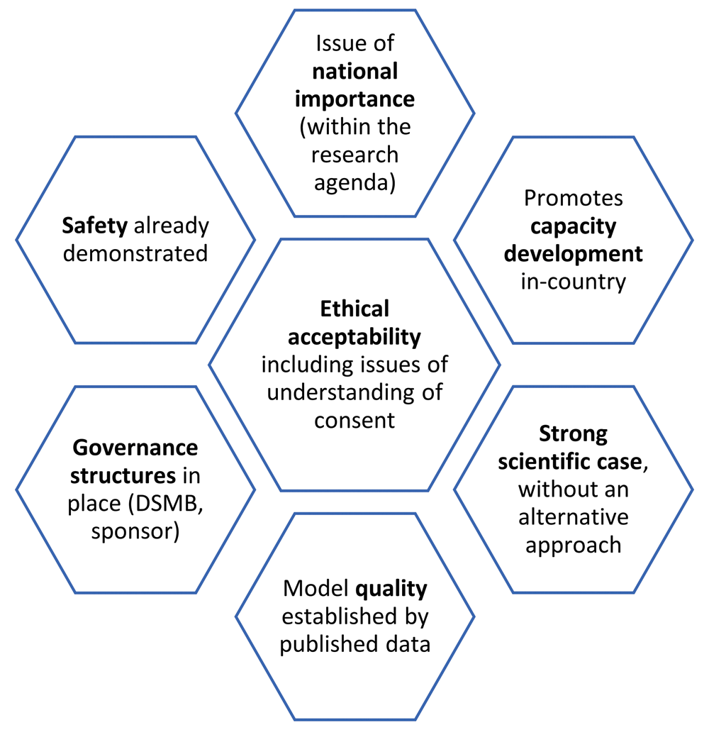
Funders Principles
Why Funders Principles?
Funders have a responsibility to support innovation that promotes and sustains the public good
CHIM studies raise unique ethical concerns – purposefully infecting a healthy individual carries a high burden of responsibility for those funding this type of research
Precedent for this model – i.e. emerging technologies, data sharing, access to medicines (also a challenge – need to ensure coherence and not just a ‘proliferation of principles’).
Complimentary to other international and local guidance
  i.e. WHO guidance, Malawi framework.
Implementable – embed in the research practice
How?
Bring together Funders to discuss and agree, convening Feb 2018 & consider how to implement
[Gordon et al, 2017]
Notes:
In addition, sponsors of scientific research have a responsibility to support innovation that promotes and sustains the public good. As funders, we have recognised the need to establish a set of standards and guiding principles for CHIM, to safeguard volunteers and the field of CHIM as a whole, whilst maximising the value of the research. Such alignment on principles among stakeholders will support decision making in order to minimize potential risks, avert preventable harm, and earn the confidence and support of the public. Principles serve as a moral compass, so that only the highest quality research endeavours consistent with the best practice guidance and standards set by the scientific community will be supported.

Slide 11

Thanks to Zoe Seager & Cecilia Chui, Vaccines Team at Wellcome
Katherine Littler
Global Policy Lead, Wellcome
k.littler@wellcome.ac.uk

