Slide 1
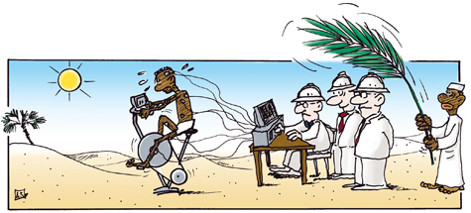


PAVING THE WAY
The Ethics Of Alternative Clinical Trial Designs from Egyptian point of view
Dr. Hany Sleem
NHTMRI, ENREC

Slide 2

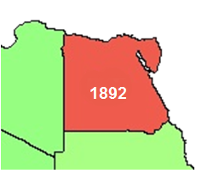
Egypt
Population: about 92 million
GDP/Capita : about 4.000 $
Number of registered Clinical trial : 1892
1892 clinical trials were conducted in Egypt with the number of clinical trials nearly tripling in the last few years making Egypt second to South Africa in African .
The biggest country regarding population and clinical trial number in the Arab World and lowest GDP/Capita.
The clinical trial law (draft) Arabic languages, (2012 ,2017). 23Pages . 18 Articles.

Slide 3
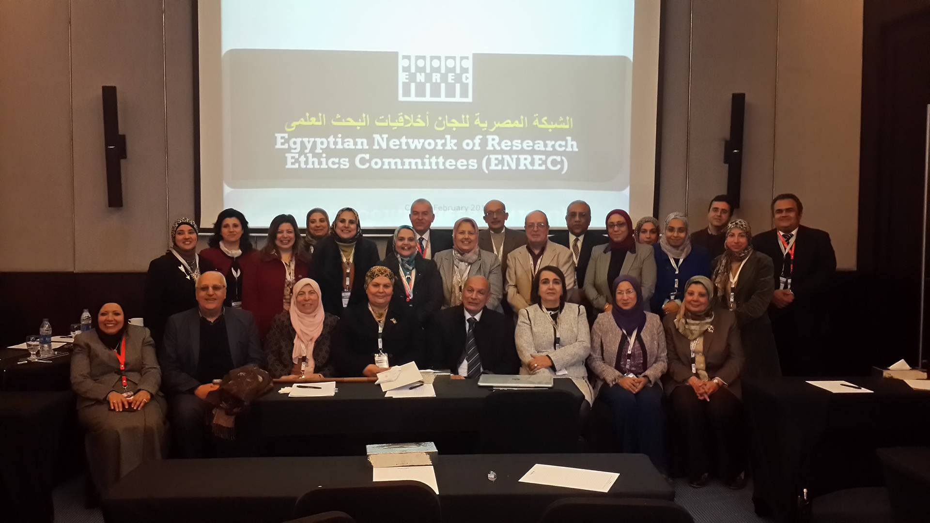
IRBs in Egypt
More than 56 Institutional Review Board (IRB) have been registered in OHRP . And 42 of them registered in the Egyptian Network of Research Ethics Committees (ENREC).

Slide 4

ENREC 10 years of commitment
ENREC was created in 2008 to raise the harmonization between Research Ethics Committees (RECs) in reviewing of research proposals and to augment sharing of information and intellectual resources, policies and review strategies. ENREC is operating under the auspices of NGO (Egyptian Society for Healthcare Development, ESHD).
Through holding bi-annual meetings of its members (18 meetings) and conducting several workshops on the ethics of scientific research .

Slide 5
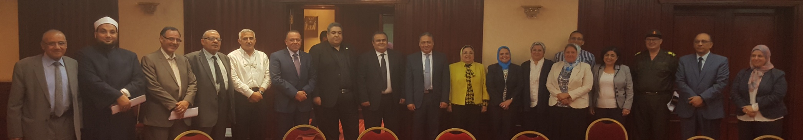
National Research Ethics Committee
Ministry of Health (MOH) National Research Ethics Committee, 24 members,10 permanent members and additional 14 members divided into two committees each committee meets every two weeks in the presence of 17 members. the first National Committee established in 2006.

Slide 6
Egyptian Clinical Trial Review Process
Institutional Scientific Committee
30 Days
Research Ethics Committee
30 Days
Ministry of Health (MOH) National Research Ethics Committee
60 Days
National Organization For Drug Control & Research (NODCAR)
60 Days

Slide 7
Possibility for Alternative Trial Designs in Egypt
Unique study populations and Rare diseases
Need for Individually tailored therapies
Special isolated Environments
Public health urgency & Emergency situations
Restricted resources coupled with an important need

Slide 8
Alternative clinical trial designs are not common practice in Egyptian clinical trials. Only one Adaptive trial for a new drug submitted for review to the Egyptian regulatory authority last year.
Egypt as a developing country is prone to infectious outbreaks or natural disaster thus it will be candidate to alternative clinical trial.
At that time IRBs and regulatory authority must be standby for ethical decisions based on enough scientific and ethical understanding of these new types of trial.

Slide 9
There are no special training or awareness workshop for Egyptian regulatory authority and IRBs especially community members on this topic.
Therefore, a series of 45 min presentation followed by 1 hour of focus group discussions.
These presentations are based on GFBR 2017 Background paper, European Medicines Agency (2007) and Food and Drug Administration (2010) guidelines.

Slide 10
Points Covered in The Presentation
Operational concerns e.g. complexity of adaptive designs , difficult interpretation of results
Recruitment and undue inducements or coercion
Safety concerns for patients in certain adaptive designs e.g. dose-escalation studies
Fair inclusion/exclusion of participants
Safety monitoring
Informed consent process

Slide 11
Points Covered in The Presentation 2
Vulnerable populations with diminished capacity to consent.
Ethical acceptability of a no-treatment control arm?
Identifying who is the research participant.
Role of gatekeepers in protecting group interests / Role of gatekeeper permissions.
Risk/ benefits assessment.
Protection of vulnerable participants.

Slide 12
Discussions will focus on the ethical dilemmas of Alternative clinical trial designs and their suitability to the Egyptian culture and regulations and this programme will be supported by ENREC.
We began with last ENREC meeting and will target the two components of the Egyptian regulatory authority.
ENREC 18th meeting attended by 30 participants include 12 IRBs Chairman or their representative .

Slide 13
Questions
Did you hear about Alternative Trial Designs before? (Majority No)
Can we control Therapeutic misconception in the Alternative Trial Designs? (Majority Yes)
Can we have a high-quality informed consent in the Alternative Trial Designs? (Majority Yes)
Waiver of informed consent is it accepted? (Majority Yes)

Slide 14
Questions
Can we consider a group of the community as a research participant? (Majority Yes)
Is it ethical to intentionally infect healthy volunteers with a pathogen as part of the trial design? (Majority No)
  Can a well-informed participant consent to any amount of risk if the social value of the study is high enough? (Majority No)
  If yes do you treat them as Phase I with a bigger compensation? (Majority No)

Slide 15
Alternative clinical trial designs in Egypt
IRBs members in Egypt still lack knowledge regarding the new designs of clinical trial , this will affect their judgment in the review process .
Alternative clinical trial designs, offer certain practical and logistical advantages in Egypt that can help simplify trial organization and fieldwork in our low resource settings.
Building capacity and promotion of the advantages and drawbacks of new clinical trial design is essential.
Thank You
Notes:
Dear. Professor / Chairman of the Research Ethics Committee
Hope this email finds you well.
According to the central administration's efforts to enhance research environment in the Arab Republic of Egypt to improve the protection of participants in research and based on the Ministerial Decree (No. 595 of 2012) for the registration of research ethics committees in colleges and research institutes and teaching hospitals. The Center Department for Health Research and Development adopted the Self-Assessment tool for research Ethics Committee of the Middle East Research Ethics Initiative (MERETI) and under the umbrella of the Ministry of Health and Population.
This will give the Egyptian RECs the chance to evaluate the quality of their work and give the committees an opportunity to know if there is any shortcoming in their work to try to reform or avoid it in order to ensure the highest degree of protection of participants in research and the Egyptian society.
Therefore, we ask you to complete the self-assessment tool in support of our efforts and to improve the efficiency of the audit systems to ensure good work performance and to strengthen the compatibility between the various committees in the audit systems and mechanisms.
Sincere thanks and appreciation,

