Slide 1

Bonglam Kromah, Physician’s Assistant: Using Convalescent Blood from Ebola Survivors
Prof Godfrey Tangwa and Jennyfer Ambe
Anonymized Case Study
University of Yaoundé
The Global Emerging Pathogens Treatment (GET) Consortium

Slide 2
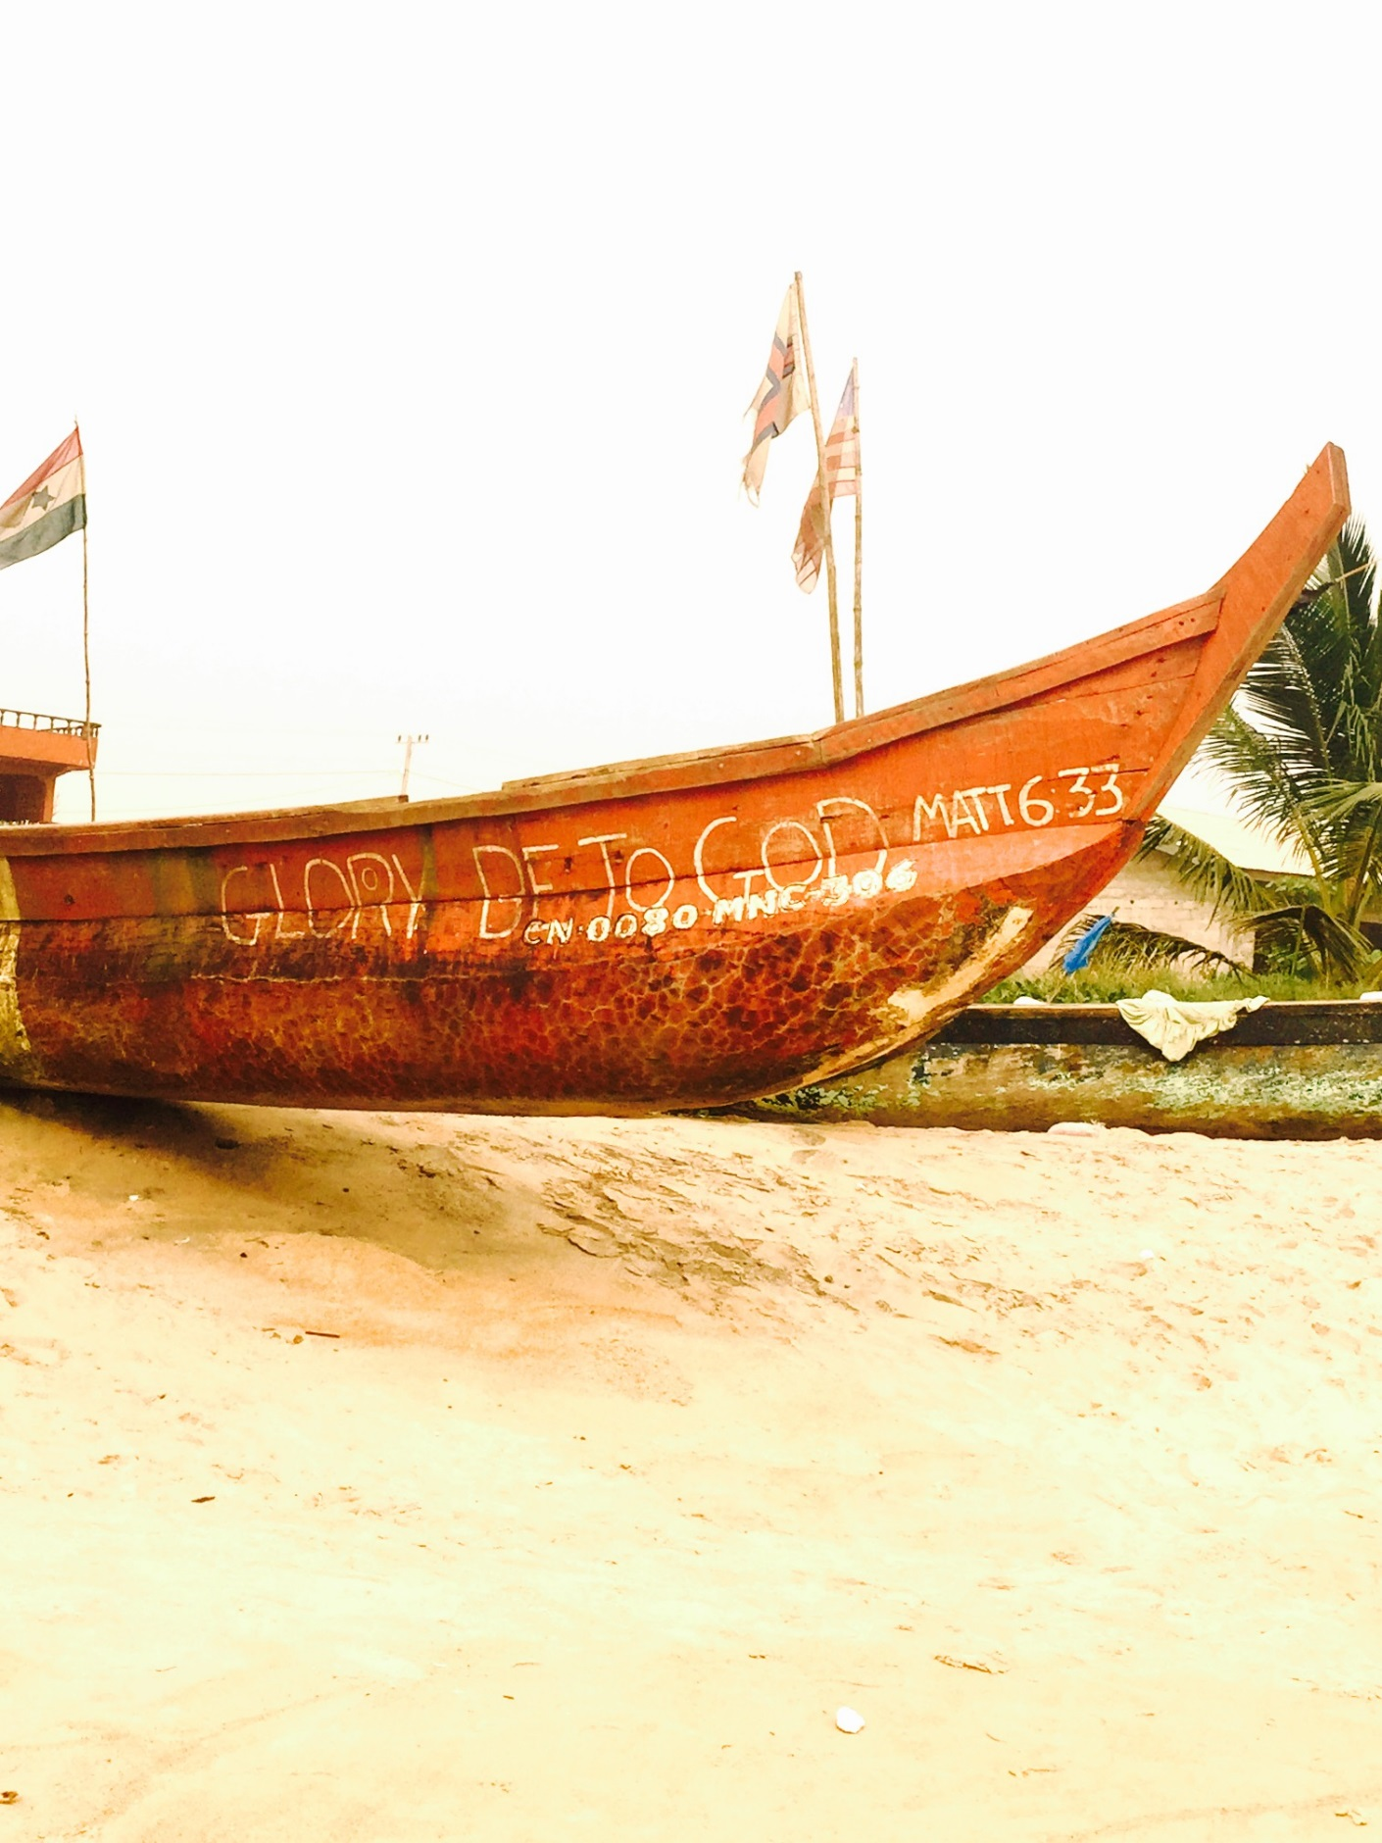
OUTLINE OF PRESENTATION
Overview: anonymized case study
Setting: Background
Bonglam’s story: Events
Questions for discussion
Disclaimer: The pictures used in this slide show are used to enhance the presentation and are NOT actual pictures depicting any specific person or place.

Slide 3

Background: Setting
At the time of the Ebola outbreak in West Africa in 2014, Bonglam Kromah (also known as Bonkro) was working as a doctor’s assistant at the Medvale Hospital in Monrovia, Liberia. He is in his mid 20’s.

Slide 4
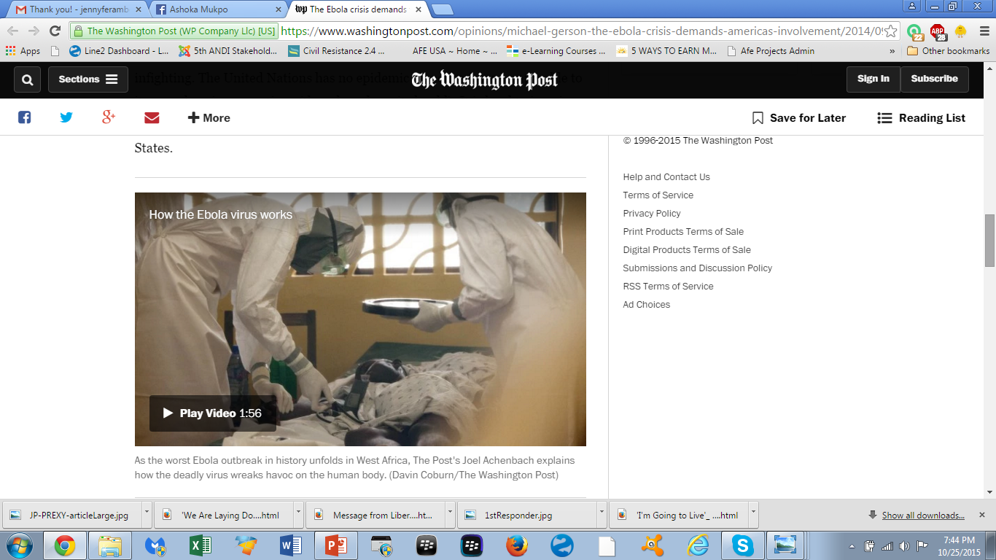
His Story: Colleague Contracts EVD
Bonkro cared for a colleague of his, Nurse 1, she was in her late 20’s and was one of the very first people he knew to come down with Ebola virus disease.

Slide 5
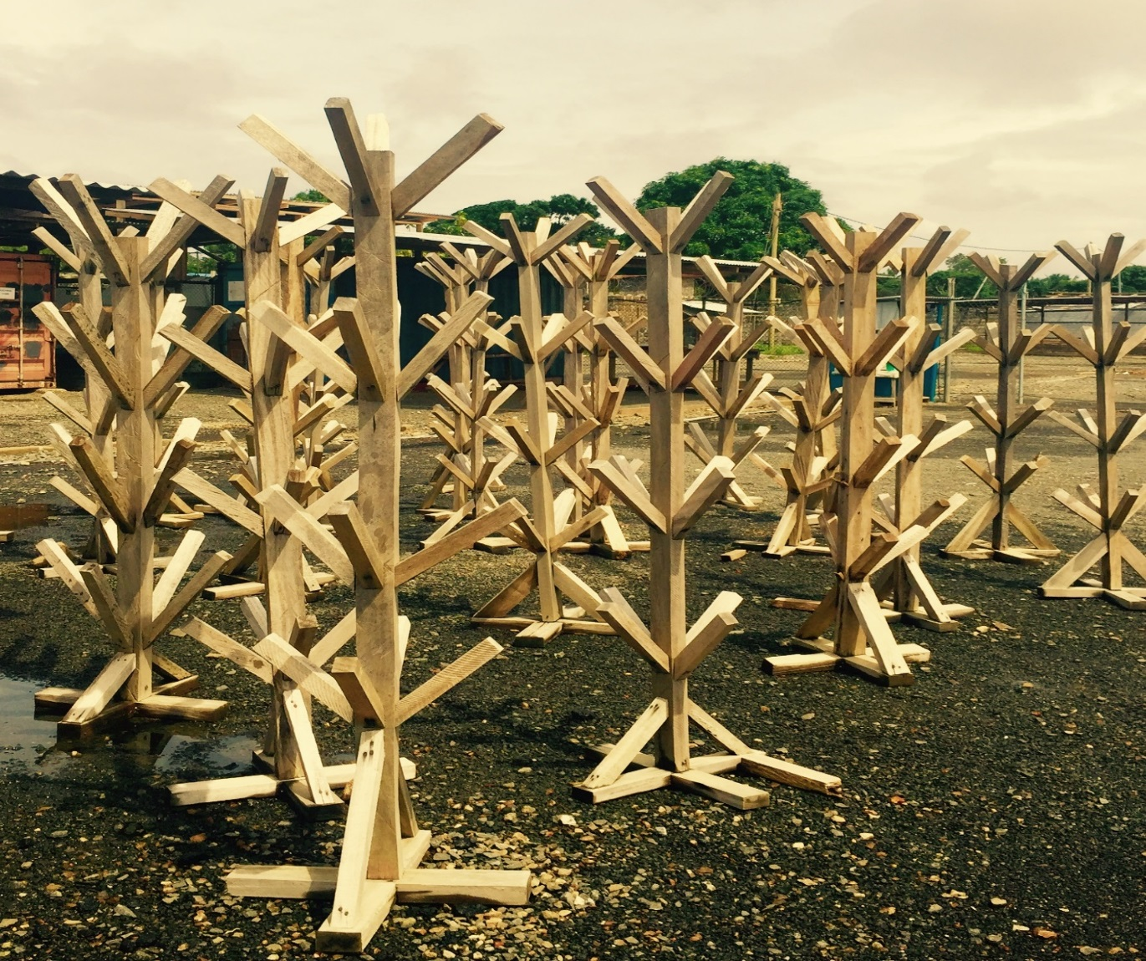
His Story: Doctor Tests Positive
A few days after Nurse 1 fell ill, one of the doctors in the hospital who had treated her, tested positive for EVD.

Slide 6
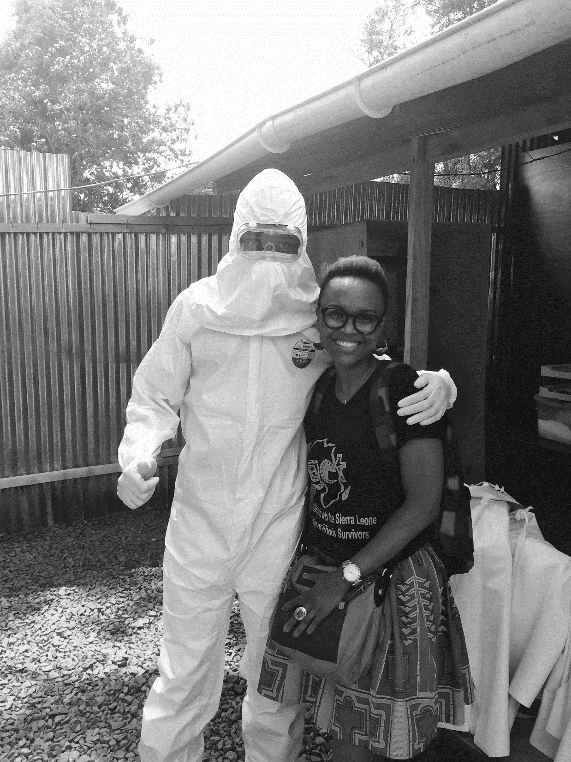
Doctor Tests Positive
The doctor was taken to an emergency treatment unit, at Sunydale Hospital, about five kilometers away from the Medvale Hospital.

Slide 7
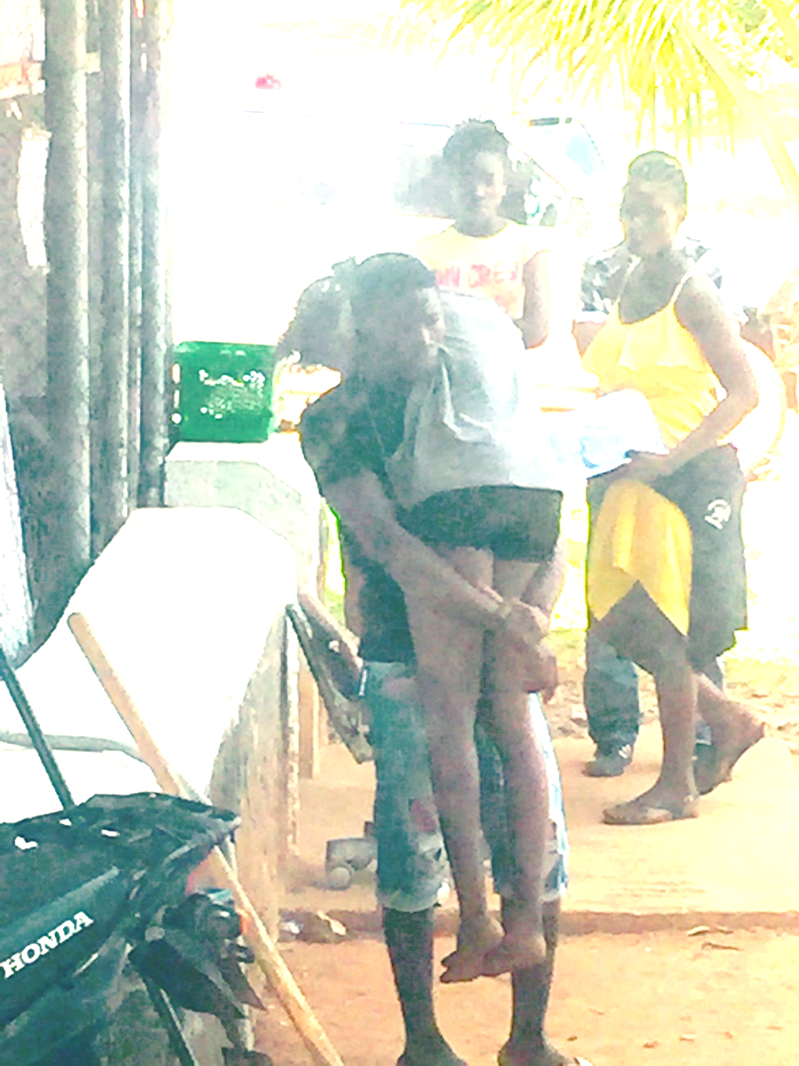
Doctor joined by a nurse from his team
a few days later the doctor was joined by one of his nurses
Let’s call her Nurse 2
Sadly the doctor died about a week after admission
After 2 weeks of care by Bonkro, Nurse 1 passed away.
However, Nurse 2 survived

Slide 8
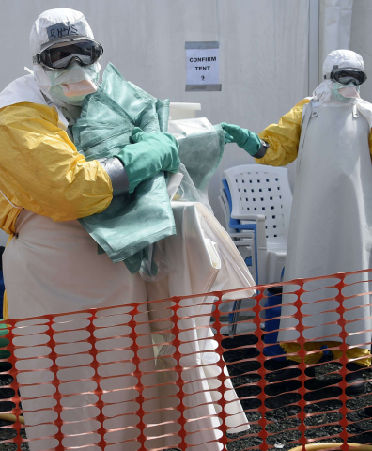
Dilemmas
Although the Sunydale ETU was theoretically one of the best places to send suspected cases of EVD, it created many dilemmas at the practical level.
Outlined are scenarios of dilemmas that actually occurred

Slide 9
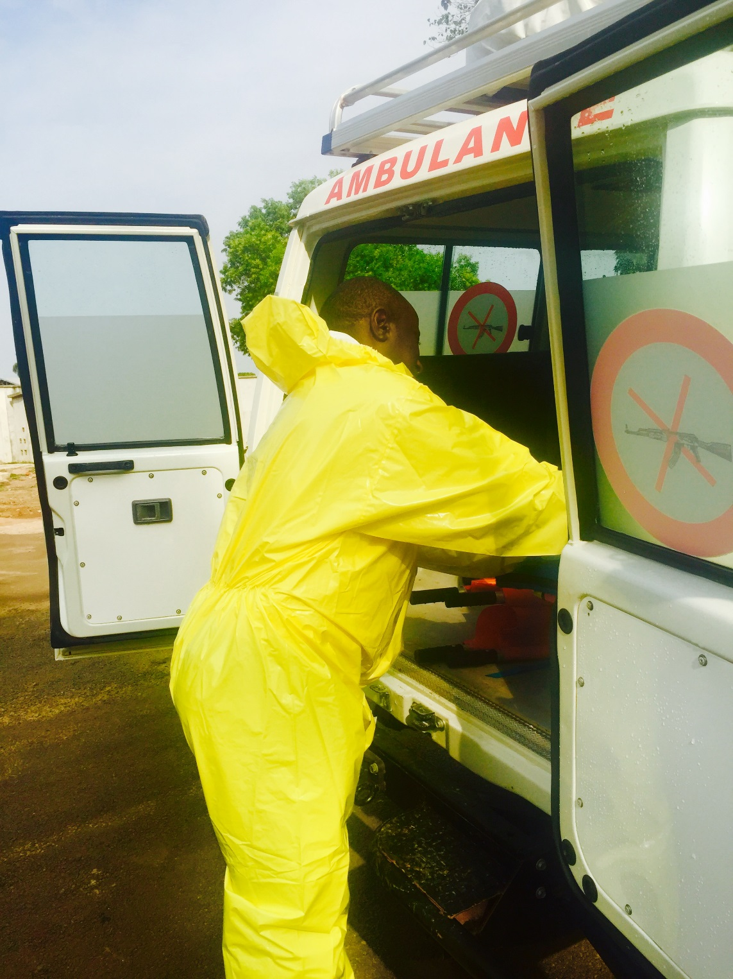
Dilemma: Case of Woman with sick husband (1)
There was, for instance, the case of a mother of three young children whose husband showed signs of fever on the day the ETU ambulance came to their village, an hour’s drive away, to pick up a confirmed case of EVD.

Slide 10
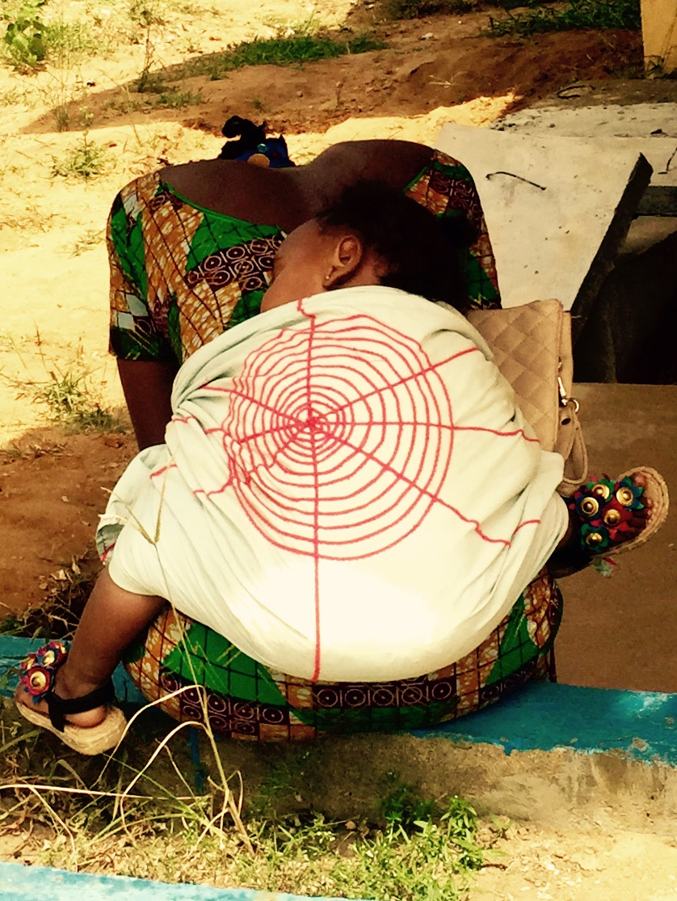
Dilemma: Woman (2)
What was the woman supposed to do? Should she beg the ambulance to take along her husband with all the risk involved in case his fever had a cause other than EVD? Alternatively, how was she to walk to the ETU with a sick husband and three young children?

Slide 11
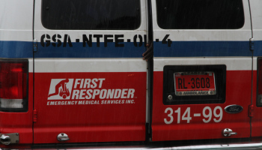
Dilemma: Ambulance Drivers (1)
Ambulance drivers faced some of the most difficult situations. At first they were counseled to avoid all physical contact with members of their family and later to avoid going home altogether.

Slide 12
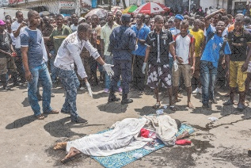
Dilemma: Ambulance Drivers (2)
They would pick up patients but not find available beds.
Should they abandon the patient at the next hospital (on the ground) or take the patient back home to die under the care of family members with all the risks involved?

Slide 13
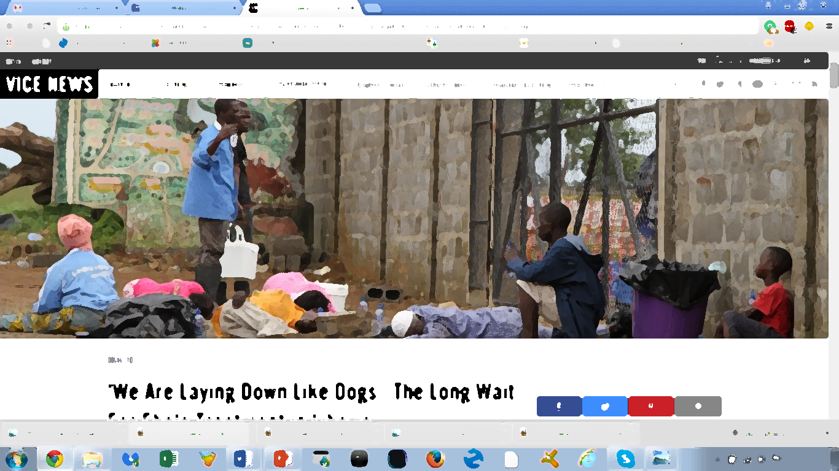
Dilemma: Families
Families also grappled with this as well. One of worst scenarios was of family members taking suspected case of EVD from hospital to hospital without finding a bed.

Slide 14
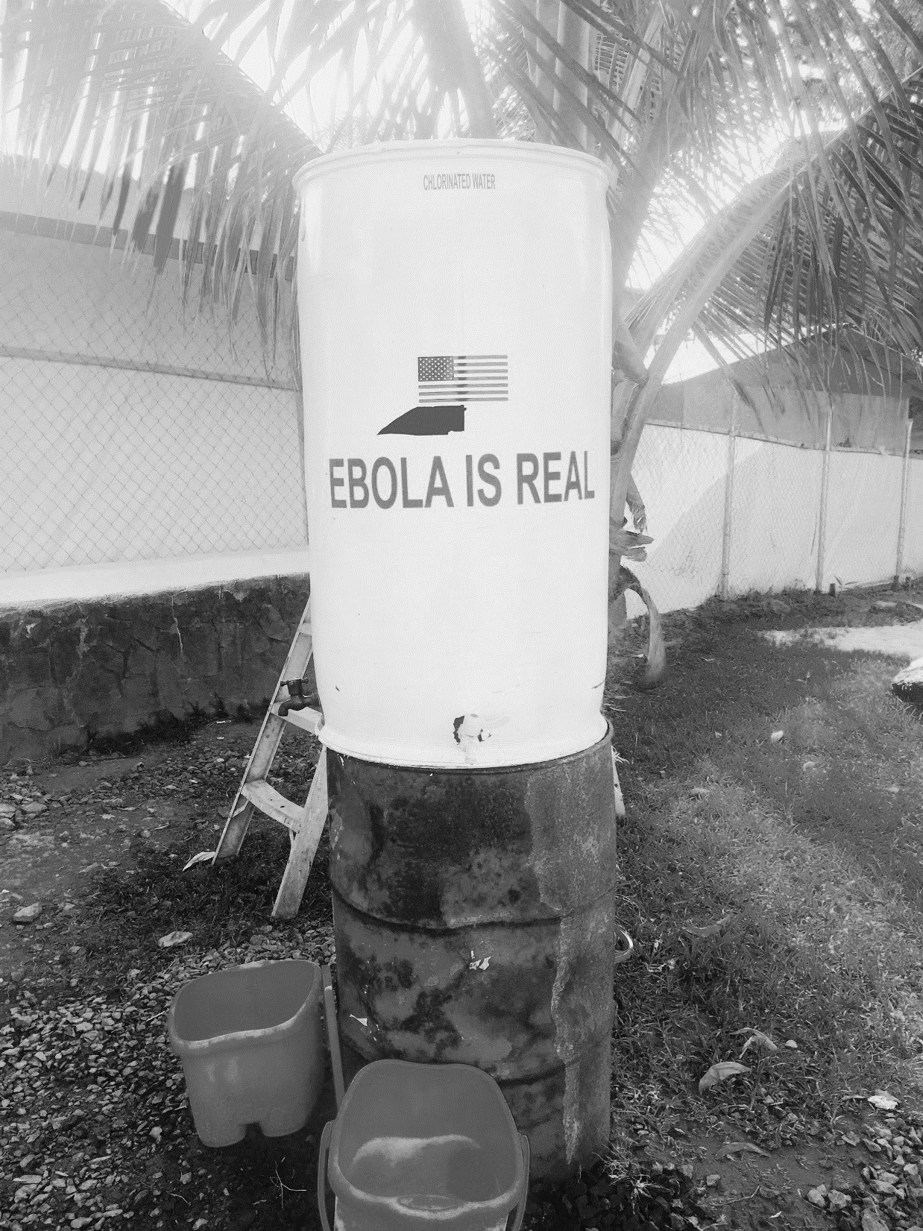
His Story
Bonkro started to feel ill and became terrified as it dawned on him that he had worked closely with sick people at Medvale Hospital.
He was admitted to Sunyvale ETU, the place where it appeared that no one came out alive!

Slide 15
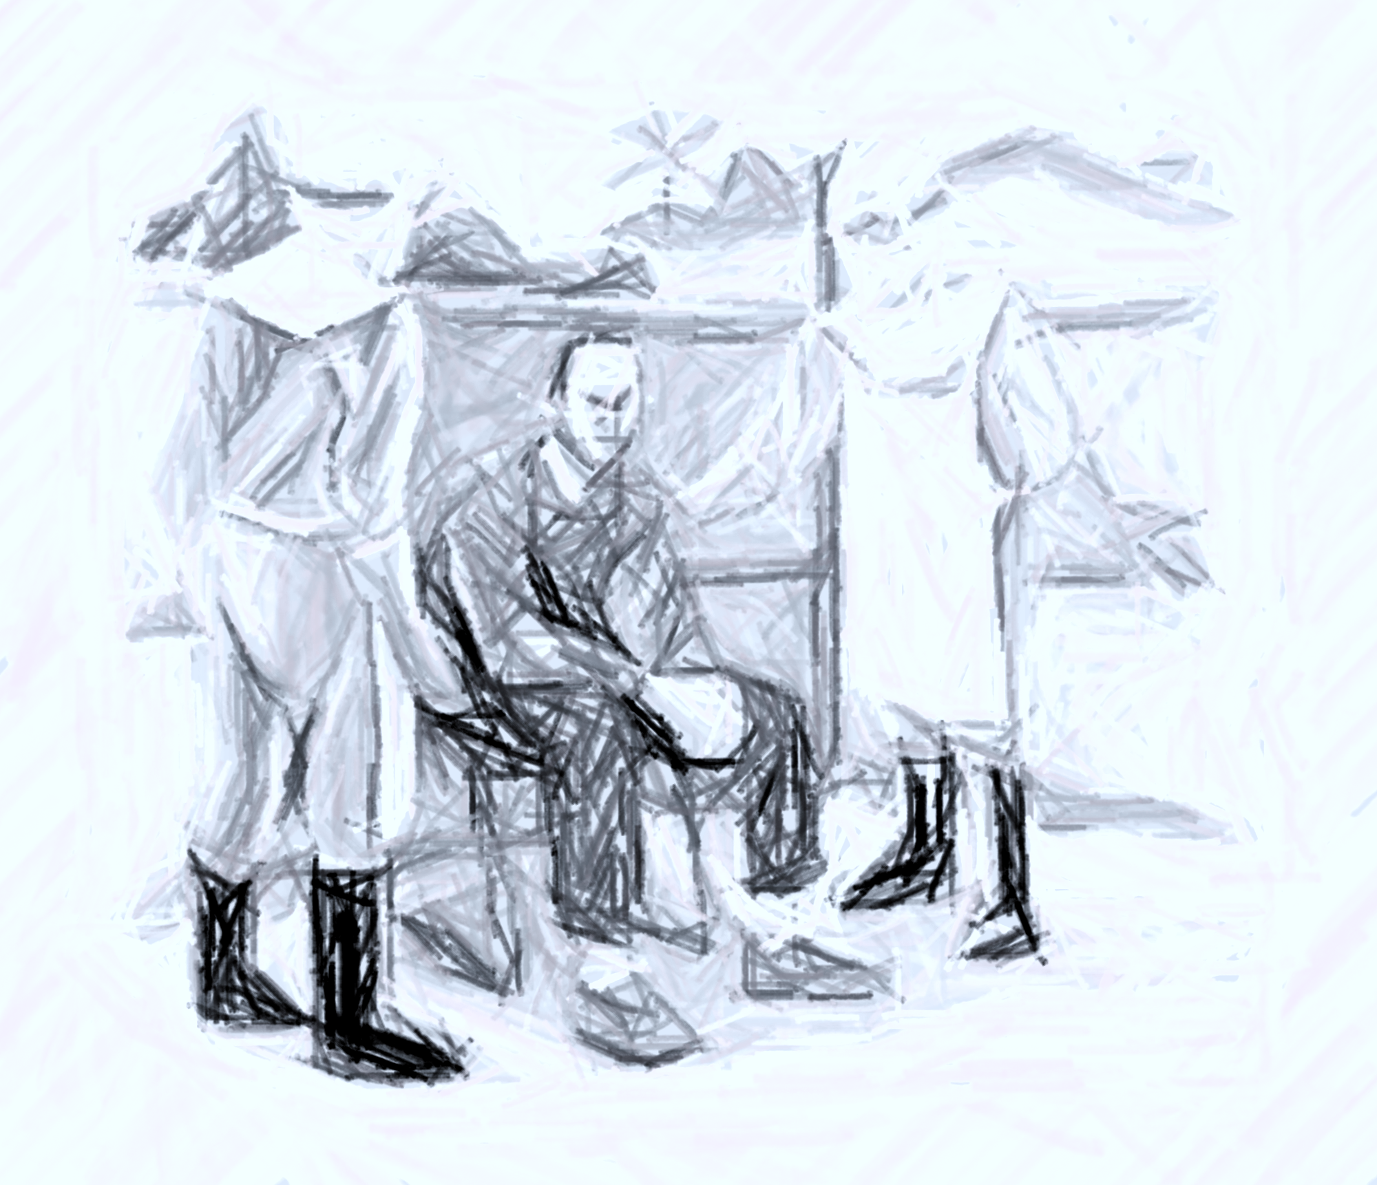
His Story
Bonkro does not remember when he was tested for EVD, but he woke up on June 28, 2014, to see two people dressed in that frightful Personal Protective Equipment (PPE) looking down and peering at him.

Slide 16
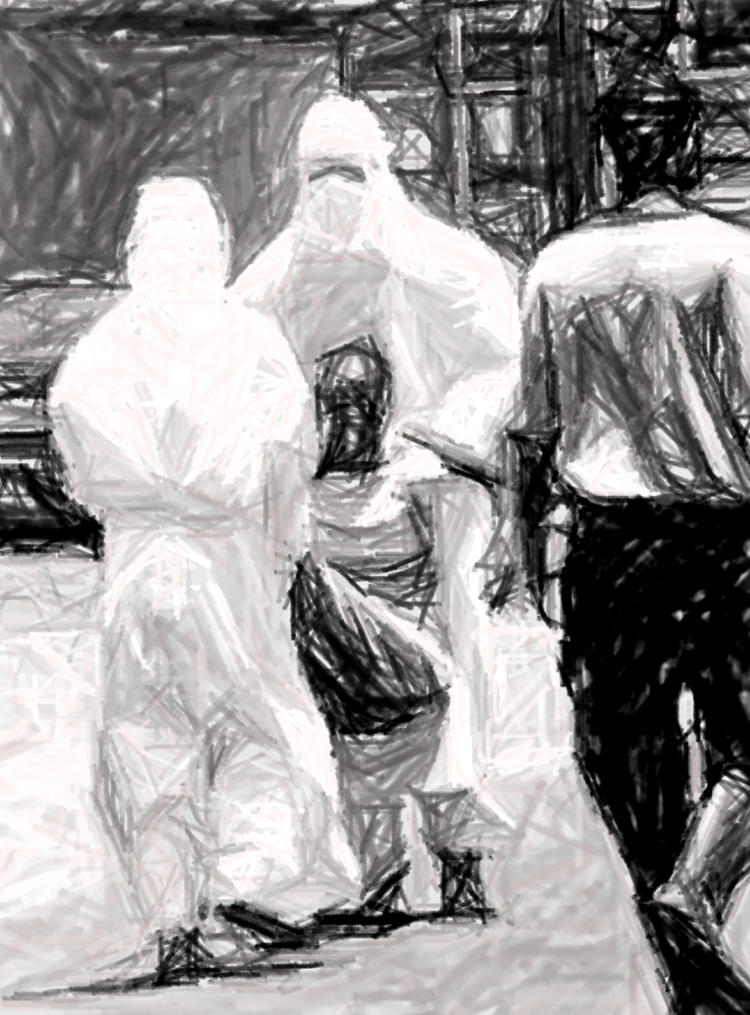
His Story
Nurse 3, from Medvale joined Bonkro at the Sunydale ETU.
Upon hearing that she tested positive, Nurse 3 became hysterical.
She attacked Bonkro who was too weak to fend her off.
Both of them, however, were to survive the infection
Nurse 3 remains emotionally unstable.

Slide 17
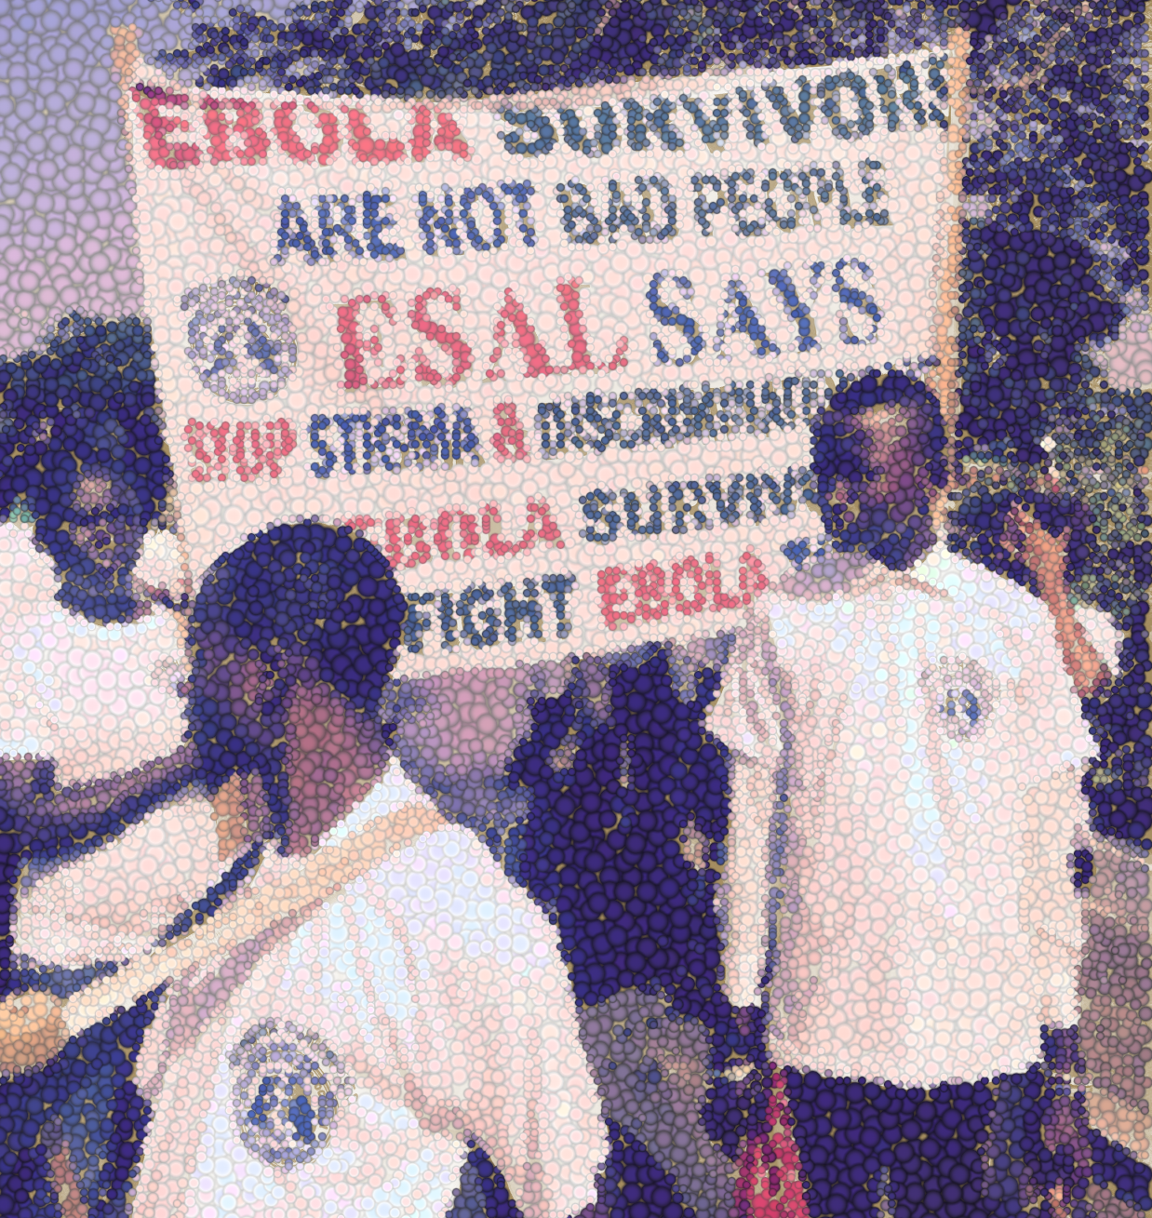
His Story: Ebola free on July 16, 2014
Discharged from the Sunydale ETU, Bonkro made his way home. He noticed, people turned away from him. Some acted as if he was a ghost. He had been pronounced dead at least twice just days before. Bonkro was confused and saddened.

Slide 18
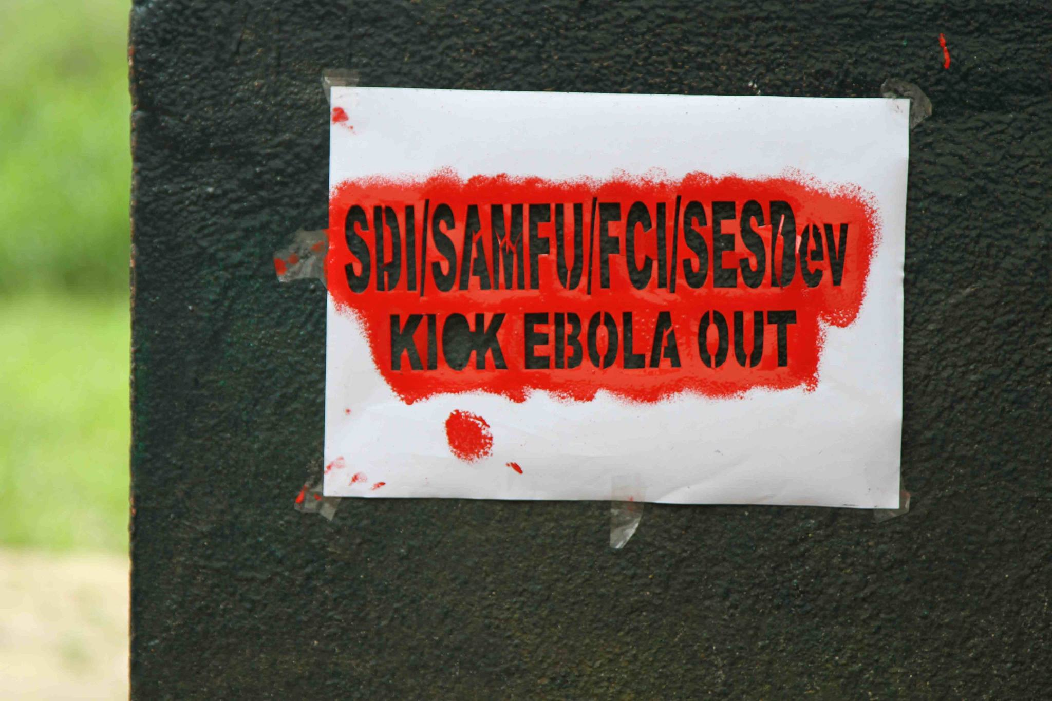
After the ETU: Physical and Mental Pains
For days, Bonkro was unable to sleep. He felt mental anguish & physical pain. He would close his eyes and become transported back to the ETU. “Am I really alive?” he would ask. He found out that while he was in the ETU, his death was, falsely announced at least twice.

Slide 19
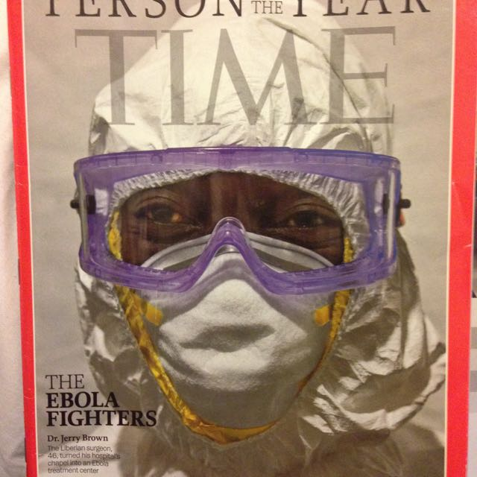
After the ETU: Researchers
A team of researchers approached Bonkro and asked him to donate blood.
They told Bonkro, he was now immune to further infection and his blood might now act like a “medicine” for those still suffering from the disease,
Bonkro started to think about how he could help his country and those still suffering from the EVD infection
Here ends the story of Bonkro for this presentation.

Slide 20
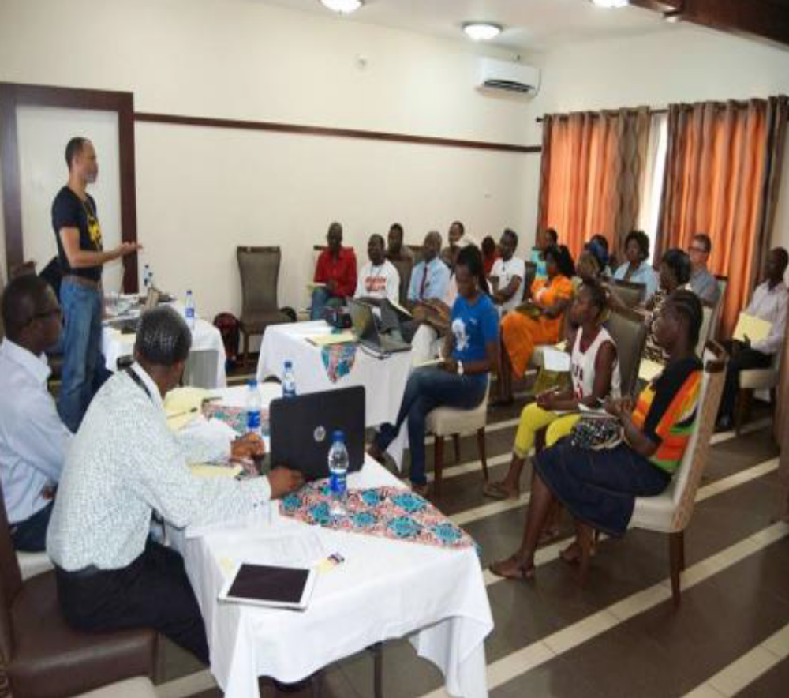
Community Engagement: Building Trust
Community Engagement
During involvement in research, survivors were informed of the risks and benefits involved in convalescent blood trials;
Social Value: Community Oriented Activities
starting small income generating activities to establish new sources for earning a living
www.getafrica.org
Session with survivors in West Africa, Feb. 2015

Slide 21
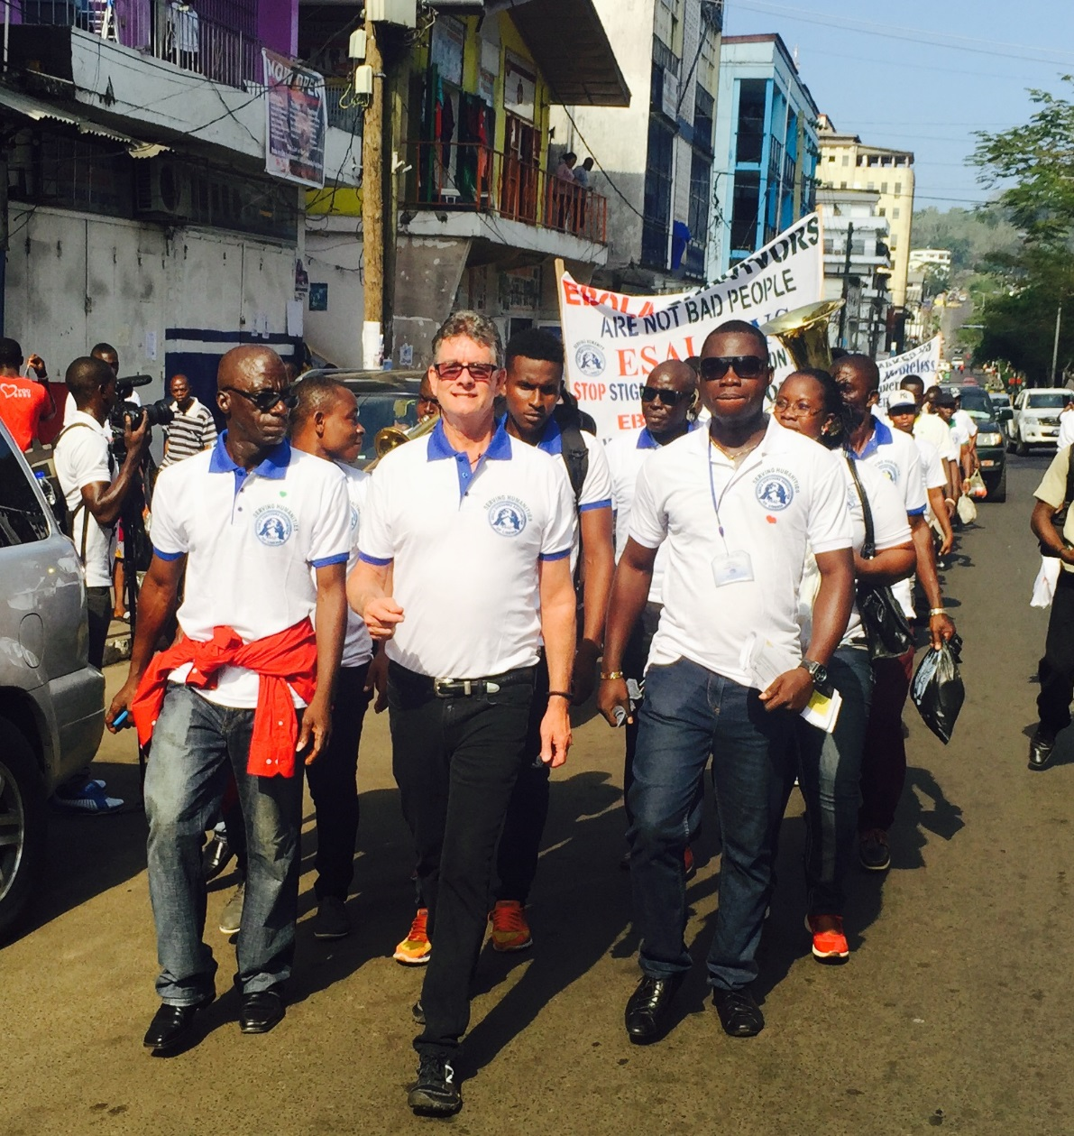
Community Engagement
mobilizing other survivors to campaign against individual and community discrimination and stigma
Forming networks of survivors to educate and empower other survivors on how to become champions in the fight against EVD
ESAL, Monrovia Liberia

Slide 22
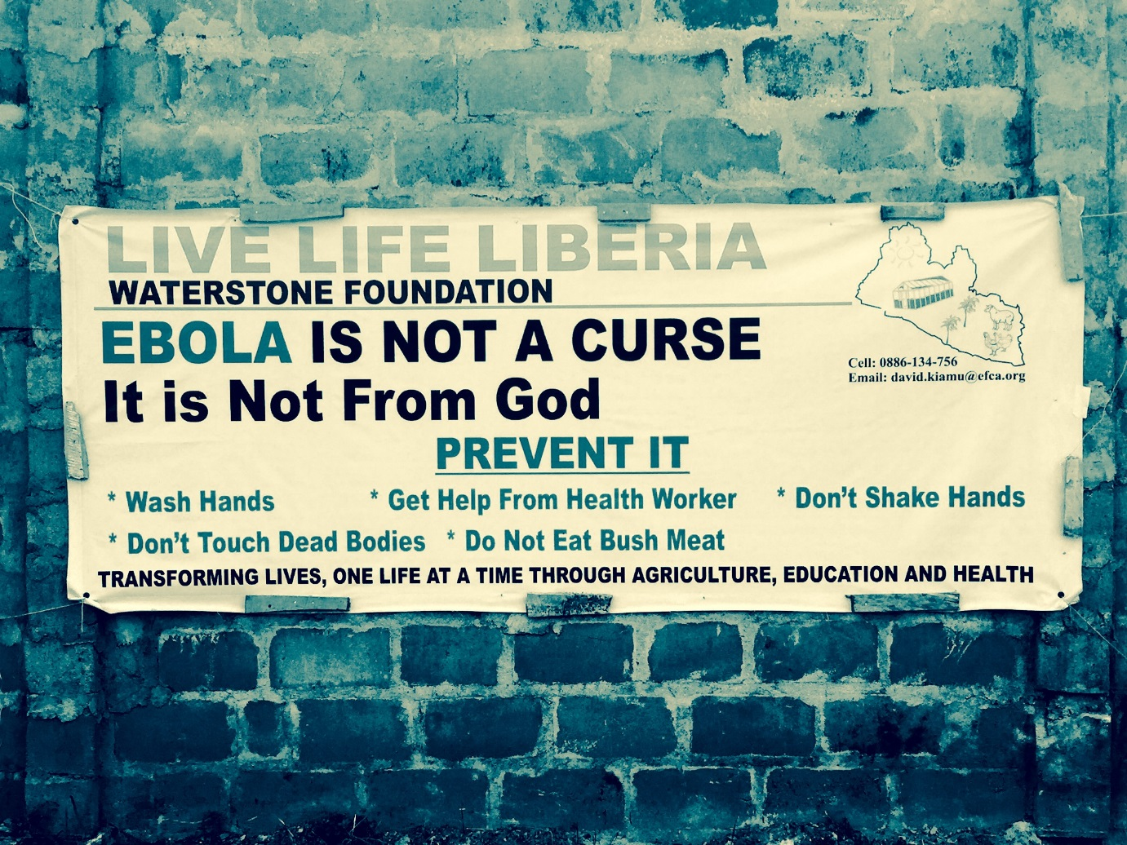
What is the Summary of Ethical Challenges Presented in this Case Study?

Slide 23
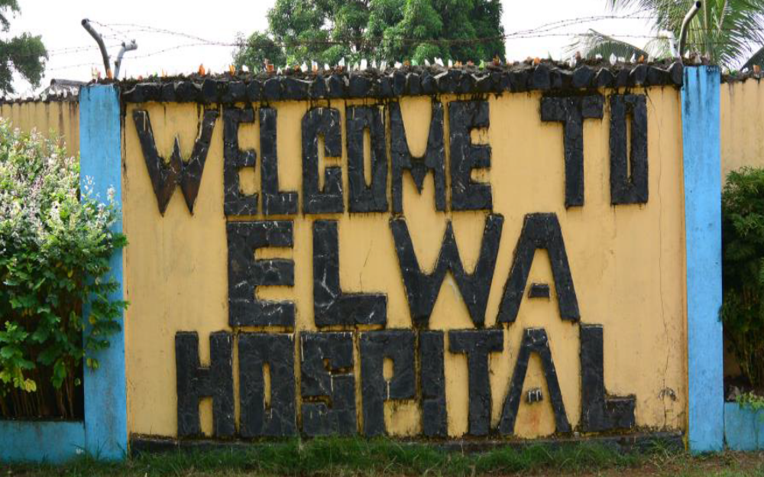
Key Questions
Could Bonkro be asked to donate blood in an attempt to save the life of an EVD patient?
Monrovia, Liberia
Clinical Trails - Convalescent plasma 2014/15

Slide 24
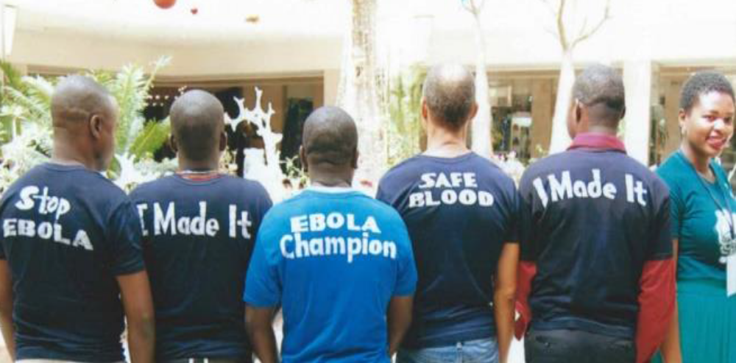
Key questions
Under these conditions, could he ethically be recruited into a clinical study?
Members of he GET Consortium Team

Slide 25
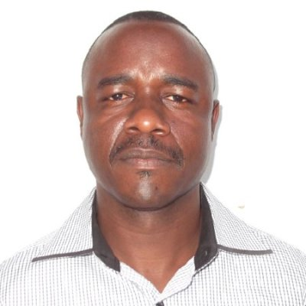
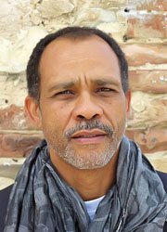
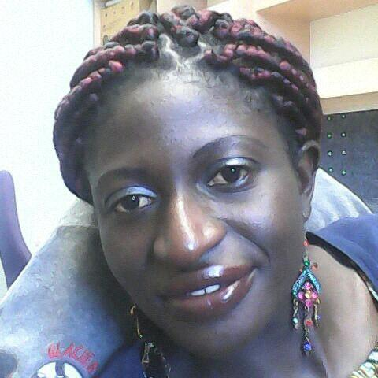
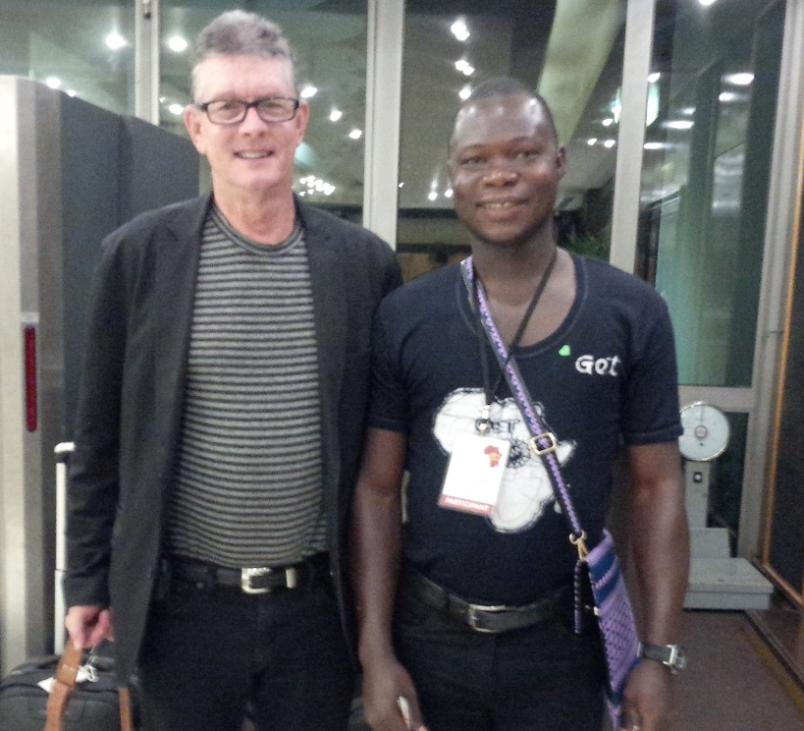
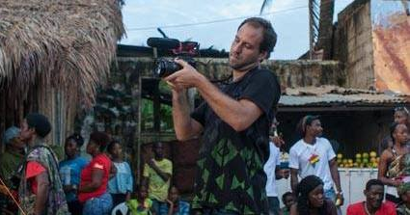
Acknowledgements:
Francis Kombe
Syntia Nachangwi
Akin Abayomi
Photo Credits: John Strader (L) and Korlia Bonarwolo (R) Ebola Survivors Association of Liberia (ESAL)
Photo Credits: Ashoka Mukpo, survivor & photo journalist

