Slide 1
Ebola phase 1 vaccine trial
A case study of ‘best practices’ in community engagement
Ms Maureen Njue
Dr Patricia Njuguna
KEMRI Wellcome Trust Research Programme, Kenya.

Slide 2
Outline
KEMRI-Wellcome Trust, Kilifi
KEMRI’s Community Engagement Programme
The Phase 1 Ebola trial in Kenya
  Study Specific Community Engagement plan
  Issues arising from various stakeholders
  Reflections

Slide 3
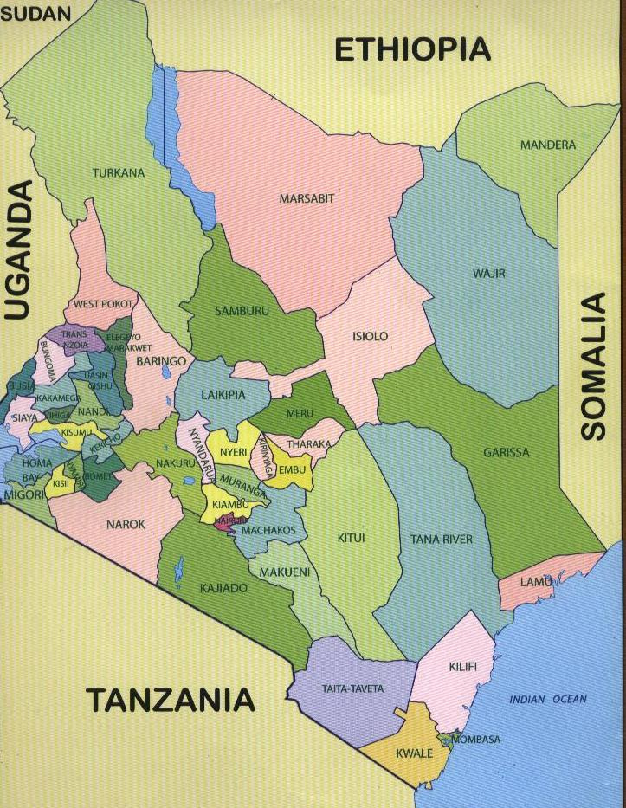
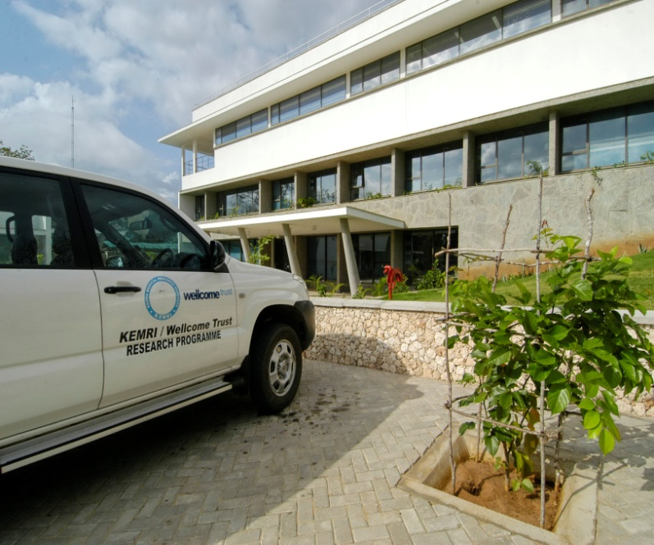
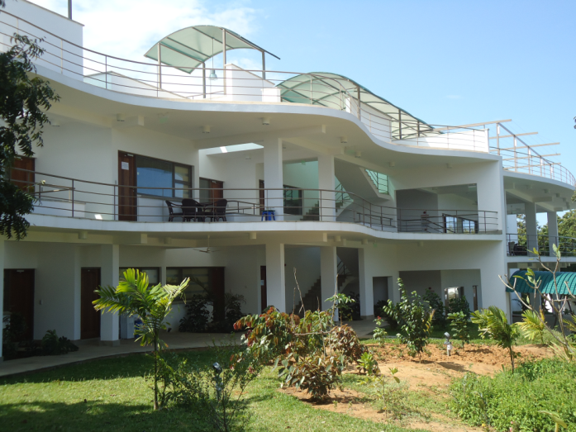
KEMRI/Wellcome Trust, Kilifi
KEMRI/WT, Kilifi - one of the 12 centers of the Kenya Medical Research Institute (KEMRI)
Collaborative site between KEMRI, Oxford University and the Wellcome Trust, UK
In operation in Kilifi for over 25 years; 16 DSS locations; Kilifi Hospital; Peripheral facilities
Kilifi and Nairobi sites; Nearly 800 staff
Many international collaborations; main funder – Wellcome Trust, UK

Slide 4
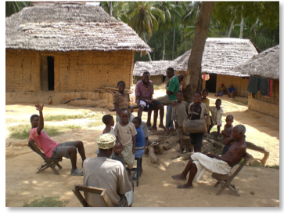
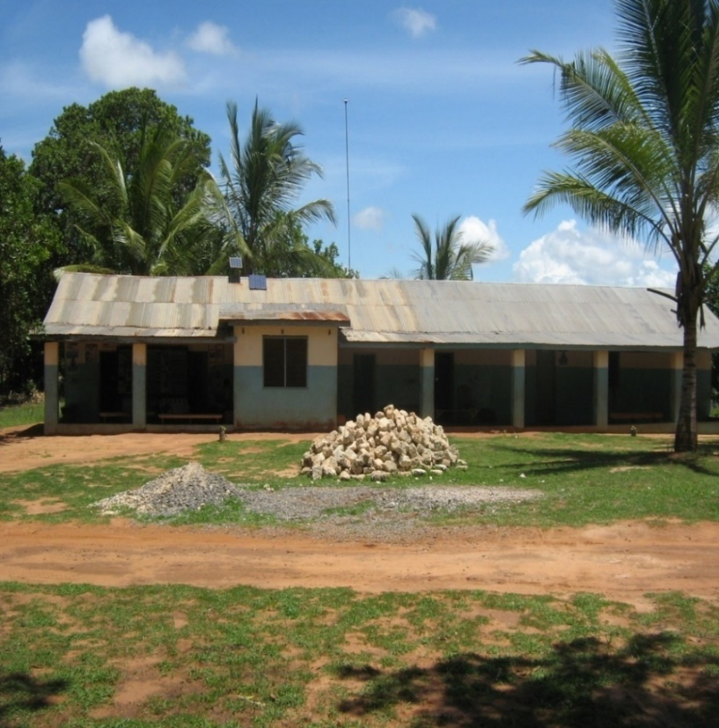
Kilifi Context
High poverty rates; low literacy levels
High morbidity and mortality rates
Public health facilities constrained
Differing norms, values, technological info
Differences in resources and power

Slide 5
Goals of KWTRP’s Community Engagement
Building mutual understanding with communities
Enhancing ethical aspects of research
Providing feedback on research findings

Slide 6
Community Engagement Strategies at KWTRP
Programme-wide CE
Focuses on the KHDSS area (16 locations)
KCR Network (222 Community Members)
Community Outreaches
Open Days for opinion leaders (chiefs, village elders, CBO chairs)
School Engagement
Study Specific CE
CE template developed for study teams
Communication language and ICF translation
CLG & Study teams meetings
CAST (Community Advice for Study Specific Teams)
Community Liaison Group (CLG)

Slide 7
Who do we engage?
Engage
KHDSS Community
KWTRP Staff
Stakeholders
Researchers
Research Participants
KCR Network
Open Days
Schools
Outreach activities
Review-research proposals
Interface Staff training

Slide 8
The Ebola Vaccine Trial in Kilifi, Kenya

Slide 9
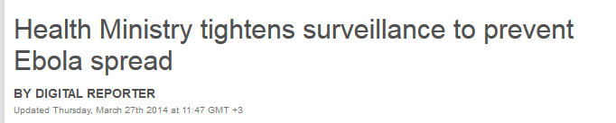
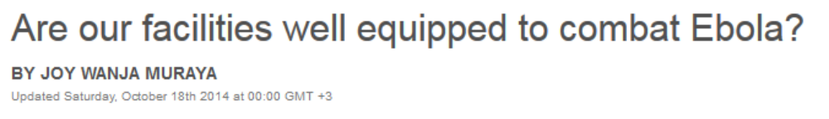
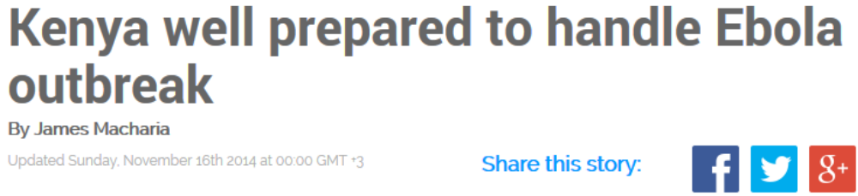
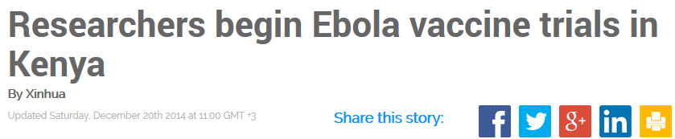
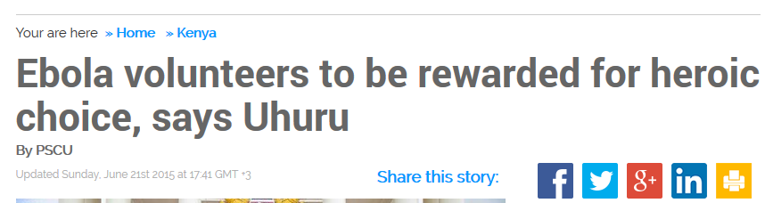

Notes:
Amid the background of such media in Kenya we began the study

Slide 10
The Clinical Trials Facility, 2006
"To be a centre of regional excellence in the conduct of clinical trials and research training“
Key studies
iPrep phase 1
Cotrimoxazole
RTSS phase 2 and 3
PRISM (Synflorix)
AQUAMAT
FEAST
REALITY
Study managers
Regulatory
Quality assurance
Monitoring
Data management

Slide 11
A Phase 1 Ebola trial in Kenya
Part of the ZEBOV consortium
Enrolled 40 participants
Study design: Phase 1, Open-Label, Dose-Escalation Study to Evaluate the Safety and Immunogenicity of the (VSVΔG-ZEBOV) Ebola Virus Vaccine Candidate in Healthy Adult Volunteers
Registered NCT02296983,
Study population was health associated workers
Single dose vaccination
Follow-up was 12 months from vaccination
http://www.wellcome.ac.uk//News/Media-office/Press-releases/2014/WTP057790.htm
Notes:
The study was part of a consortium funded by the WT, ZEBOV. It includes the Geneva, Gabon, Germany sites with WHO oversight. Approvals were 18th November and 8th December 2014 for IRB and regulatory. There are other Ebola vaccines under investigation: cAd3
-
EBO, Ad26.ZEBOV/MVA
-
BN
-
Filo,

Slide 12
Why did we do this?
Primary objective
To evaluate the safety and tolerability of two doses of a candidate ebola vaccine
Why engage the community and stakeholders?
Share the study aims, rationale and what it entails
Get feedback on the study processes
Get feedback on the acceptability of the study
Notes:
The doses are 3X10(^6) and 2 X10(^7). Other doses, higher and lower were tested at other sites.

Slide 13
Outcome of the engagement planning meeting
Identified various stakeholders
Identified the approaches to engage various stakeholders
Developed key messages for the different audiences
Developed a frequently asked questions and answer script for consistency
Notes:
What does CAST mean ?

Slide 14
Who we engaged:
National level – Office of President, Ministry of Health , ERC, IRB, Media
correspondence, interviews, press briefs
Briefing meetings, Adhoc briefs
Seminars
Info giving
Consent sessions
County Level– Health management committees, Community advisors and Local administrators
Individual level – Health associated staff; potential participants

Slide 15
Issues arising from stakeholders
Engagement
Individuals
Site selection – why Kilifi?
Population included
Safety issues
Compliance issues
Perceived stigma and disclosure associated with participation
Higher levels of compensation
Safety issues
The study procedures
The study vaccine
Ebola the disease
Tests and samples collected
Notes:
They did not vary between groups but safety was more prominent to those who chose to enrol than those just interested to hear about it or being informed.

Slide 16
Reflecting on the ‘best practices’ in CE
Achieved the target numbers for the trial
Minimized rumours/misconceptions re the trial through continuous communication; PI and study team active interaction with participants
Continuous engagement of stakeholders during study; provided updates on any new developments
We had ‘political’ support due to the context in which the study was introduced (right from the President, Minister, our Directors, staff etc)
Early involvement of the media – identified individuals who would engage with the media; how to address any crisis that may arise in the study
?KEY
Important to constantly review engagement strategies for different types of studies; adapt to varying circumstances

Slide 17

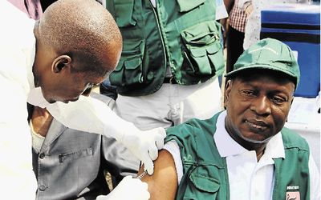
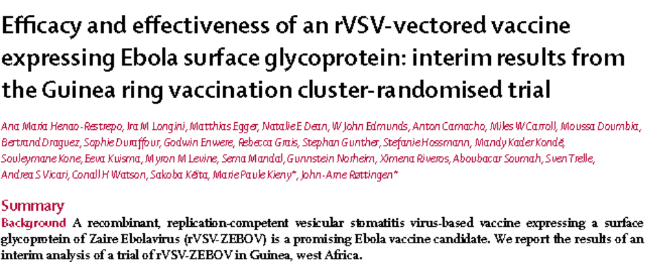
Where are we now
Head of the Guinean Ebola Response
Co-ordination Dr Sakoba Seita receives
a vaccination at a health centre in Conakry,
Guinea, during the first clinical trials of the
VSV-EBOV vaccine against the Ebola virus.
Notes:
A phase 2/3 trial with plans to vaccinate 10,000 people in 190 rings, with those vaccinated followed up for three months. The trial is voluntary.
No cases in Liberia since July 2015. Still cases and deaths reported in Guinea and Sierra Leone.

Slide 18
Acknowledgements
GFBR organisers and sponsors
Ebola CAST members : Noni Mumba , Salim Mwalukore, Dorcas Kamuya, Cynthia Mauncho, Francis Kombe, Barbara Mambo, Caroline Ogwang, Philip Bejon.
Our KEMRI ERC and Kenya regulator for a thorough and expedited review
Sassy Molyneux
Cynthia Mauncho

