Slide 1


Adaptive Trial Design
GFBR
Annecy, 3-4 Nov 2015
Piero Olliaro
UNICEF/UNDP/World Bank/WHO Special Programme on Research & Training in Tropical Diseases (TDR)
Centre for Tropical Medicine, Nuffield Department of Medicine
University of Oxford
Peter Horby (U Oxford)
John Whitehead (U Lancaster)

Slide 2
Possible clinical studies…
Desired goal?
Best individual chance of survival
'Compassionate use'?
Best chance of identifying a useful intervention
Multi-stage trial?
Best point estimate of efficacy
RCT?

Slide 3
FACILITIES: FEW, OVERWHELMED
FEW CANDIDATES
HIGH FATALITY = SAVE LIVES NOW (BUILD EVIDENCE)
FACILITIES: MANY, DWINDLING, DILUTED CASES
SELECTED CANDIDATES
BUILD EVIDENCE, SAVE LIVES

Slide 4
Therapeutics proposed at the start of the outbreak
Interferons
Vulture Gastric Fluid
Monoclonal antibodies
Brincidofovir
Chamomile Tea
Ayurvedic Oils
Micronutrients
HIV therapy: Lamivudine
Crystals
Vitamins
Anti-influenza: favipiravir
Anti-malarials
Magnets
Bath salts
Si-RNA
Electromagnetic Waves
Convalescent blood/plasma
Root Extracts

Slide 5
WHO STAC EE
COORDINATION, PRIORITISATION
TIMELY SHARING OF INFORMATION (!?)
Interferons
Vulture Gastric Fluid
Monoclonal antibodies
Brincidofovir
Chamomile Tea
Ayurvedic Oils
Micronutrients
HIV therapy: Lamivudine
Crystals
Vitamins
Anti-influenza: favipiravir
Anti-malarials
Magnets
Bath salts
Si-RNA
Electromagnetic Waves
Convalescent blood/plasma
Root Extracts

Slide 6
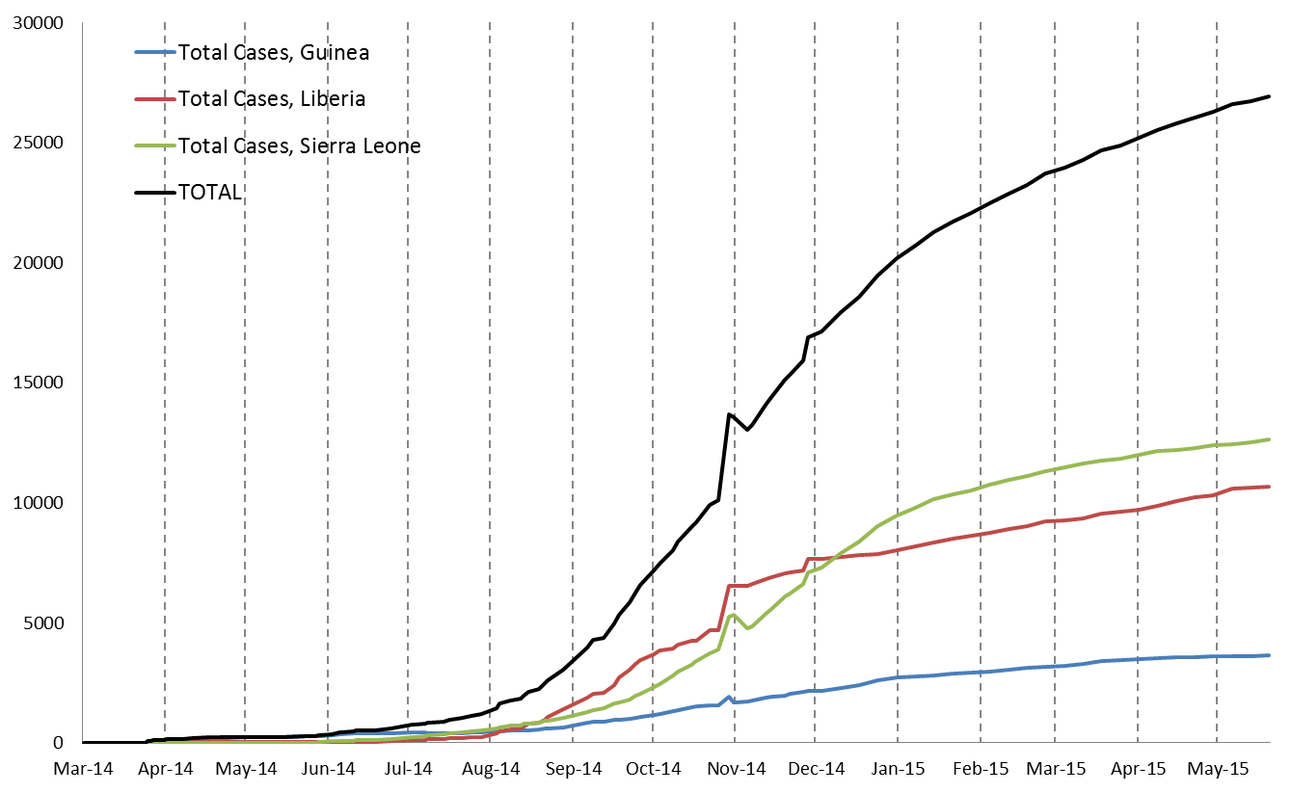
EVD Treatment Trials
Experimental evidence
+ Product available
Favipiravir
Brincidofovir
TKM
TKM
zMAPP
Trial starts
Brincidofovir
zMAPP
Favipiravir

Slide 7
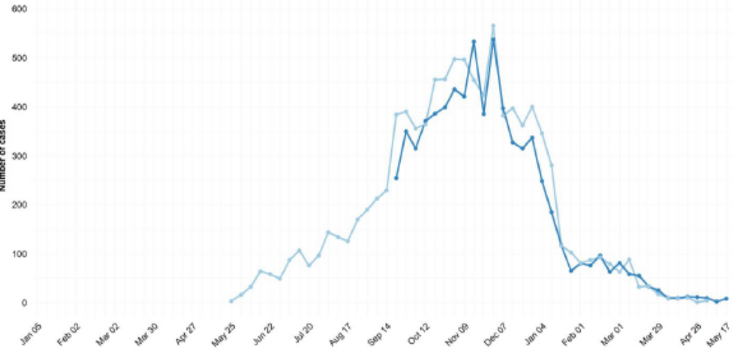
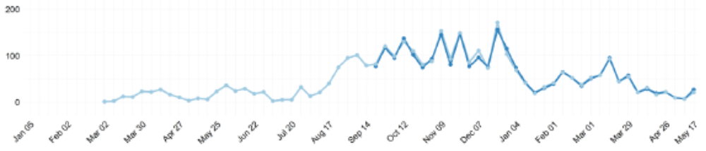
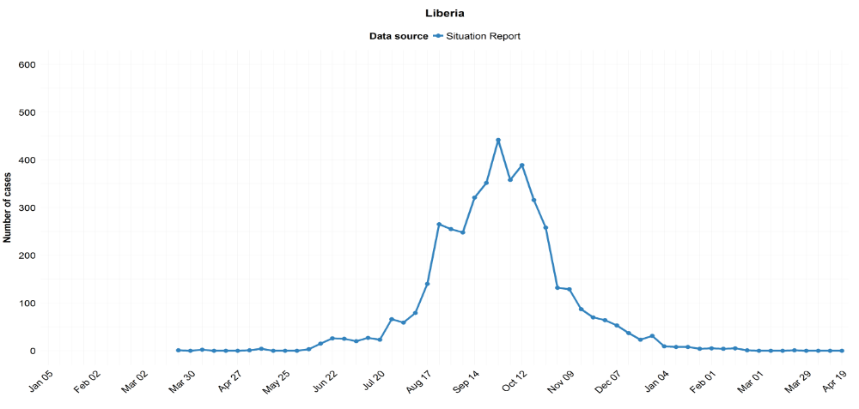
Convalescent plasma, Natl
SIERRA
LEONE
TKM
zMAPP
Favipiravir
GUINEA
Convalescent plasma
LIBERIA
Brincidofovir
zMAPP

Slide 8
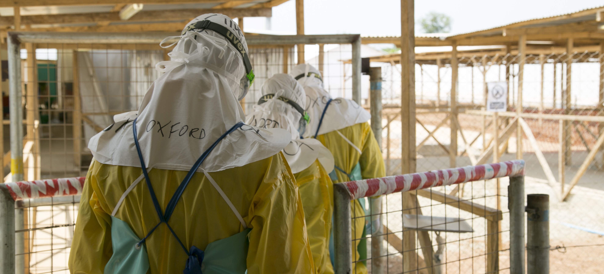
Challenges of generating evidence in epidemics

Slide 9
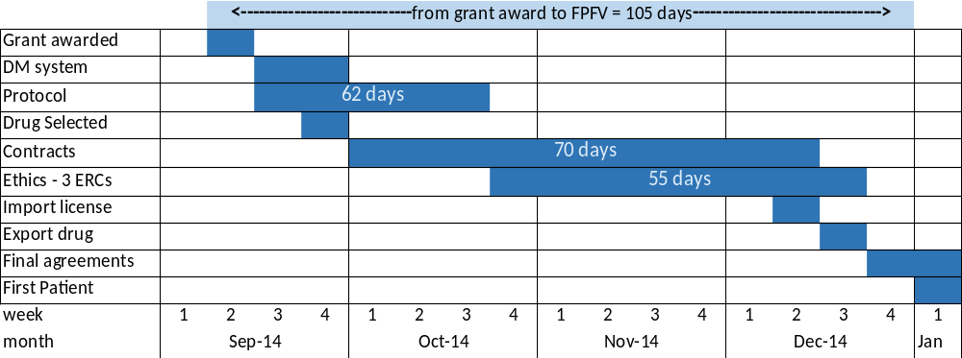
Trials can be set up quickly
FROM 1ST PROTOCOL DRAFT TO 1ST PATIENT 1ST VISIT:
BRINCIDOFOVIR = 12 WEEKS
TKM = 9 WEEKS

Slide 10
Clinical trials:
What is special about EVD?
Little is known about how effective treatments are
Clinical research ('phase 2 – 3') into treatments can only be conducted during an outbreak
Urgency to provide answers while the outbreak lasts and in time to influence treatment during the outbreak
Treatment facilities likely to be simple & overstretched
EVD can be deadly to health workers
Patients will be treated in close proximity to one another

Slide 11
Clinical trials:
General considerations
Our question should be: “What treatment is best for EVD?” - not: “Does this specific treatment work?”
Simple endpoints, such as “Alive on Day 14”
Placebo treatment and blinding will often be impractical &/or unethical
Adaptive designs are both possible and essential
Large treatment effects (odds ratios of 2) should be sought

Slide 12
Programme objectives
Primary: Rapidly assess and triage a number of potential Ebola treatments in Phase 2 studies.
Secondary:
find persuasive evidence that one or more treatments should be recommended for general use;
provide GCP-compliant data to support registration
 | Survival | Conclusion | Outcome
(a) | 80% | Very effective | Maximize benefits
(b) | 67% | Promising | Justification for RCT
(c) | 50% | Ineffective | Minimize wasted effort

Slide 13
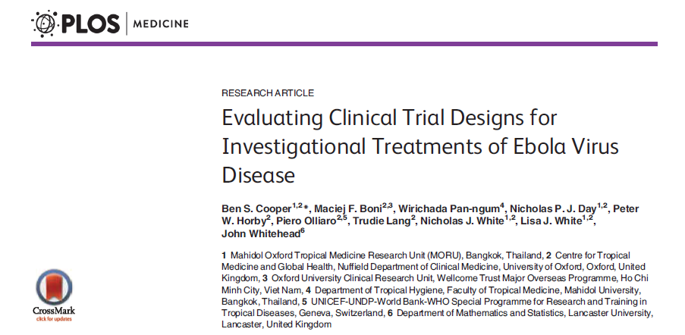

Slide 14
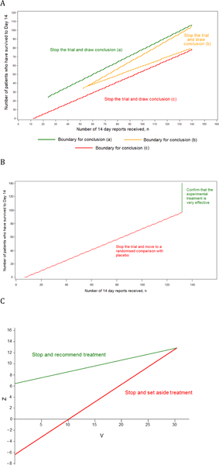
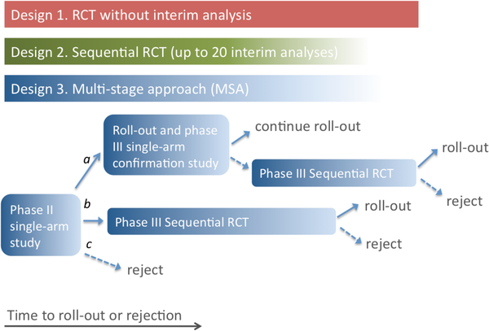
Single arm phase II
Phase III single arm confirmatory
Conclusions
MSA discards ineffective treatments quickly
MSA reliably provides evidence concerning effective treatments
With 100 new cases per day, MSA 6% and 15% greater reductions in mortality over first 100d for highly effective treatments compared to SRCT
MSA appropriate for clinical evaluation of potential EVD treatments
Phase III SRCT
Cooper et al, PLOS Medicine, April 14 2015

Slide 15
Outlook

Slide 16
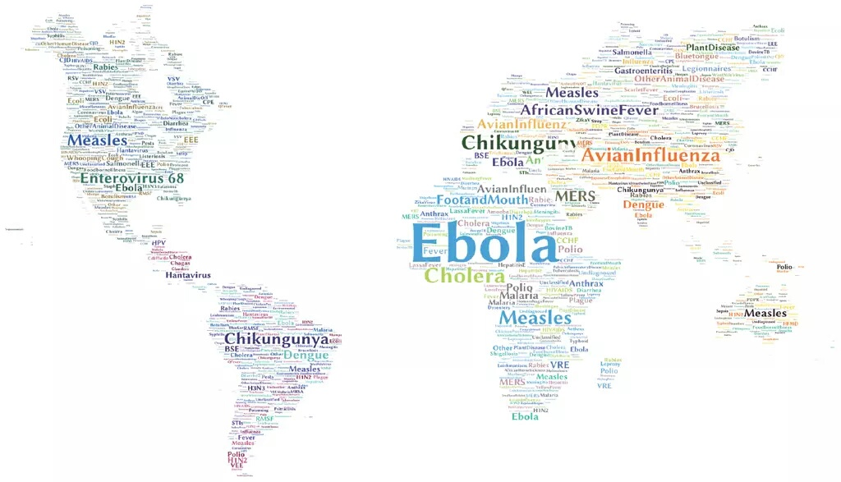
WHO R&D Blueprint

Slide 17
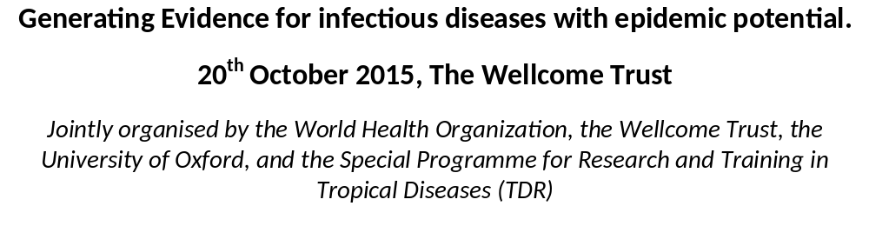



Slide 18
Conclusions - clinical trials
No obvious one-size-fits-all approach to the generation of evidence during outbreaks
To successfully conduct research during epidemics adaptability and agility are essential
A participatory process for prioritising the completion of clinical trials on the ground is needed, to mitigate competition between groups for enrollment to studies

Slide 19
Conclusions – toolkit supported
Potential elements of a toolkit should be mapped, current work in the areas identified, and responsibilities agreed
Protocol templates based on epidemic types would be useful
Developed with the involvement of ethics and regulatory authorities
Scenario planning will be of great utility to allow us to prepare, discuss and rehearse different situations

Slide 20
Thank you

