Slide 1


Ethics and clinical research during epidemics
Reflections from Ebola clinical trials
Peter Horby
University of Oxford
Global Forum on Bioethics in Research (GFBR)
Epidemic infections and experimental medical treatments
Annecy, 04 November 2015

Slide 2
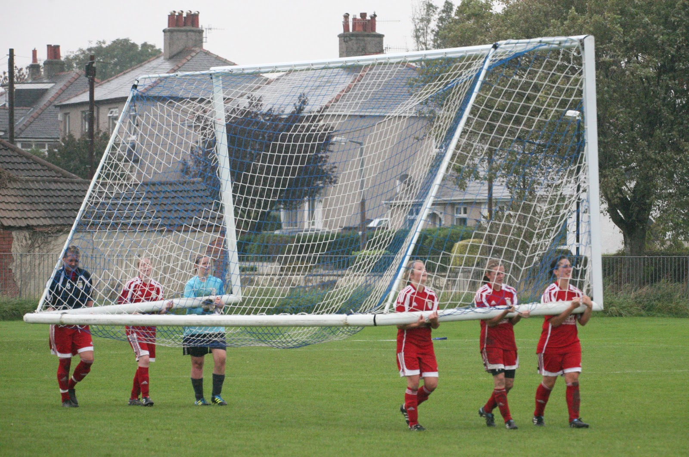
Ebola – a different kind of catastrophe?

Slide 3
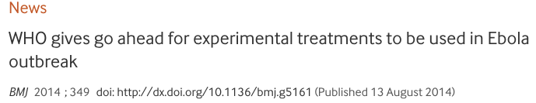
13th August 2014
“investigators have a moral duty to evaluate these interventions in the best possible clinical studies that can be conducted under the circumstances of the epidemic.”

Slide 4
Some of the many questions?
Should we do research?
What kind of research?
Who should be involved?
Can we ensure informed consent & self-determination?
What to do with biological samples?
Individual vs collective ethics for health security threats?

Slide 5
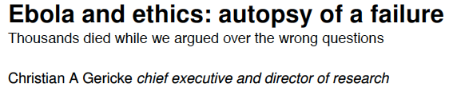
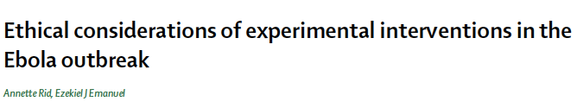
Should therapies be tested?
“side-tracked relief efforts”
“more focus on strengthening of health systems and infrastructure and less on experimental treatments.”

Slide 6
Clinical research….
Desired goal?
Patient care & control of
transmission using
known tools
Research a distraction
New knowledge for better response
Research a moral obligation

Slide 7



Slide 8
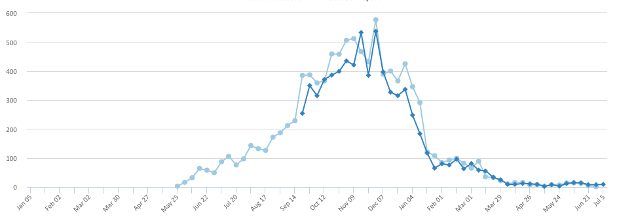
Key Ebola treatment trials timeline
Conv. whole blood
opened
JIKI
opened
BCV
opened
Ebola Tx CVP
opened
ZMapp
opened
TKM
opened

Slide 9
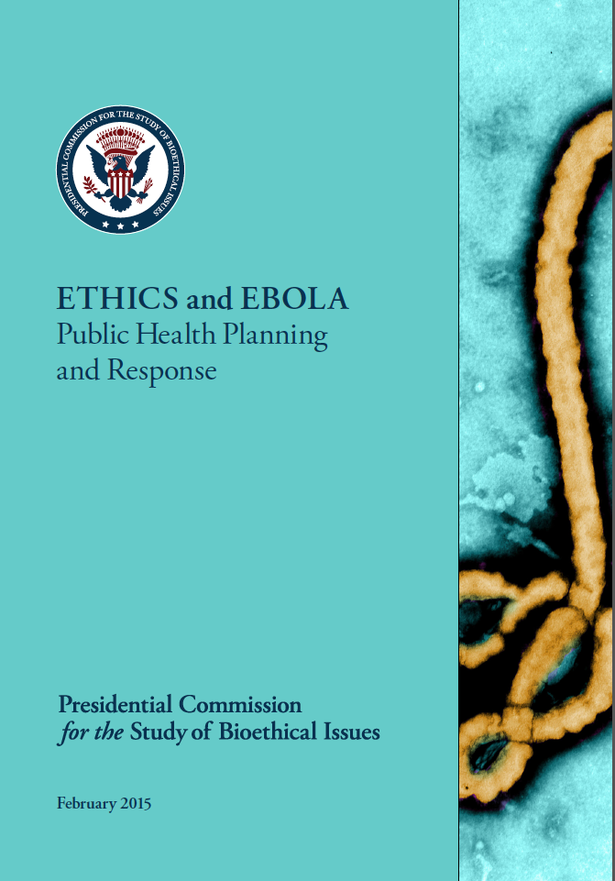
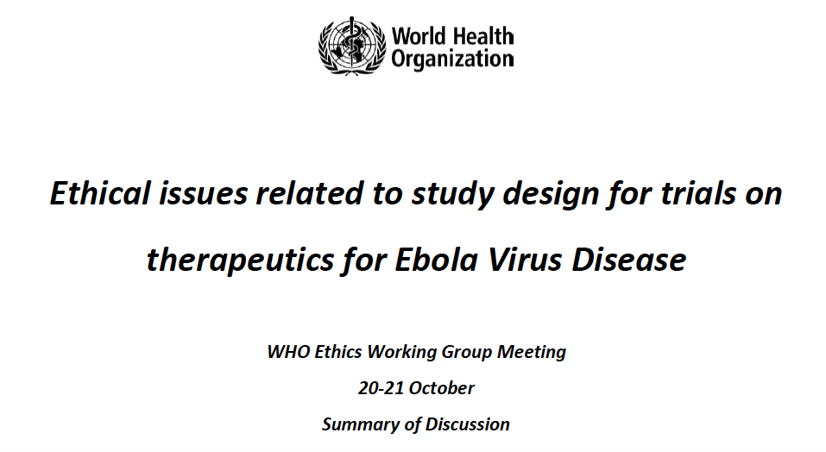
What trial design?
‘All scientifically recognized methodologies and study designs should be considered as ethically acceptable.’
‘No one clinical trial design is ethically required in the context of the current Ebola epidemic.’

Slide 10
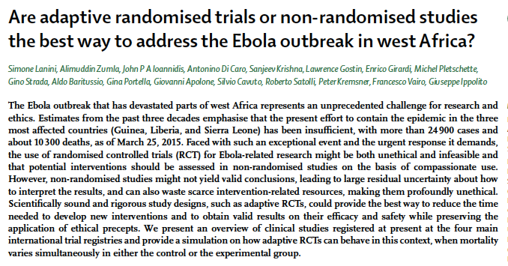
“non-randomised studies…….profoundly unethical”
Lancet Infect Dis. 2015 Jun;15(6):738-45.

Slide 11
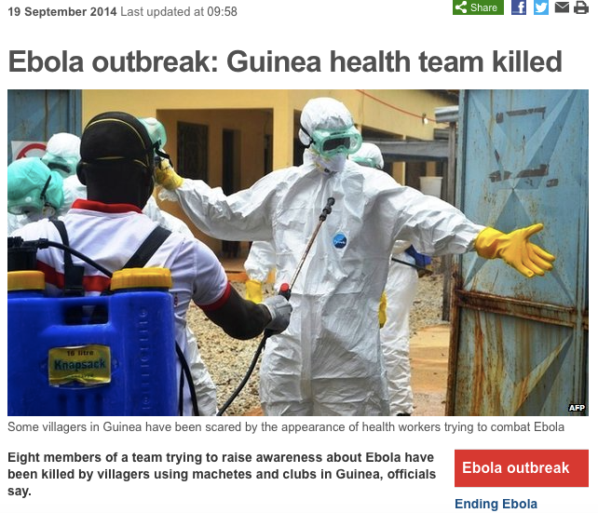
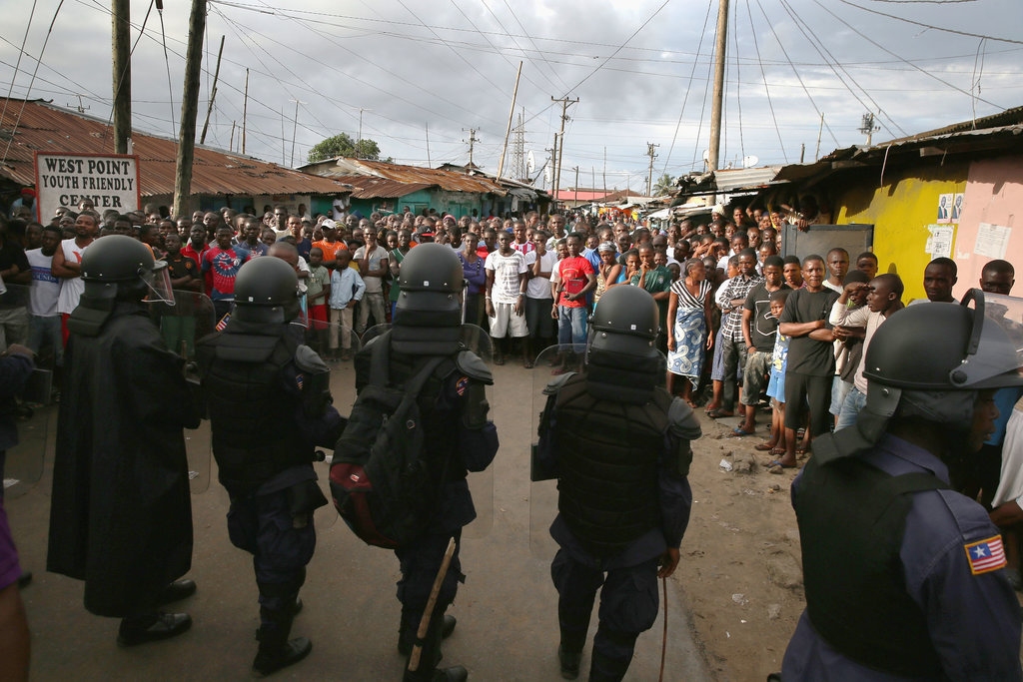

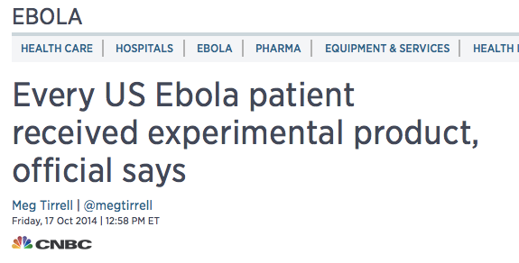
‘Design that is ethically and practically acceptable to the community in which the research is to be conducted’
Notes:
April: MSF operations Macenta suspended
Aug: Kenema hospital attacked / Ebola clinic looted Monrovia
Sept: Eight people killed Guinea / Red Cross team attacked in Forecariah

Slide 12
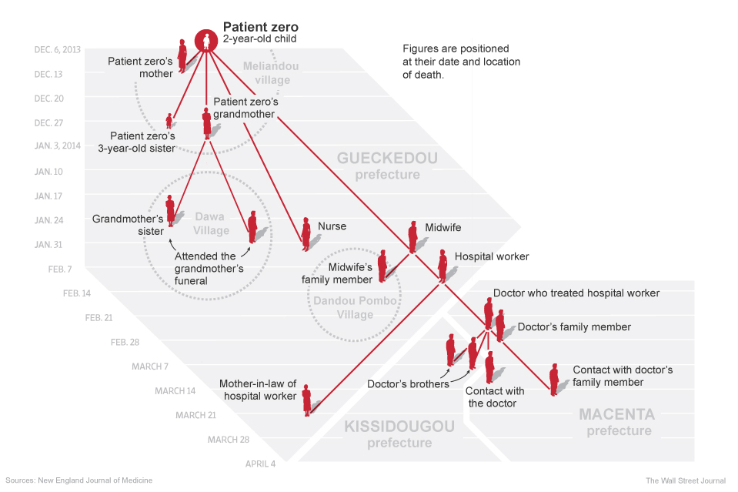
Who should be involved?
Children
Pregnant women
Community views

Slide 13
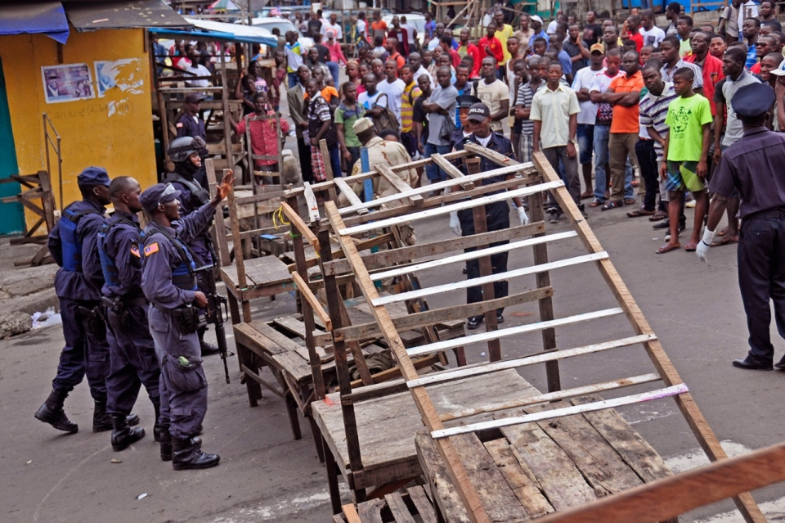
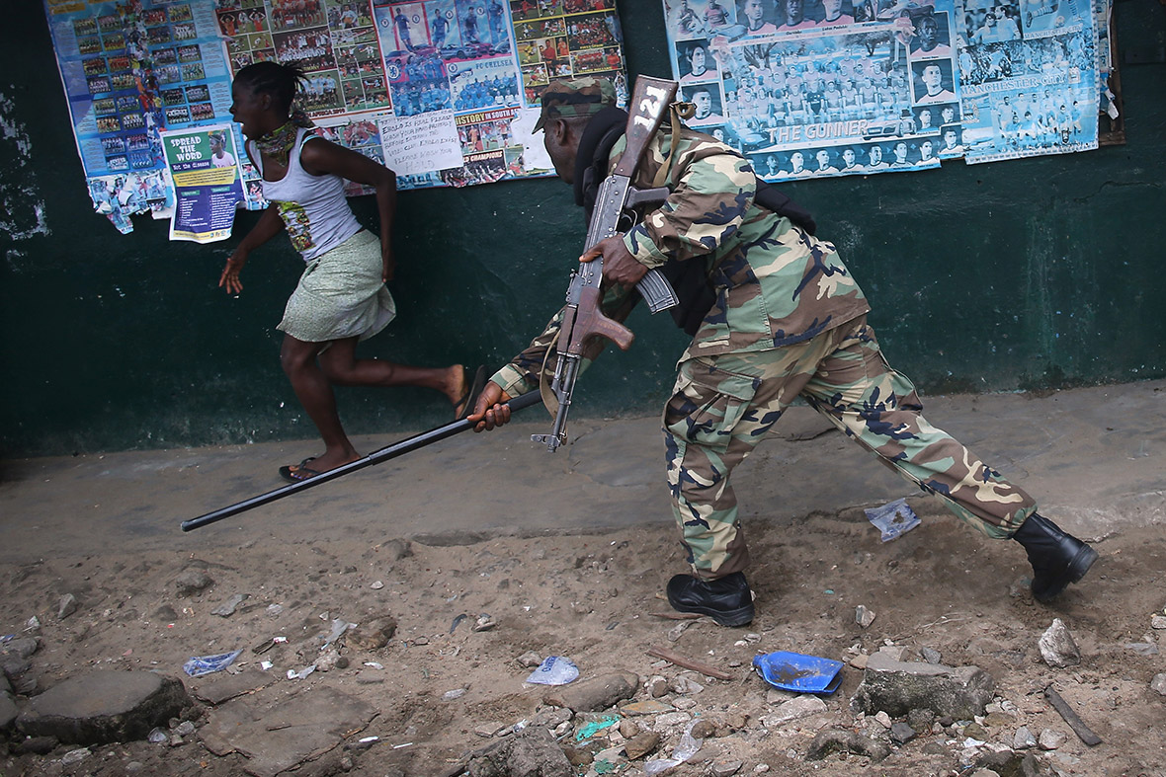
Informed consent & self determination
Containment
Coercion
Fear
Proxy consent

Slide 14
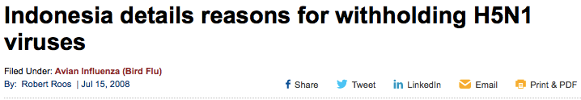
Biological samples
Maximizing scientific value
vs
Individual self-determination
vs
National sovereignty

Slide 15

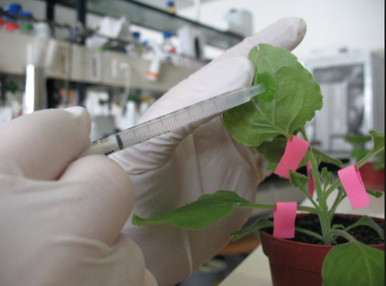
Access and pricing

Slide 16
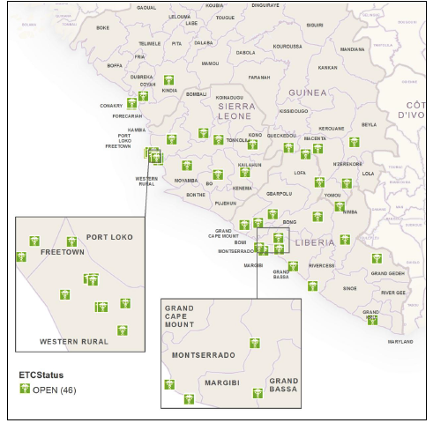
‘Meta – ethics’
TKM-Ebola
Favipiravir
Which trial?
Individual vs collective ethics for a global health security threat.
Convalescent
plasma
ZMapp
Brincidofovir

Slide 17
A new agenda for bioethics?
Old problems, new context
New problems?
Vulnerable populations
Informed consent
Use of specimens
Access & pricing
Research designs for catastrophic infectious epidemics
‘Meta-ethics’

Slide 18

Thank you

