Slide 1
GFBR 2015
Summary
Doug Wassenaar SARETI UKZN South Africa
Liza Dawson NIAID NIH USA

Slide 2
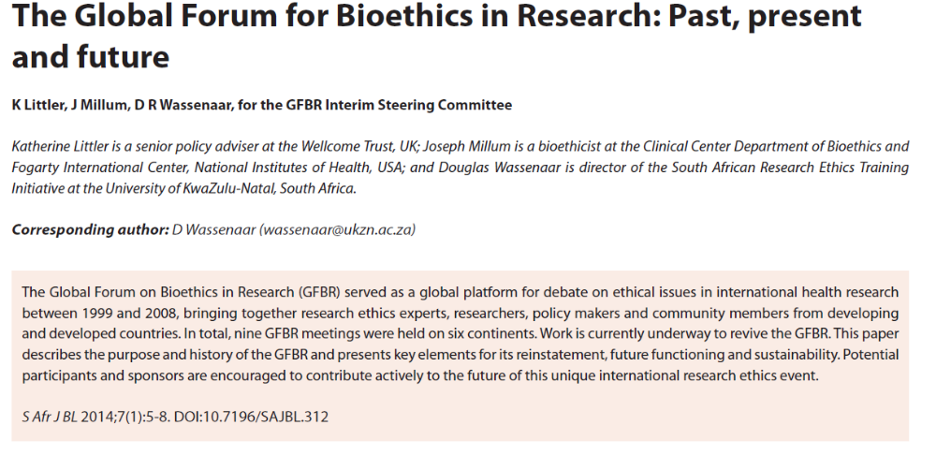
Aims & ethos of GFBR

Slide 3
Aims:
to maintain and strengthen the protection of human participants in health research
to provide a forum for north-south dialogue on ethical issues in research
to explore opportunities to enhance capacity for ethical review and conduct of research
to create a context for research involving human participants in which scientists, ethicists, community representatives, policy-makers, industry, and other relevant stakeholders in developing and developed countries can address ethical issues in ways that allow expeditious long-term joint management of research protocols (p. 6)
to stimulate further conceptual and empirical research to inform policy and ethical practice

Slide 4
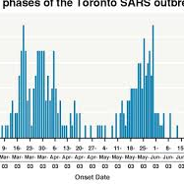
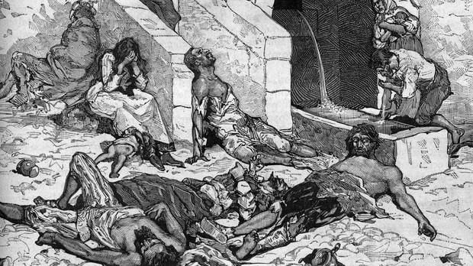
Epidemics are as old as humanity
Every epidemic is new

Slide 5
Capacity building
Capacity needs to be built in ahead of time
Capacity requires diverse expertise
We need to develop best practices that can be carried forward into emergencies; we do not have time (nor should we expect to have the luxury of time to develop new procedures or methods in an emergency:
Medical, public health practice
Ethical best practices
Infrastructure and communication needs to be built up
Expertise from host countries must be brought into the picture
Not only scientific expertise but also social science, ethics, engagement with communities

Slide 6
Accountability
Understand that every group has its rituals, including scientists, ethicists, research ethics committees, organizations, local traditional communities
The existence of rituals does not abrogate other ethical responsibilities in a crisis
Politics involved in many decisions; need continued advocacy for transparency and ethical and evidence based decision-making.
We need to continue to press for accountability of organizations; international, national, local; research teams

Slide 7
Knowledge
Obligations of research community
We need public health measures that are evidence based
It is possible to do research even in an epidemic setting
We need to have solid scientific evidence for interventions, for prevention, infection control, for treatment
Data and information sharing is an ethical imperative
Transparency and inclusiveness in decision making regarding study design and conduct
Recognizing there can be certain tradeoffs of quality, reliability of data, strength of inferences, feasibility and acceptability of trials

Slide 8
Research to public health and back again
Multiple sources of expertise are needed
Epidemics demand immediate public health response
Ethical dilemmas in emergency response: triage, standards of care, addressing community responses
These acute issues affect ethics of clinical care as well as research ethics
A variety of disciplines and expertise go into effective responses; social science, ethics, technical and psychological support, as well as medical and public health interventions

Slide 9
Agenda setting 1
1) For conceptual work:
  Key ethical principles applicable to ethical conduct of research in emerging epidemic infections
    Underutilisation of past work/guidance “amnesia…” (Upshur; Kilmarx)
    Review of past guidance to identify and refine best current principles (WHO, pending)
    Disconnect between responding parties and existing guidelines and scholarship…
    Informed consent, coercion, fear and containment, proxy consent…?
    Development of indicators of optimal stakeholder engagement principles and practices for RECs/IRBs to consider before approving emergency epidemic trials/studies (should RECs be the adjudicators….if not, who else?)
    Emergency research vs compassionate use…
    Balancing individual and collective interests…
    Fate and management of biological samples/data…
    Best trial designs…?

Slide 10
Agenda setting 2
2) For empirical work
  Empirical social science/ethics studies of stakeholder perspectives
  Empirical social science/ethics studies of best stakeholder engagement practices
  Empirical social science/ethics studies of best benefit sharing applications/practices
  Publication of GFBR and other case studies illustrating best and worst practices from real emergency epidemic research situations, including detailed ethical analysis of the key issues with reference to research ethics guidance and scholarship
  Observatory of data from different trial designs

Slide 11
Agenda setting 3
3) For policy and practice
  Standard ethics review is agreed to be too slow: Draft generic SOPs for all RECs so that all RECs can add standard SOPs for rapid but competent review of emerging epidemic infection intervention research
  Early engagement with RECs/IRBs
  WHO could add these generic SOPs to their excellent existing generic “Standards and Operational Guidance for Ethics Review of Health-Related Research with Human Participants” (2011)
  Draft generic protocol templates “toolkits” for pre-approved emergency epidemic research…
  Ethical issues in inter-organizational collaboration in emergency epidemic research – are there best practice or optimal models to be described…?
  Prioritise training of REC/IRB chairs, ministries, health officials/and PIs on key ethical issues, including ethical issues in adaptive trial designs, to minimise delays without compromising protection – who should sponsor such training (UNAIDS model….?)
  Create WHO list of experts/advisors on best ethical practices and research designs for emerging infections research….

Slide 12
New
GFBR Travel Fellowships!
New GFBR Website www.gfbr.global – repository of discussions is complete back to GFBR 1 2002 – refer students and scholars to it!
Social media – Twitter #gfbr2015 – storify – tweets will be captured
Post-GFBR journal publication of short reports on each future GFBR identifying key themes discussed and potential implications

Slide 13
GFBR 2016
Probably Buenos Aires, Argentina:
  Likely major theme: Ethical issues in maternal and child health research

Slide 14
Thanks
Attendees
Chairs
Facilitators
Case presenters
Plenary presenters
Hosts
Sponsors and the project staff from the Wellcome Trust

